Slide 1

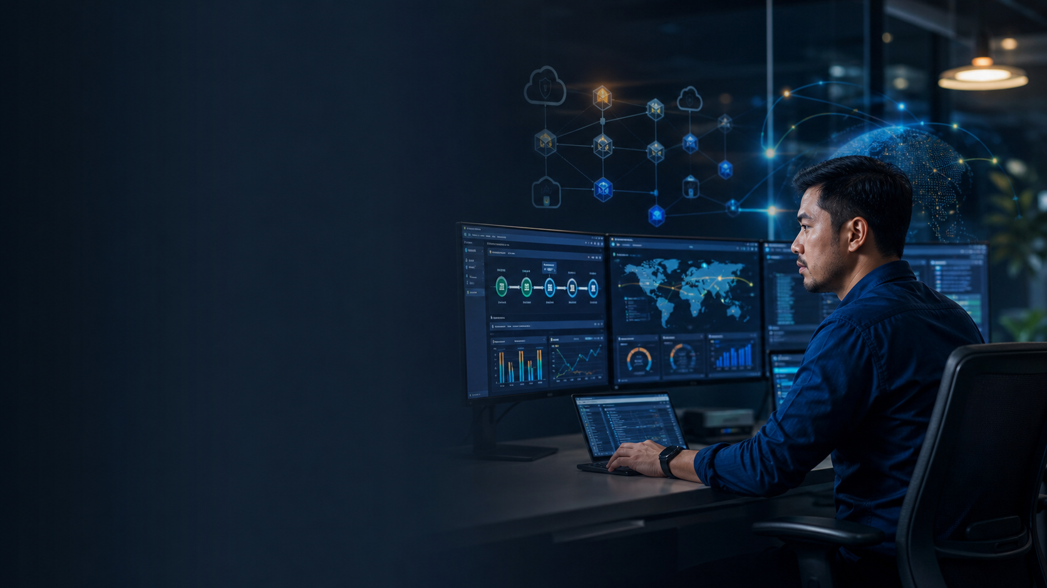
DOP-C02
DEVOPS ENGINEER
COURSE SLIDES · WSQ
DevOps Engineering on AWS
WSQ Course Code: TGS-2023040474
Conducted by Tertiary Infotech Academy Pte Ltd
UEN: 201200696W
Version v12 · 23 August 2026
© 2026 Tertiary Infotech Academy Pte Ltd. All rights reserved. · www.tertiarycourses.com.sg
Notes:
Title slide.
Cover hero illustration created for this course with AI image generation (ImageGen).
[Sources]
- Legacy course deck: WSQ Master Trainer Slides — DevOps Engineering on AWS (v7).

Slide 2
COURSE ADMINISTRATION
Welcome & Housekeeping
DevOps Engineering on AWS · TGS-2023040474
© 2026 Tertiary Infotech Academy Pte Ltd
1

Slide 3
TRAQOM · SSG DIGITAL ATTENDANCE
Digital Attendance (Mandatory)
Take the SSG digital attendance at three points on every funded day:
SCAN TO SUBMIT ATTENDANCE
AM
PM
ASSESSMENT
Start of the morning session
Start of the afternoon session
Before the Day 5 assessment
1
The trainer/administrator displays the SSG digital-attendance QR code from the portal.
2
Scan the QR code with your mobile phone camera and submit your attendance.
3
It is mandatory for AM, PM and the Assessment sessions on WSQ-funded courses.
SSG digital-attendance QR — displayed live from the portal by the trainer
Minimum 75% attendance on the SSG Digital Attendance record is required to be eligible for assessment and funding.
DevOps Engineering on AWS · TGS-2023040474
© 2026 Tertiary Infotech Academy Pte Ltd
2
Notes:
Digital attendance (TRAQOM / SSG). Mandatory AM, PM and Assessment attendance for WSQ-funded courses.
The trainer displays the live QR from the SSG portal; the on-slide QR is an illustrative placeholder.
A minimum of 75% attendance is required for assessment and funding.
[Sources]
- Legacy course deck: WSQ Master Trainer Slides — DevOps Engineering on AWS (v7).

Slide 4
YOUR TRAINER · GENERAL
About the Trainer
NAME
____________________________________________
?
TITLE / DESIGNATION
____________________________________________
QUALIFICATIONS
____________________________________________
Your Trainer
AREAS OF EXPERTISE
____________________________________________
General Trainer template —
to be completed by the trainer
TRAINING & INDUSTRY EXPERIENCE
____________________________________________
CONTACT
____________________________________________
DevOps Engineering on AWS · TGS-2023040474
© 2026 Tertiary Infotech Academy Pte Ltd
3

Slide 5
YOUR TRAINER
About the Trainer
ROLE
Principal Trainer, Tertiary Infotech Academy Pte Ltd
AA
QUALIFICATIONS
PhD; ACTA/DACE-certified adult educator.
EXPERTISE
AWS cloud architecture, DevOps, CI/CD automation, Infrastructure as Code and cloud security.
Dr Alfred Ang
DELIVERS
WSQ courses on AWS, DevOps engineering, cloud and software engineering.
Principal Trainer
Tertiary Infotech Academy Pte Ltd
FOUNDER
Founder and lead instructor at Tertiary Infotech / Tertiary Courses.
DevOps Engineering on AWS · TGS-2023040474
© 2026 Tertiary Infotech Academy Pte Ltd
4

Slide 6
ICE-BREAKER
Let's Know Each Other
• Your name and organisation / role.
• Your experience with AWS, DevOps or automation (if any).
• What you want to automate or improve on AWS after this course.
DevOps Engineering on AWS · TGS-2023040474
© 2026 Tertiary Infotech Academy Pte Ltd
5

Slide 7
HOUSEKEEPING
Ground Rules
Set your mobile phone to silent mode.
Participate actively — no question is too small.
1
2
Mutual respect: agree to disagree.
One conversation at a time.
3
4
Be punctual; return from breaks on time.
75% attendance is required for funding.
5
6
DevOps Engineering on AWS · TGS-2023040474
© 2026 Tertiary Infotech Academy Pte Ltd
6

Slide 8
COURSE PORTAL
Download Your Course Material
🔒 lms-tms.tertiaryinfotech.com
Sign in
Log in to lms-tms.tertiaryinfotech.com with your enrolled account.
1
DevOps Engineering on AWS
My Courses › Course Material
Open your course
Go to My Courses and select DevOps Engineering on AWS.
2
⬇ Trainer Slides (PDF)
⬇ Learner Guide (PDF)
Course Material
Open the Course Material tab for this course.
3
⬇ Lesson Plan (PDF)
Download
Download the Trainer Slides, Learner Guide and Lesson Plan for the open-book assessment.
4
DevOps Engineering on AWS · TGS-2023040474
© 2026 Tertiary Infotech Academy Pte Ltd
7

Slide 9
CRITERIA FOR FUNDING
Funding & Eligibility
Attendance
Minimum 75% attendance on the SSG Digital Attendance record.
Assessment
Complete the assessment and be assessed as ‘Competent’.
1
2
Open book
The slides and Learner Guide may be used during the assessment.
Course portal
All materials, attendance and assessment are on lms-tms.tertiaryinfotech.com.
3
4
DevOps Engineering on AWS · TGS-2023040474
© 2026 Tertiary Infotech Academy Pte Ltd
8

Slide 10
COURSE SCHEDULE · 40 HOURS (37 INSTRUCTIONAL + 3 ASSESSMENT)
Lesson Plan — 5 Days · 5 Hands-On Labs per Day (25 Labs)
Day 1
Foundations & SDLC Automation (Labs 1–5)
Day 2
Configuration Management & IaC (Labs 6–10)
1
2
Day 3
Resilient Cloud Solutions (Labs 11–15)
Day 4
Monitoring, Logging & Incident Response (Labs 16–20)
3
4
Day 5
Security, Compliance & Capstone (Labs 21–25) + Final Assessment
Daily timing
9:30 am – 6:00 pm · 30-minute lunch · tea breaks within
5
6
DevOps Engineering on AWS · TGS-2023040474
© 2026 Tertiary Infotech Academy Pte Ltd
9

Slide 11
WHAT YOU'LL ACHIEVE
Learning Outcomes
LO1
Develop an AWS CI/CD pipeline proof of concept.
LO2
Identify the technical and practical requirements in an AWS cloud infrastructure setup.
1
2
LO3
Develop a resilient cloud solution based on AWS cloud components.
LO4
Implement regular AWS monitoring and perform necessary troubleshooting.
3
4
LO5
Demonstrate solutions to incidents and business problems on the AWS cloud.
LO6
Prepare a technical blueprint to address security and compliance.
5
6
DevOps Engineering on AWS · TGS-2023040474
© 2026 Tertiary Infotech Academy Pte Ltd
10

Slide 12
TSC MAPPING · K1–K7 · A1–A6 · LO1–LO6
Skills Framework Alignment (ICT-DES-4006-1.1)
Domain
Learning Outcome
Knowledge
Ability
01 SDLC Automation
LO1
K1
A1
02 Configuration Management and IaC
LO2
K3
A3
03 Resilient Cloud Solutions
LO3
K2, K4
A2
04 Monitoring and Logging
LO4
K5
A6
05 Incident and Event Response
LO5
K7
A5
06 Security and Compliance
LO6
K6
A4
DevOps Engineering on AWS · TGS-2023040474
© 2026 Tertiary Infotech Academy Pte Ltd
11

Slide 13
BEFORE THE ASSESSMENT
Briefing for Assessment
• Place phones and other materials under the table or on the floor unless the assessment is open book.
• No photos or recording of assessment scripts.
• No discussion during the assessment.
• Use a black/blue pen for hard-copy assessments.
• No liquid paper / correction tape.
• Scripts are collected when time is up.
DevOps Engineering on AWS · TGS-2023040474
© 2026 Tertiary Infotech Academy Pte Ltd
12

Slide 14
FINAL ASSESSMENT
Assessment
• Written Assessment (WA) — Short-Answer Questions (SAQ), 1 hour, open book.
• Practical Performance (PP) — hands-on AWS DevOps tasks, 2 hours, open book.
• Format: Open Book — course slides, Learner Guide and approved materials only.
• Conducted on Day 5 after the training content (3 assessment hours in total — WA 1 hour + PP 2 hours).
• A minimum of 75% attendance is required to be eligible for assessment and funding.
• An appeal process is available if required.
DevOps Engineering on AWS · TGS-2023040474
© 2026 Tertiary Infotech Academy Pte Ltd
13

Slide 15
ON ASSESSMENT DAY
Assessment Flow
1
2
3
4
5
▶
▶
▶
▶
TRAQOM survey — scan the QR code on the LMS
Assessment digital attendance — scan the SSG QR
Sit WA (SAQ) then PP — open book
Submit your answers on the LMS
Sign the Assessment Summary Record
DevOps Engineering on AWS · TGS-2023040474
© 2026 Tertiary Infotech Academy Pte Ltd
14

Slide 16
FOUNDATIONS
DevOps Engineering on AWS
DevOps Engineering on AWS · TGS-2023040474
© 2026 Tertiary Infotech Academy Pte Ltd
15

Slide 17
THE MINDSET
What is DevOps?
Culture + practice
DevOps unites development and operations to deliver value faster and more reliably.
Automate everything
Build, test, deploy and infrastructure become code — repeatable and reviewable.
1
2
Fast, safe feedback
Small, frequent changes with monitoring make failures cheap and recoverable.
Shared ownership
Teams own their service end to end — you build it, you run it.
3
4
DevOps Engineering on AWS · TGS-2023040474
© 2026 Tertiary Infotech Academy Pte Ltd
16

Slide 18
CULTURE FRAMEWORK
The CALMS Model
Culture
Collaboration and shared responsibility across dev and ops.
Automation
Remove manual, error-prone steps from the delivery pipeline.
1
2
Lean
Small batches, fast flow, eliminate waste.
Measurement
Metrics and feedback drive continuous improvement.
3
4
Sharing
Transparency, blameless learning and reusable patterns.
5
DevOps Engineering on AWS · TGS-2023040474
© 2026 Tertiary Infotech Academy Pte Ltd
17

Slide 19
A CONTINUOUS LOOP
The DevOps Lifecycle
1
2
3
4
5
6
7
▶
▶
▶
▶
▶
▶
Plan
backlog, design
Code
version control
Build
compile + package
Test
automated checks
Release
artifacts + approve
Deploy
to environments
Operate & Monitor
feedback loop
DevOps Engineering on AWS · TGS-2023040474
© 2026 Tertiary Infotech Academy Pte Ltd
18

Slide 20
OUTCOMES THAT MATTER
Measuring DevOps — The DORA Metrics
Deployment frequency
How often you ship to production — elite teams deploy on demand.
Lead time for changes
Commit → production time — minutes/hours, not weeks.
1
2
Change failure rate
% of deployments causing a failure — lower is healthier.
Mean time to recover
How fast you restore service after an incident — minimise it.
3
4
DevOps Engineering on AWS · TGS-2023040474
© 2026 Tertiary Infotech Academy Pte Ltd
19

Slide 21
END-TO-END DELIVERY
The AWS DevOps Toolchain
Source
CodeCommit / GitHub
Build & Test
CodeBuild
Artifacts
S3 / CodeArtifact
Deploy
CodeDeploy
Infra as Code
CloudFormation
Secure & Audit
IAM / Config / CloudTrail
Monitor
CloudWatch
Run
EC2 / ECS / Lambda
▶ CodePipeline orchestrates the top row; IaC, monitoring and security wrap the whole lifecycle.
DevOps Engineering on AWS · TGS-2023040474
© 2026 Tertiary Infotech Academy Pte Ltd
20
Notes:
The AWS DevOps Toolchain. CodePipeline orchestrates the top row; IaC, monitoring and security wrap the whole lifecycle.
Editable reference architecture drawn as native PowerPoint shapes.
[Sources]
- AWS Certified DevOps Engineer – Professional (DOP-C02) Exam Guide (docs.aws.amazon.com/pdfs/aws-certification/latest/devops-engineer-professional-02).
- Legacy course deck: WSQ Master Trainer Slides — DevOps Engineering on AWS (v7).
- AWS Developer Tools Documentation (docs.aws.amazon.com/codepipeline).

Slide 22
SIX PILLARS
AWS Well-Architected Framework
Operational Excellence
Run and monitor systems; improve processes continuously.
Security
Protect data, systems and assets with least-privilege and audit.
1
2
Reliability
Recover from failure automatically; meet availability targets.
Performance Efficiency
Use resources efficiently as demand and technology change.
3
4
Cost Optimisation
Deliver business value at the lowest price point.
Sustainability
Minimise the environmental impact of running workloads.
5
6
DevOps Engineering on AWS · TGS-2023040474
© 2026 Tertiary Infotech Academy Pte Ltd
21

Slide 23
HOW THE COURSE IS WEIGHTED
Exam / Skills Domain Weightings
WHAT THE DATA SHOWS
SDLC Automation (22%) and the two 17% domains — IaC and Security & Compliance — carry the most weight; plan revision time accordingly.
DevOps Engineering on AWS · TGS-2023040474
© 2026 Tertiary Infotech Academy Pte Ltd
22
Notes:
Exam / Skills Domain Weightings. What the data shows: SDLC Automation (22%) and the two 17% domains — IaC and Security & Compliance — carry the most weight; plan revision time accordingly.
Figures are illustrative teaching values to convey the relationship, not measured benchmarks.
[Sources]
- AWS Certified DevOps Engineer – Professional (DOP-C02) Exam Guide (docs.aws.amazon.com/pdfs/aws-certification/latest/devops-engineer-professional-02).

Slide 24
WHO SECURES WHAT
AWS Shared Responsibility Model
AWS responsibility
Your responsibility
• AWS — security OF the cloud
– Physical data centres & hardware
– Global network & virtualisation layer
– Managed-service infrastructure
– Availability Zones and Regions
• You — security IN the cloud
– IAM, identities and permissions
– OS, network & firewall configuration
– Application code & data encryption
– Patching guest OS and dependencies
DevOps Engineering on AWS · TGS-2023040474
© 2026 Tertiary Infotech Academy Pte Ltd
23

Slide 25
THE SERVICES YOU'LL USE
Core AWS Building Blocks
Compute
EC2, ECS/EKS, Lambda, Auto Scaling.
Networking
VPC, subnets, security groups, ELB, Route 53.
1
2
Storage & data
S3, EBS, RDS, DynamoDB.
Identity & security
IAM, KMS, Secrets Manager, Config.
3
4
Developer tools
CodePipeline, CodeBuild, CodeDeploy, CloudFormation.
Observability
CloudWatch, X-Ray, CloudTrail, EventBridge.
5
6
DevOps Engineering on AWS · TGS-2023040474
© 2026 Tertiary Infotech Academy Pte Ltd
24

Slide 26
THE BUSINESS CASE
Why CI/CD — Release Frequency & Lead Time
WHAT THE DATA SHOWS
Automating the pipeline turns a few risky monthly releases into many small, low-risk ones that recover in hours, not days.
DevOps Engineering on AWS · TGS-2023040474
© 2026 Tertiary Infotech Academy Pte Ltd
25
Notes:
Why CI/CD — Release Frequency & Lead Time. What the data shows: Automating the pipeline turns a few risky monthly releases into many small, low-risk ones that recover in hours, not days.
Figures are illustrative teaching values to convey the relationship, not measured benchmarks.
[Sources]
- DORA / Google Cloud, Accelerate State of DevOps (dora.dev).
- AWS Certified DevOps Engineer – Professional (DOP-C02) Exam Guide (docs.aws.amazon.com/pdfs/aws-certification/latest/devops-engineer-professional-02).

Slide 27
WHY IT MATTERS
Build, test, deploy — automatically and safely.
The six AWS DevOps domains follow the delivery lifecycle: automate the SDLC, codify infrastructure, make it resilient, observe it, respond to events, and secure it.
DevOps Engineering on AWS · TGS-2023040474
© 2026 Tertiary Infotech Academy Pte Ltd
26

Slide 28
MEASURING DEVOPS OUTCOMES
DORA Metrics — The Delivery/Stability Balance
Move faster
Stay stable
• Throughput
– Deployment frequency — how often you ship
– Lead time for changes — commit to production
– Elite: on-demand deploys, <1 day lead time
• Stability
– Change failure rate — % of deploys that hurt
– Time to restore service — MTTR after failure
– Elite: <15% CFR, restore in <1 hour
DevOps Engineering on AWS · TGS-2023040474
© 2026 Tertiary Infotech Academy Pte Ltd
27
Notes:
DORA's four metrics pair speed with stability so 'go faster' never means 'break more'.
[Sources]
- DORA / Google Cloud, Accelerate State of DevOps (dora.dev).

Slide 29
HOW TEAMS BRANCH
Version Control Strategy — Trunk-Based vs Long-Lived Branches
Trunk-based
Short-lived branches merged to trunk daily — keeps integration continuous.
Feature flags
Ship unfinished work dark; decouple deploy from release.
1
2
Gitflow (heavier)
Release/develop branches — more ceremony, slower integration.
Branch protection
Required reviews and green checks before merge, enforced in GitHub.
3
4
DevOps Engineering on AWS · TGS-2023040474
© 2026 Tertiary Infotech Academy Pte Ltd
28
Notes:
Trunk-based development plus feature flags is the pattern that makes continuous integration real.
[Sources]
- DORA / Google Cloud, Accelerate State of DevOps (dora.dev).
- AWS Certified DevOps Engineer – Professional (DOP-C02) Exam Guide (docs.aws.amazon.com/pdfs/aws-certification/latest/devops-engineer-professional-02).

Slide 30
ONE ARTIFACT, MANY ENVIRONMENTS
Promotion Across Environments
1
2
3
4
5
▶
▶
▶
▶
Build once
immutable artifact
Deploy to Dev
smoke tests
Deploy to Staging
production-like
Approve
(if gated)
Deploy to Prod
progressive rollout
DevOps Engineering on AWS · TGS-2023040474
© 2026 Tertiary Infotech Academy Pte Ltd
29
Notes:
The same versioned artifact is promoted through environments; only configuration differs — so what you tested is what you ship.
[Sources]
- AWS Certified DevOps Engineer – Professional (DOP-C02) Exam Guide (docs.aws.amazon.com/pdfs/aws-certification/latest/devops-engineer-professional-02).
- AWS CodePipeline Documentation (docs.aws.amazon.com/codepipeline).

Slide 31
SOURCE INTEGRATION
GitHub via AWS CodeConnections — The Modern Source Path
Managed connection
Connect GitHub/GitHub Enterprise/Bitbucket/GitLab without long-lived Git credentials.
Webhook triggers
A push starts the pipeline instantly — no polling latency.
1
2
Keep your workflow
Existing pull requests, reviews and branch protection still apply.
CodeCommit optional
AWS-native Git remains available, but is not required for new work.
3
4
DevOps Engineering on AWS · TGS-2023040474
© 2026 Tertiary Infotech Academy Pte Ltd
30
Notes:
New labs use GitHub through CodeConnections as the primary source path; CodeCommit is discussed as an AWS-native option only.
[Sources]
- AWS Certified DevOps Engineer – Professional (DOP-C02) Exam Guide (docs.aws.amazon.com/pdfs/aws-certification/latest/devops-engineer-professional-02).
- AWS CodeConnections Documentation (docs.aws.amazon.com/dtconsole/latest/userguide/welcome-connections.html).
- Legacy course deck: WSQ Master Trainer Slides — DevOps Engineering on AWS (v7).

Slide 32
A CLOUD-NATIVE MINDSET
Immutable Infrastructure — Cattle, Not Pets
Replace, don't patch
Deploy a new, tested image instead of mutating running servers.
No configuration drift
Every instance is built the same way from the same artifact.
1
2
Fast, safe rollback
Roll back by launching the previous known-good image.
Bake with a pipeline
EC2 Image Builder / golden AMIs produce reproducible images.
3
4
DevOps Engineering on AWS · TGS-2023040474
© 2026 Tertiary Infotech Academy Pte Ltd
31
Notes:
Immutable infrastructure removes whole classes of drift and 'works on that box' failures.
[Sources]
- AWS Well-Architected Framework (docs.aws.amazon.com/wellarchitected).
- AWS Certified DevOps Engineer – Professional (DOP-C02) Exam Guide (docs.aws.amazon.com/pdfs/aws-certification/latest/devops-engineer-professional-02).

Slide 33
DEVOPS MEETS FINOPS
Cost Awareness in DevOps — Build It In
Right-size & auto-scale
Match capacity to demand; scale to zero where you can.
Tag everything
Cost allocation tags make spend visible per team/service.
1
2
Clean up as code
Tear-down steps in every lab/pipeline stop orphaned resources.
Budgets & alarms
AWS Budgets alert before spend surprises the finance team.
3
4
DevOps Engineering on AWS · TGS-2023040474
© 2026 Tertiary Infotech Academy Pte Ltd
32
Notes:
Cost is a first-class operational metric — the same automation that builds resources should clean them up.
[Sources]
- AWS Well-Architected Framework (docs.aws.amazon.com/wellarchitected).
- AWS Certified DevOps Engineer – Professional (DOP-C02) Exam Guide (docs.aws.amazon.com/pdfs/aws-certification/latest/devops-engineer-professional-02).

Slide 34
SECURITY IS EVERYONE'S JOB
DevSecOps — Shift Security Left
Scan in the pipeline
SAST/SCA on code and dependencies; scan IaC templates.
Least-privilege pipelines
Scope build and deploy roles; no secrets in source.
1
2
Policy as code
Guardrails as SCPs and Config rules, versioned like code.
Continuous compliance
Detect and remediate drift automatically, always-on.
3
4
DevOps Engineering on AWS · TGS-2023040474
© 2026 Tertiary Infotech Academy Pte Ltd
33
Notes:
DevSecOps folds security into every stage rather than bolting it on before release.
[Sources]
- AWS Well-Architected Framework (docs.aws.amazon.com/wellarchitected).
- AWS Certified DevOps Engineer – Professional (DOP-C02) Exam Guide (docs.aws.amazon.com/pdfs/aws-certification/latest/devops-engineer-professional-02).

Slide 35
MATCH THE RUNTIME TO THE WORKLOAD
Choosing Compute — EC2 vs ECS/EKS vs Lambda
Option
Best for
Ops overhead
Scaling
EC2 + ASG
Lift-and-shift, full OS control
Higher (patching, AMIs)
Instances via ASG
ECS / Fargate
Containerised services
Medium (Fargate = serverless)
Tasks/services
EKS
Kubernetes-standard workloads
Higher (cluster ops)
Pods via HPA
Lambda
Event-driven, spiky, short tasks
Lowest
Automatic per request
DevOps Engineering on AWS · TGS-2023040474
© 2026 Tertiary Infotech Academy Pte Ltd
34
Notes:
Comparison — Choosing Compute — EC2 vs ECS/EKS vs Lambda.
[Sources]
- AWS Certified DevOps Engineer – Professional (DOP-C02) Exam Guide (docs.aws.amazon.com/pdfs/aws-certification/latest/devops-engineer-professional-02).
- AWS Well-Architected Framework (docs.aws.amazon.com/wellarchitected).
- AWS Compute Documentation (docs.aws.amazon.com/whitepapers/latest/aws-overview/compute-services.html).

Slide 36
01
DOMAIN 01
SDLC Automation
Exam weighting 22% · CI/CD pipelines · automated testing · artifacts · deployment strategies
DevOps Engineering on AWS · TGS-2023040474
© 2026 Tertiary Infotech Academy Pte Ltd
35

Slide 37

DELIVERY AUTOMATION
SDLC Automation
▶ Automating the software-delivery lifecycle on AWS
DevOps Engineering on AWS · TGS-2023040474
© 2026 Tertiary Infotech Academy Pte Ltd
36
Notes:
Automating the software-delivery lifecycle on AWS
Illustration created for this course with AI image generation (ImageGen).
[Sources]
- Legacy course deck: WSQ Master Trainer Slides — DevOps Engineering on AWS (v7).

Slide 38
DOMAIN 01 · WEIGHTING 22%
Key Concepts — SDLC Automation
Continuous Integration
Developers push often; CodeBuild runs the build and tests on every commit so bugs are found early, not at release.
Continuous Delivery / Deployment
Every green build is releasable; CodePipeline and CodeDeploy move it through dev → test → prod with approvals.
1
2
The AWS developer tools
CodeCommit / CodeBuild / CodeDeploy / CodePipeline / CodeArtifact / CodeGuru compose the managed CI/CD toolchain.
buildspec & appspec
buildspec.yml tells CodeBuild what to build and test; appspec.yml tells CodeDeploy what and how to deploy.
3
4
Deployment strategies
In-place, rolling, blue/green and canary trade release speed against blast radius and rollback safety.
Artifacts
Build outputs are versioned in S3 / CodeArtifact so any release is reproducible and traceable.
5
6
DevOps Engineering on AWS · TGS-2023040474
© 2026 Tertiary Infotech Academy Pte Ltd
37
Notes:
Key concepts for Domain 01 — SDLC Automation.
Continuous Integration: Developers push often; CodeBuild runs the build and tests on every commit so bugs are found early, not at release.
Continuous Delivery / Deployment: Every green build is releasable; CodePipeline and CodeDeploy move it through dev → test → prod with approvals.
The AWS developer tools: CodeCommit / CodeBuild / CodeDeploy / CodePipeline / CodeArtifact / CodeGuru compose the managed CI/CD toolchain.
buildspec & appspec: buildspec.yml tells CodeBuild what to build and test; appspec.yml tells CodeDeploy what and how to deploy.
Deployment strategies: In-place, rolling, blue/green and canary trade release speed against blast radius and rollback safety.
Artifacts: Build outputs are versioned in S3 / CodeArtifact so any release is reproducible and traceable.
[Sources]
- AWS Certified DevOps Engineer – Professional (DOP-C02) Exam Guide (docs.aws.amazon.com/pdfs/aws-certification/latest/devops-engineer-professional-02).
- AWS CodePipeline Documentation (docs.aws.amazon.com/codepipeline).
- Legacy course deck: WSQ Master Trainer Slides — DevOps Engineering on AWS (v7).

Slide 39
THE MANAGED CI/CD TOOLCHAIN
The AWS Developer Tools
CodeCommit
Managed, private Git repositories (or bring GitHub).
CodeBuild
Fully managed build & test service driven by buildspec.yml.
1
2
CodeDeploy
Automated deployment to EC2, on-prem, ECS and Lambda.
CodePipeline
Orchestrates Source → Build → Deploy with approvals.
3
4
CodeArtifact
Secure artifact & package repository.
CodeGuru
ML-powered code reviews and profiler.
5
6
DevOps Engineering on AWS · TGS-2023040474
© 2026 Tertiary Infotech Academy Pte Ltd
38
Notes:
Domain 01 deep dive — SDLC Automation. Editable AWS-native diagram/table/chart.
[Sources]
- AWS Certified DevOps Engineer – Professional (DOP-C02) Exam Guide (docs.aws.amazon.com/pdfs/aws-certification/latest/devops-engineer-professional-02).
- AWS CodePipeline Documentation (docs.aws.amazon.com/codepipeline).
- Legacy course deck: WSQ Master Trainer Slides — DevOps Engineering on AWS (v7).

Slide 40
KNOW THE DIFFERENCE
CI vs CD vs Continuous Deployment
Integrate
Deliver / Deploy
• Continuous Integration
– Merge & test every commit automatically
– CodeBuild runs unit tests on push
– Fast feedback, fewer merge conflicts
• Continuous Delivery / Deployment
– Every green build is releasable
– Delivery = one approval to promote to prod
– Deployment = fully automatic to prod
DevOps Engineering on AWS · TGS-2023040474
© 2026 Tertiary Infotech Academy Pte Ltd
39
Notes:
Domain 01 deep dive — SDLC Automation. Editable AWS-native diagram/table/chart.
[Sources]
- AWS Certified DevOps Engineer – Professional (DOP-C02) Exam Guide (docs.aws.amazon.com/pdfs/aws-certification/latest/devops-engineer-professional-02).
- AWS CodePipeline Documentation (docs.aws.amazon.com/codepipeline).
- Legacy course deck: WSQ Master Trainer Slides — DevOps Engineering on AWS (v7).

Slide 41
DOMAIN 01 · CODEPIPELINE
CI/CD Pipeline on AWS
Developer
commit
Source
CodeCommit / GitHub
Build & Test
CodeBuild (buildspec)
Manual Approval
Deploy
CodeDeploy (appspec)
Artifacts
S3
Targets
EC2 / ECS / Lambda
▶ A commit flows Source → Build → Approve → Deploy; a failed test stops the pipeline before production.
DevOps Engineering on AWS · TGS-2023040474
© 2026 Tertiary Infotech Academy Pte Ltd
40
Notes:
Domain 01 deep dive — SDLC Automation. Editable AWS-native diagram/table/chart.
[Sources]
- AWS Certified DevOps Engineer – Professional (DOP-C02) Exam Guide (docs.aws.amazon.com/pdfs/aws-certification/latest/devops-engineer-professional-02).
- AWS CodePipeline Documentation (docs.aws.amazon.com/codepipeline).
- Legacy course deck: WSQ Master Trainer Slides — DevOps Engineering on AWS (v7).

Slide 42
CHOOSING A RELEASE PATTERN
Deployment Strategies Compared
Strategy
How it works
Rollback
Best for
In-place
Update the same instances
Redeploy previous
Dev / simple apps
Rolling
Update in batches
Batch by batch
Steady, low-risk updates
Blue/Green
Shift traffic to a new fleet
Instant switch-back
Zero-downtime prod
Canary
Shift a small % first
Stop & revert
High-risk changes
DevOps Engineering on AWS · TGS-2023040474
© 2026 Tertiary Infotech Academy Pte Ltd
41
Notes:
Domain 01 deep dive — SDLC Automation. Editable AWS-native diagram/table/chart.
[Sources]
- AWS Certified DevOps Engineer – Professional (DOP-C02) Exam Guide (docs.aws.amazon.com/pdfs/aws-certification/latest/devops-engineer-professional-02).
- AWS CodePipeline Documentation (docs.aws.amazon.com/codepipeline).
- Legacy course deck: WSQ Master Trainer Slides — DevOps Engineering on AWS (v7).

Slide 43
TRADE-OFFS
Deployment Strategy — Blast Radius vs Rollback Speed
WHAT THE DATA SHOWS
Blue/green and canary minimise how many users a bad release can affect and let you roll back fastest.
DevOps Engineering on AWS · TGS-2023040474
© 2026 Tertiary Infotech Academy Pte Ltd
42
Notes:
Deployment Strategy — Blast Radius vs Rollback Speed. What the data shows: Blue/green and canary minimise how many users a bad release can affect and let you roll back fastest.
Figures are illustrative teaching values to convey the relationship, not measured benchmarks.

Slide 44
SHIFT LEFT
Automated Testing in the Pipeline
Unit tests
Run in CodeBuild on every commit — fail fast, block the merge.
Integration tests
Verify services work together before promotion to staging.
1
2
Security scans
SAST/SCA on code and dependencies inside the build phase.
Quality gates
CodeGuru / linters and coverage thresholds gate the release.
3
4
DevOps Engineering on AWS · TGS-2023040474
© 2026 Tertiary Infotech Academy Pte Ltd
43
Notes:
Domain 01 deep dive — SDLC Automation. Editable AWS-native diagram/table/chart.
[Sources]
- AWS Certified DevOps Engineer – Professional (DOP-C02) Exam Guide (docs.aws.amazon.com/pdfs/aws-certification/latest/devops-engineer-professional-02).
- AWS CodePipeline Documentation (docs.aws.amazon.com/codepipeline).
- Legacy course deck: WSQ Master Trainer Slides — DevOps Engineering on AWS (v7).

Slide 45
HOW CODEBUILD KNOWS WHAT TO DO
Anatomy of buildspec.yml
version / env
Declare the buildspec version and environment variables / secrets.
phases: install
Set up the runtime and install dependencies.
1
2
phases: pre_build
Log in to registries, run linters.
phases: build
Compile, run unit tests, package the app.
3
4
phases: post_build
Push images, generate reports.
artifacts
Declare the versioned output CodePipeline carries forward.
5
6
DevOps Engineering on AWS · TGS-2023040474
© 2026 Tertiary Infotech Academy Pte Ltd
44
Notes:
Domain 01 deep dive — SDLC Automation. Editable AWS-native diagram/table/chart.
[Sources]
- AWS Certified DevOps Engineer – Professional (DOP-C02) Exam Guide (docs.aws.amazon.com/pdfs/aws-certification/latest/devops-engineer-professional-02).
- AWS CodePipeline Documentation (docs.aws.amazon.com/codepipeline).
- Legacy course deck: WSQ Master Trainer Slides — DevOps Engineering on AWS (v7).

Slide 46
IN DEPTH
Continuous Integration — mechanics, not just merging
IN DEPTH
WHY IT MATTERS
Small, frequent integrations keep the merge delta tiny, so defects are cheap to locate and revert — the opposite of a painful 'big-bang' integration before release.
• Every commit to the mainline triggers an automated build and test run, so integration problems surface within minutes of the change that caused them.
• CodeBuild runs the build in an ephemeral, reproducible container defined by buildspec.yml — the same steps run for every developer.
• A red build blocks the merge; the team's working agreement is that a broken mainline is fixed before any new work continues.
FAILURE MODE
Long-lived feature branches that integrate weekly recreate the very merge-hell CI exists to prevent; the build stays green only because nothing is really being integrated.
TRADE-OFF / DECISION
Faster feedback needs fast builds — split slow suites into parallel CodeBuild batches or later pipeline stages so the commit-stage stays under ~10 minutes.
DevOps Engineering on AWS · TGS-2023040474
© 2026 Tertiary Infotech Academy Pte Ltd
45
Notes:
Continuous Integration — mechanics, not just merging.
Why it matters: Small, frequent integrations keep the merge delta tiny, so defects are cheap to locate and revert — the opposite of a painful 'big-bang' integration before release.
Failure mode: Long-lived feature branches that integrate weekly recreate the very merge-hell CI exists to prevent; the build stays green only because nothing is really being integrated.
Trade-off: Faster feedback needs fast builds — split slow suites into parallel CodeBuild batches or later pipeline stages so the commit-stage stays under ~10 minutes.
[Sources]
- AWS Certified DevOps Engineer – Professional (DOP-C02) Exam Guide (docs.aws.amazon.com/pdfs/aws-certification/latest/devops-engineer-professional-02).
- AWS CodeBuild Documentation (docs.aws.amazon.com/codebuild).
- DORA / Google Cloud, Accelerate State of DevOps (dora.dev).

Slide 47
IN DEPTH
Continuous Delivery vs Continuous Deployment
IN DEPTH
WHY IT MATTERS
Delivery gives regulated or high-blast-radius teams a control point; Deployment gives high-trust teams maximum flow once automated tests and progressive rollout make failures cheap.
• Continuous Delivery keeps every green build in a releasable state; a human approval action gates the final promotion to production.
• Continuous Deployment removes that gate — every change that passes the pipeline goes to production automatically.
• Both rely on the same pipeline; the only difference is whether a person presses the button.
FAILURE MODE
Adopting Continuous Deployment before you have strong automated tests and fast rollback turns the pipeline into an automated way to ship bugs to customers.
TRADE-OFF / DECISION
An approval gate adds safety but also queueing delay and 'rubber-stamp' risk — reserve manual approval for genuinely irreversible or compliance-driven steps.
DevOps Engineering on AWS · TGS-2023040474
© 2026 Tertiary Infotech Academy Pte Ltd
46
Notes:
Continuous Delivery vs Continuous Deployment.
Why it matters: Delivery gives regulated or high-blast-radius teams a control point; Deployment gives high-trust teams maximum flow once automated tests and progressive rollout make failures cheap.
Failure mode: Adopting Continuous Deployment before you have strong automated tests and fast rollback turns the pipeline into an automated way to ship bugs to customers.
Trade-off: An approval gate adds safety but also queueing delay and 'rubber-stamp' risk — reserve manual approval for genuinely irreversible or compliance-driven steps.
[Sources]
- AWS Certified DevOps Engineer – Professional (DOP-C02) Exam Guide (docs.aws.amazon.com/pdfs/aws-certification/latest/devops-engineer-professional-02).
- AWS CodePipeline Documentation (docs.aws.amazon.com/codepipeline).
- DORA / Google Cloud, Accelerate State of DevOps (dora.dev).

Slide 48
IN DEPTH
Source control as the pipeline trigger — GitHub via CodeConnections
IN DEPTH
WHY IT MATTERS
CodeConnections removes long-lived Git credentials from the pipeline and lets teams keep their existing GitHub workflow, reviews and branch protection.
• The modern AWS path connects a GitHub (or GitHub Enterprise / Bitbucket / GitLab) repository through AWS CodeConnections, so a push starts the pipeline over a managed, OAuth/app-based connection.
• CodeCommit remains an AWS-native Git option, but new work standardises on external Git providers via CodeConnections.
• The Source stage stores the commit as an artifact in an encrypted S3 bucket that later stages consume.
FAILURE MODE
Polling a repository instead of using the connection's webhook adds minutes of latency and can miss rapid successive commits.
TRADE-OFF / DECISION
Managed connections centralise trust in one integration — scope its permissions and monitor CodeConnections access as part of your security posture.
DevOps Engineering on AWS · TGS-2023040474
© 2026 Tertiary Infotech Academy Pte Ltd
47
Notes:
Source control as the pipeline trigger — GitHub via CodeConnections.
Why it matters: CodeConnections removes long-lived Git credentials from the pipeline and lets teams keep their existing GitHub workflow, reviews and branch protection.
Failure mode: Polling a repository instead of using the connection's webhook adds minutes of latency and can miss rapid successive commits.
Trade-off: Managed connections centralise trust in one integration — scope its permissions and monitor CodeConnections access as part of your security posture.
[Sources]
- AWS Certified DevOps Engineer – Professional (DOP-C02) Exam Guide (docs.aws.amazon.com/pdfs/aws-certification/latest/devops-engineer-professional-02).
- AWS CodeConnections Documentation (docs.aws.amazon.com/dtconsole/latest/userguide/welcome-connections.html).
- Legacy course deck: WSQ Master Trainer Slides — DevOps Engineering on AWS (v7).

Slide 49
IN DEPTH
buildspec.yml — teaching CodeBuild your build
IN DEPTH
WHY IT MATTERS
A declarative build spec makes the build reproducible and reviewable in code review, and identical across every developer and the pipeline.
• buildspec.yml declares phases (install, pre_build, build, post_build), the runtime versions, environment variables and the artifacts to export.
• Secrets are pulled at build time from Secrets Manager or SSM Parameter Store, never hard-coded in the file.
• The build produces a single versioned artifact that every downstream stage reuses — build once, deploy many times.
FAILURE MODE
Baking credentials or environment-specific values into buildspec.yml couples the artifact to one environment and leaks secrets into logs.
TRADE-OFF / DECISION
Rich caching (dependencies, layers) speeds builds but can hide dependency drift — pin versions and periodically build clean.
DevOps Engineering on AWS · TGS-2023040474
© 2026 Tertiary Infotech Academy Pte Ltd
48
Notes:
buildspec.yml — teaching CodeBuild your build.
Why it matters: A declarative build spec makes the build reproducible and reviewable in code review, and identical across every developer and the pipeline.
Failure mode: Baking credentials or environment-specific values into buildspec.yml couples the artifact to one environment and leaks secrets into logs.
Trade-off: Rich caching (dependencies, layers) speeds builds but can hide dependency drift — pin versions and periodically build clean.
[Sources]
- AWS CodeBuild buildspec Documentation (docs.aws.amazon.com/codebuild/latest/userguide/build-spec-ref.html).
- AWS Certified DevOps Engineer – Professional (DOP-C02) Exam Guide (docs.aws.amazon.com/pdfs/aws-certification/latest/devops-engineer-professional-02).

Slide 50
IN DEPTH
appspec + deployment lifecycle hooks
IN DEPTH
WHY IT MATTERS
Lifecycle hooks turn 'copy files' into a safe, verifiable release with an explicit go/no-go check before the deployment is declared successful.
• appspec.yml tells CodeDeploy what to copy and which lifecycle-hook scripts to run (BeforeInstall, AfterInstall, ApplicationStart, ValidateService).
• The ValidateService hook is where a health check decides whether the new version is actually serving traffic.
• For blue/green, CodeDeploy shifts traffic between target groups instead of updating files in place.
FAILURE MODE
A ValidateService hook that always exits 0 defeats automated rollback — a broken release is reported as healthy.
TRADE-OFF / DECISION
Longer validation windows catch more problems but slow each deployment and hold the fleet in a mixed-version state.
DevOps Engineering on AWS · TGS-2023040474
© 2026 Tertiary Infotech Academy Pte Ltd
49
Notes:
appspec + deployment lifecycle hooks.
Why it matters: Lifecycle hooks turn 'copy files' into a safe, verifiable release with an explicit go/no-go check before the deployment is declared successful.
Failure mode: A ValidateService hook that always exits 0 defeats automated rollback — a broken release is reported as healthy.
Trade-off: Longer validation windows catch more problems but slow each deployment and hold the fleet in a mixed-version state.
[Sources]
- AWS CodeDeploy appspec Documentation (docs.aws.amazon.com/codedeploy/latest/userguide/reference-appspec-file.html).
- AWS Certified DevOps Engineer – Professional (DOP-C02) Exam Guide (docs.aws.amazon.com/pdfs/aws-certification/latest/devops-engineer-professional-02).

Slide 51
IN DEPTH
Artifacts, versioning and traceability
IN DEPTH
WHY IT MATTERS
Immutable, versioned artifacts make releases reproducible and auditable — essential for incident forensics and compliance evidence.
• Build outputs are versioned in S3 and packages in CodeArtifact, each tied to the source commit that produced it.
• Any production release can be traced back to an exact commit, build log and test result.
• Rollback becomes 'redeploy the previous known-good artifact', not 'rebuild and hope'.
FAILURE MODE
Rebuilding from source on rollback can pull newer dependencies and reintroduce or mask the very fault you are rolling back from.
TRADE-OFF / DECISION
Retaining every artifact aids traceability but grows storage cost — apply S3 lifecycle rules to age out old, unreferenced builds.
DevOps Engineering on AWS · TGS-2023040474
© 2026 Tertiary Infotech Academy Pte Ltd
50
Notes:
Artifacts, versioning and traceability.
Why it matters: Immutable, versioned artifacts make releases reproducible and auditable — essential for incident forensics and compliance evidence.
Failure mode: Rebuilding from source on rollback can pull newer dependencies and reintroduce or mask the very fault you are rolling back from.
Trade-off: Retaining every artifact aids traceability but grows storage cost — apply S3 lifecycle rules to age out old, unreferenced builds.
[Sources]
- AWS CodeArtifact Documentation (docs.aws.amazon.com/codeartifact).
- AWS S3 versioning Documentation (docs.aws.amazon.com/AmazonS3/latest/userguide/Versioning.html).
- AWS Certified DevOps Engineer – Professional (DOP-C02) Exam Guide (docs.aws.amazon.com/pdfs/aws-certification/latest/devops-engineer-professional-02).

Slide 52
IN DEPTH
Automated testing and quality gates in the pipeline
IN DEPTH
WHY IT MATTERS
Shifting testing left catches defects when they are cheapest to fix and keeps the mainline releasable at all times.
• Unit tests run in the commit stage; integration, security (SAST/SCA) and performance checks run in later stages before promotion.
• Quality gates — coverage thresholds, CodeGuru findings, linters — can fail the build automatically.
• Test data and environments are provisioned as code so tests are repeatable.
FAILURE MODE
Flaky tests train the team to ignore red builds; a pipeline everyone overrides provides no protection at all.
TRADE-OFF / DECISION
More gates raise confidence but lengthen lead time — order them fast-to-slow and fail fast on the cheapest checks.
DevOps Engineering on AWS · TGS-2023040474
© 2026 Tertiary Infotech Academy Pte Ltd
51
Notes:
Automated testing and quality gates in the pipeline.
Why it matters: Shifting testing left catches defects when they are cheapest to fix and keeps the mainline releasable at all times.
Failure mode: Flaky tests train the team to ignore red builds; a pipeline everyone overrides provides no protection at all.
Trade-off: More gates raise confidence but lengthen lead time — order them fast-to-slow and fail fast on the cheapest checks.
[Sources]
- AWS CodeGuru Documentation (docs.aws.amazon.com/codeguru).
- DORA / Google Cloud, Accelerate State of DevOps (dora.dev).
- AWS Certified DevOps Engineer – Professional (DOP-C02) Exam Guide (docs.aws.amazon.com/pdfs/aws-certification/latest/devops-engineer-professional-02).

Slide 53
IN DEPTH
Choosing a deployment strategy by blast radius
IN DEPTH
WHY IT MATTERS
Matching the strategy to the change's risk lets you trade release speed against how many users a bad release can touch.
• In-place is simplest but updates live instances and risks downtime; rolling limits impact to a batch at a time.
• Blue/green stands up a parallel fleet and switches traffic — instant rollback by switching back.
• Canary shifts a small percentage first, watches metrics, then completes or aborts the rollout.
FAILURE MODE
Blue/green without draining connections or warming caches can still cause a visible blip at cut-over.
TRADE-OFF / DECISION
Blue/green needs roughly double capacity during the shift; canary needs good metrics and automated alarms to be safe.
DevOps Engineering on AWS · TGS-2023040474
© 2026 Tertiary Infotech Academy Pte Ltd
52
Notes:
Choosing a deployment strategy by blast radius.
Why it matters: Matching the strategy to the change's risk lets you trade release speed against how many users a bad release can touch.
Failure mode: Blue/green without draining connections or warming caches can still cause a visible blip at cut-over.
Trade-off: Blue/green needs roughly double capacity during the shift; canary needs good metrics and automated alarms to be safe.
[Sources]
- AWS CodeDeploy deployment configs Documentation (docs.aws.amazon.com/codedeploy/latest/userguide/deployment-configurations.html).
- AWS Certified DevOps Engineer – Professional (DOP-C02) Exam Guide (docs.aws.amazon.com/pdfs/aws-certification/latest/devops-engineer-professional-02).
- AWS Well-Architected Framework (docs.aws.amazon.com/wellarchitected).

Slide 54
IN DEPTH
Pipeline structure — stages, actions and promotion
IN DEPTH
WHY IT MATTERS
Modelling promotion explicitly gives a single, auditable path to production and prevents 'works in staging, different build in prod' drift.
• A pipeline is stages (Source → Build → Test → Deploy-to-Staging → Approve → Deploy-to-Prod), each containing actions that can run in parallel.
• The same immutable artifact is promoted across environments; only configuration changes between them.
• Cross-account deployment uses assumed roles so the production account trusts the pipeline without sharing credentials.
FAILURE MODE
Rebuilding per environment breaks the guarantee that what you tested is what you shipped.
TRADE-OFF / DECISION
More environments raise confidence but add cost and lead time — keep pre-prod as production-like as budget allows.
DevOps Engineering on AWS · TGS-2023040474
© 2026 Tertiary Infotech Academy Pte Ltd
53
Notes:
Pipeline structure — stages, actions and promotion.
Why it matters: Modelling promotion explicitly gives a single, auditable path to production and prevents 'works in staging, different build in prod' drift.
Failure mode: Rebuilding per environment breaks the guarantee that what you tested is what you shipped.
Trade-off: More environments raise confidence but add cost and lead time — keep pre-prod as production-like as budget allows.
[Sources]
- AWS CodePipeline structure Documentation (docs.aws.amazon.com/codepipeline/latest/userguide/reference-pipeline-structure.html).
- AWS Certified DevOps Engineer – Professional (DOP-C02) Exam Guide (docs.aws.amazon.com/pdfs/aws-certification/latest/devops-engineer-professional-02).

Slide 55
CHOOSING THE SOURCE PATH
CI/CD Toolchain — AWS-native vs external
Concern
GitHub via CodeConnections
AWS CodeCommit
Where new work goes
Primary, modern path
AWS-native option; not required
Credentials
Managed connection (no static keys)
IAM / Git credentials
Team workflow
Existing GitHub PRs & branch rules
Native Git, AWS console/IAM
Trigger
Connection webhook
CloudWatch Events / EventBridge
DevOps Engineering on AWS · TGS-2023040474
© 2026 Tertiary Infotech Academy Pte Ltd
54
Notes:
Comparison — CI/CD Toolchain — AWS-native vs external.
[Sources]
- AWS CodeConnections Documentation (docs.aws.amazon.com/dtconsole/latest/userguide/welcome-connections.html).
- AWS Certified DevOps Engineer – Professional (DOP-C02) Exam Guide (docs.aws.amazon.com/pdfs/aws-certification/latest/devops-engineer-professional-02).

Slide 56
OPTIMISE THE BOTTLENECK
Pipeline Lead Time by Stage — Where the Minutes Go
WHAT THE DATA SHOWS
Manual approval dominates lead time here — automate the checks it waits on so approval is a formality, not a bottleneck.
DevOps Engineering on AWS · TGS-2023040474
© 2026 Tertiary Infotech Academy Pte Ltd
55
Notes:
Pipeline Lead Time by Stage — Where the Minutes Go. What the data shows: Manual approval dominates lead time here — automate the checks it waits on so approval is a formality, not a bottleneck.
Figures are illustrative teaching values to convey the relationship, not measured benchmarks.
[Sources]
- DORA / Google Cloud, Accelerate State of DevOps (dora.dev).
- AWS Certified DevOps Engineer – Professional (DOP-C02) Exam Guide (docs.aws.amazon.com/pdfs/aws-certification/latest/devops-engineer-professional-02).

Slide 57
WHAT BREAKS PIPELINES
CI/CD Failure Modes & Anti-Patterns
Snowflake build agents
Builds pass locally, fail in CodeBuild → pin runtime-versions and build in clean containers.
Secrets in source/logs
Keys committed or echoed → pull from Secrets Manager/SSM at build time; mask in logs.
1
2
Flaky tests ignored
Red builds routinely overridden → quarantine and fix flaky tests; a gate you bypass is no gate.
Rebuild on promotion
Different artifact per environment → build once, promote the same artifact.
3
4
No automated rollback
Bad deploy needs a human at 2am → alarm-based rollback on CodeDeploy.
Polling instead of webhooks
Slow, missed triggers → use the CodeConnections webhook.
5
6
DevOps Engineering on AWS · TGS-2023040474
© 2026 Tertiary Infotech Academy Pte Ltd
56
Notes:
CI/CD Failure Modes & Anti-Patterns.
Snowflake build agents — Builds pass locally, fail in CodeBuild → pin runtime-versions and build in clean containers.
Secrets in source/logs — Keys committed or echoed → pull from Secrets Manager/SSM at build time; mask in logs.
Flaky tests ignored — Red builds routinely overridden → quarantine and fix flaky tests; a gate you bypass is no gate.
Rebuild on promotion — Different artifact per environment → build once, promote the same artifact.
No automated rollback — Bad deploy needs a human at 2am → alarm-based rollback on CodeDeploy.
Polling instead of webhooks — Slow, missed triggers → use the CodeConnections webhook.
[Sources]
- AWS Certified DevOps Engineer – Professional (DOP-C02) Exam Guide (docs.aws.amazon.com/pdfs/aws-certification/latest/devops-engineer-professional-02).
- AWS CodeBuild Documentation (docs.aws.amazon.com/codebuild).
- DORA / Google Cloud, Accelerate State of DevOps (dora.dev).

Slide 58
PROVEN PRACTICES
Delivery Patterns Worth Adopting
Trunk-based development
Short-lived branches merged to trunk daily keep integration continuous.
Build once, deploy many
One immutable artifact promoted across environments.
1
2
Progressive delivery
Canary/blue-green with automated metric analysis before full rollout.
Pipeline as code
Define the pipeline in CloudFormation/CDK so it is versioned and reviewable.
3
4
Fail fast
Cheapest, fastest checks first; stop the line on first failure.
Immutable infrastructure
Replace, don't patch, running servers.
5
6
DevOps Engineering on AWS · TGS-2023040474
© 2026 Tertiary Infotech Academy Pte Ltd
57
Notes:
Delivery Patterns Worth Adopting.
Trunk-based development — Short-lived branches merged to trunk daily keep integration continuous.
Build once, deploy many — One immutable artifact promoted across environments.
Progressive delivery — Canary/blue-green with automated metric analysis before full rollout.
Pipeline as code — Define the pipeline in CloudFormation/CDK so it is versioned and reviewable.
Fail fast — Cheapest, fastest checks first; stop the line on first failure.
Immutable infrastructure — Replace, don't patch, running servers.
[Sources]
- DORA / Google Cloud, Accelerate State of DevOps (dora.dev).
- AWS Well-Architected Framework (docs.aws.amazon.com/wellarchitected).
- AWS Certified DevOps Engineer – Professional (DOP-C02) Exam Guide (docs.aws.amazon.com/pdfs/aws-certification/latest/devops-engineer-professional-02).

Slide 59
CONTINUOUS DELIVERY vs DEPLOYMENT
Architecture Decision — Approval Gate or Not?
A
Manual approval before prod
B
Automated to prod
C
Hybrid
Regulated change, irreversible action, or immature test suite. Adds a control point and audit record — at the cost of queueing delay.
High test coverage, fast rollback and progressive rollout in place. Maximises flow — requires strong alarms and canary analysis.
Auto-deploy low-risk services; gate high-blast-radius or data-migration changes. The common enterprise middle ground.
DevOps Engineering on AWS · TGS-2023040474
© 2026 Tertiary Infotech Academy Pte Ltd
58
Notes:
Architecture Decision — Approval Gate or Not?.
Option A — Manual approval before prod: Regulated change, irreversible action, or immature test suite. Adds a control point and audit record — at the cost of queueing delay.
Option B — Automated to prod: High test coverage, fast rollback and progressive rollout in place. Maximises flow — requires strong alarms and canary analysis.
Option C — Hybrid: Auto-deploy low-risk services; gate high-blast-radius or data-migration changes. The common enterprise middle ground.
[Sources]
- AWS Certified DevOps Engineer – Professional (DOP-C02) Exam Guide (docs.aws.amazon.com/pdfs/aws-certification/latest/devops-engineer-professional-02).
- DORA / Google Cloud, Accelerate State of DevOps (dora.dev).

Slide 60
REASONING THROUGH THE RESPONSE
Scenario — A bad release reaches production
SITUATION
A deployment passes all pipeline stages, but error rates climb 3 minutes after it reaches production.
ANALYSIS
• The build and unit tests were green, so the fault is environment- or scale-specific — exactly what canary analysis is designed to catch.
• Because releases use immutable, versioned artifacts, the last known-good build is one redeploy away.
• A CloudWatch alarm on error rate can trigger CodeDeploy's automatic rollback without waiting for a human.
DECISION
Wire an error-rate alarm to CodeDeploy auto-rollback and move this service to a canary configuration so the next bad change is caught at 5% of traffic, not 100%.
DevOps Engineering on AWS · TGS-2023040474
© 2026 Tertiary Infotech Academy Pte Ltd
59
Notes:
Scenario: A deployment passes all pipeline stages, but error rates climb 3 minutes after it reaches production.
The build and unit tests were green, so the fault is environment- or scale-specific — exactly what canary analysis is designed to catch.
Because releases use immutable, versioned artifacts, the last known-good build is one redeploy away.
A CloudWatch alarm on error rate can trigger CodeDeploy's automatic rollback without waiting for a human.
Decision: Wire an error-rate alarm to CodeDeploy auto-rollback and move this service to a canary configuration so the next bad change is caught at 5% of traffic, not 100%.
[Sources]
- AWS Certified DevOps Engineer – Professional (DOP-C02) Exam Guide (docs.aws.amazon.com/pdfs/aws-certification/latest/devops-engineer-professional-02).
- AWS CodeDeploy rollback Documentation (docs.aws.amazon.com/codedeploy/latest/userguide/deployments-rollback-and-redeploy.html).

Slide 61
OPTIMISING FEEDBACK TIME
Scenario — Builds are too slow, developers merge less
SITUATION
The commit-stage build takes 25 minutes; developers batch changes to avoid the wait, so integrations get large and risky.
ANALYSIS
• Slow feedback is pushing the team back towards big-bang integration — the DORA lead-time and batch-size signals both degrade.
• Test suites can be split and run in parallel CodeBuild projects; dependency caching removes repeated downloads.
• Slow end-to-end tests can move to a later stage so the commit stage stays fast.
DECISION
Target a sub-10-minute commit stage: parallelise tests, cache dependencies, and defer slow suites downstream so small, frequent merges become painless again.
DevOps Engineering on AWS · TGS-2023040474
© 2026 Tertiary Infotech Academy Pte Ltd
60
Notes:
Scenario: The commit-stage build takes 25 minutes; developers batch changes to avoid the wait, so integrations get large and risky.
Slow feedback is pushing the team back towards big-bang integration — the DORA lead-time and batch-size signals both degrade.
Test suites can be split and run in parallel CodeBuild projects; dependency caching removes repeated downloads.
Slow end-to-end tests can move to a later stage so the commit stage stays fast.
Decision: Target a sub-10-minute commit stage: parallelise tests, cache dependencies, and defer slow suites downstream so small, frequent merges become painless again.
[Sources]
- DORA / Google Cloud, Accelerate State of DevOps (dora.dev).
- AWS CodeBuild Documentation (docs.aws.amazon.com/codebuild).

Slide 62
FROM PRACTICE TO NUMBERS
Worked Analysis — Sizing the Impact of CI/CD
Before: 2 releases/month, 14-day lead time
Large batches; each release bundles ~150 changes, so failures are hard to isolate.
After: 40 releases/month, ~1-day lead time
Small batches; each release is ~7 changes, so a regression is trivially bisected.
Change-failure rate 30% → 10%
Automated gates catch defects pre-prod; progressive rollout limits blast radius.
MTTR 8h → 1h
Versioned artifacts + alarm-based rollback make recovery a redeploy, not a rebuild.
TAKEAWAY
The gain is not just speed — smaller batches make every DORA metric move together: deploy more often, recover faster, fail less.
DevOps Engineering on AWS · TGS-2023040474
© 2026 Tertiary Infotech Academy Pte Ltd
61
Notes:
Worked Analysis — Sizing the Impact of CI/CD.
Before: 2 releases/month, 14-day lead time — Large batches; each release bundles ~150 changes, so failures are hard to isolate.
After: 40 releases/month, ~1-day lead time — Small batches; each release is ~7 changes, so a regression is trivially bisected.
Change-failure rate 30% → 10% — Automated gates catch defects pre-prod; progressive rollout limits blast radius.
MTTR 8h → 1h — Versioned artifacts + alarm-based rollback make recovery a redeploy, not a rebuild.
Takeaway: The gain is not just speed — smaller batches make every DORA metric move together: deploy more often, recover faster, fail less.
[Sources]
- DORA / Google Cloud, Accelerate State of DevOps (dora.dev).
- AWS Certified DevOps Engineer – Professional (DOP-C02) Exam Guide (docs.aws.amazon.com/pdfs/aws-certification/latest/devops-engineer-professional-02).

Slide 63
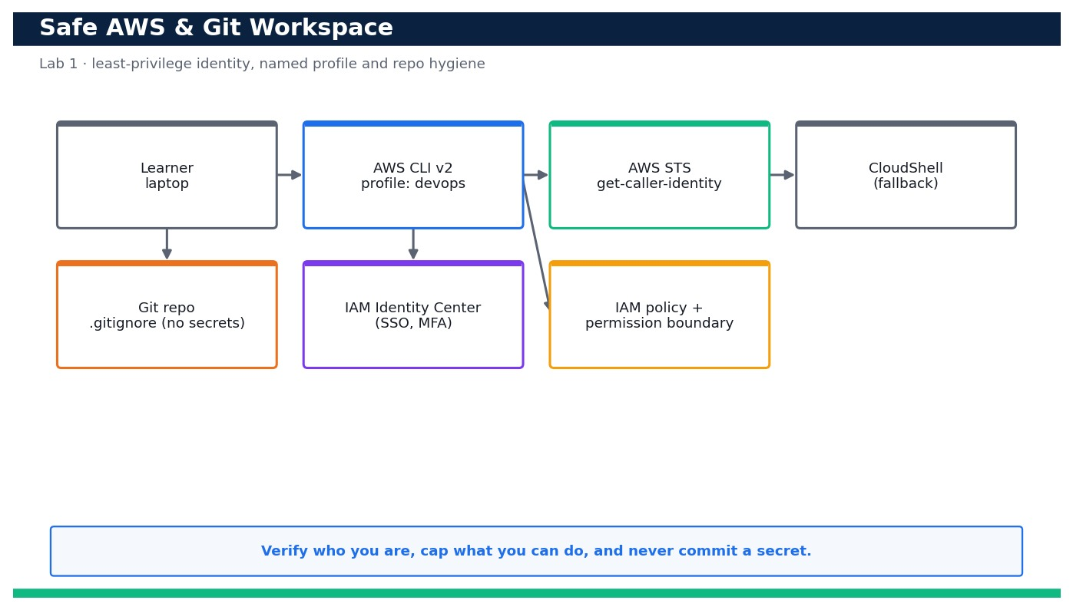
LAB 1 · DAY 1 · LO1 · HANDS-ON
Set Up a Safe AWS & Git Working Environment and Verify Identity
LAB 1
Day 1 · LO1 · K1, A1
Before automating anything you need a workspace you can trust. In this lab you install and configure AWS CLI v2 with a named least-privilege 'devops' profile (or an IAM Identity Center session), prove exactly who you are with STS, pin a Region, attach a permission boundary so the profile can never exceed its remit, and lock down your Git repository so plaintext secrets …
YOU'LL BUILD
A named, MFA-aware, least-privilege 'devops' CLI profile plus a Git repo with a secrets-safe.gitignore, verified with an AWS caller-identity check and a clean secret scan.
Tools: AWS IAM, AWS CLI v2, IAM Identity Center, CloudShell, Git
Reference architecture
OUTCOME & EVIDENCE
Outcome: You can run identity-check.sh and get 'PROFILE OK' with the correct ARN and Region, the permission boundary provably blocks …
Evidence: Screenshot of showing your own Account and ARN.
DevOps Engineering on AWS · TGS-2023040474
© 2026 Tertiary Infotech Academy Pte Ltd
62
Notes:
Lab 1 overview — Stand up a least-privilege AWS CLI/Git workspace and confirm your identity.
Concept-led briefing only. The full detailed procedure, commands, expected outputs, validation and cleanup live in the Learner Guide and the lab README (not on the slides).
Reference architecture: course-generated diagram for Lab 1.
[Sources]
- AWS Certified DevOps Engineer – Professional (DOP-C02) Exam Guide (docs.aws.amazon.com/pdfs/aws-certification/latest/devops-engineer-professional-02).
- Legacy course deck: WSQ Master Trainer Slides — DevOps Engineering on AWS (v7).

Slide 64
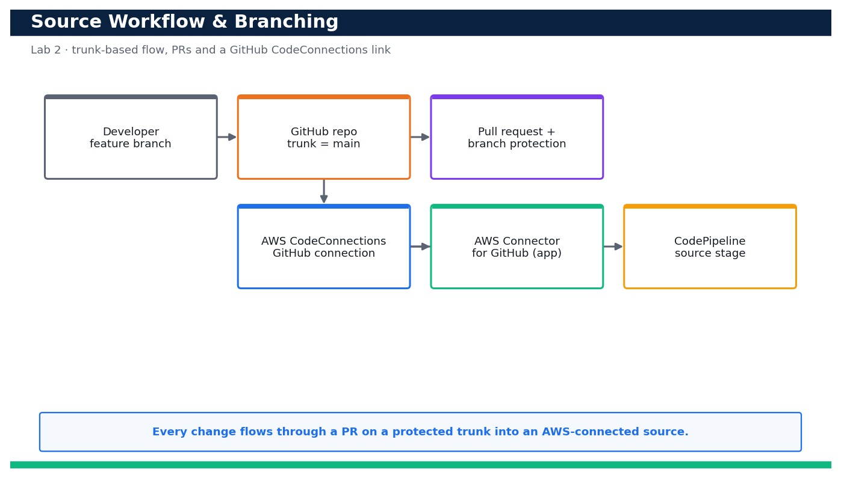
LAB 2 · DAY 1 · LO1 · HANDS-ON
Establish a Source-Control Workflow and Branching for the Sample App
LAB 2
Day 1 · LO1 · K1, A1
Good delivery starts with disciplined source control. In this lab you fork and clone the sample web app, adopt a trunk-based workflow, cut a short-lived feature branch, commit a change, push it, open a pull request and protect the main branch. You …
YOU'LL BUILD
A protected trunk-based GitHub repo with an open/merged PR, plus an AVAILABLE AWS CodeConnections connection to GitHub ready to drive CodeBuild and CodePipeline.
Tools: GitHub, AWS CodeConnections, Git, AWS CodePipeline (source stage)
Reference architecture
OUTCOME & EVIDENCE
Outcome: You can push a feature branch, open and merge a PR into a protected main, and prove an AWS CodeConnections connection to …
Evidence: The GitHub PR page for feature/bump-version showing the diff and an approving review.
DevOps Engineering on AWS · TGS-2023040474
© 2026 Tertiary Infotech Academy Pte Ltd
63
Notes:
Lab 2 overview — Adopt a trunk-based Git workflow and connect the repository to AWS with CodeConnections.
Concept-led briefing only. The full detailed procedure, commands, expected outputs, validation and cleanup live in the Learner Guide and the lab README (not on the slides).
Reference architecture: course-generated diagram for Lab 2.
[Sources]
- AWS Certified DevOps Engineer – Professional (DOP-C02) Exam Guide (docs.aws.amazon.com/pdfs/aws-certification/latest/devops-engineer-professional-02).
- Legacy course deck: WSQ Master Trainer Slides — DevOps Engineering on AWS (v7).

Slide 65
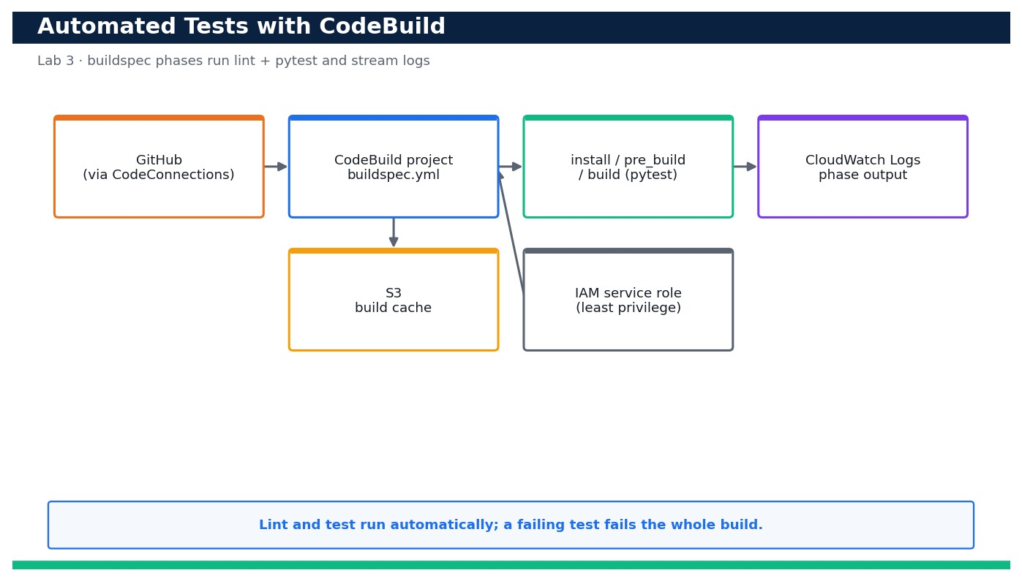
LAB 3 · DAY 1 · LO1 · HANDS-ON
Run Automated Tests on Every Commit with AWS CodeBuild
LAB 3
Day 1 · LO1 · K1, A1
Automated tests are the gate that keeps broken code out of production. In this lab you author a buildspec.yml with install/pre_build/build phases that install dependencies, run a linter and run pytest, then create a CodeBuild project that pulls the source through your CodeConnections link. You start a build, read the phase-by-phase logs in CloudWatch, deliberately …
YOU'LL BUILD
A CodeBuild project that runs the linter and, streams phase logs to CloudWatch, and fails loudly when a test is broken.
Tools: AWS CodeBuild, Amazon S3, AWS IAM, Amazon CloudWatch Logs
Reference architecture
OUTCOME & EVIDENCE
Outcome: You can start a build that runs the linter and, read the phase logs, break a test to see the build FAIL, and fix it to see the build SUCCEED …
Evidence: The CodeBuild build page showing buildStatus SUCCEEDED with INSTALL/PRE_BUILD/BUILD green.
DevOps Engineering on AWS · TGS-2023040474
© 2026 Tertiary Infotech Academy Pte Ltd
64
Notes:
Lab 3 overview — Author a buildspec and a CodeBuild project that automatically lints and tests the app.
Concept-led briefing only. The full detailed procedure, commands, expected outputs, validation and cleanup live in the Learner Guide and the lab README (not on the slides).
Reference architecture: course-generated diagram for Lab 3.
[Sources]
- AWS Certified DevOps Engineer – Professional (DOP-C02) Exam Guide (docs.aws.amazon.com/pdfs/aws-certification/latest/devops-engineer-professional-02).
- Legacy course deck: WSQ Master Trainer Slides — DevOps Engineering on AWS (v7).

Slide 66
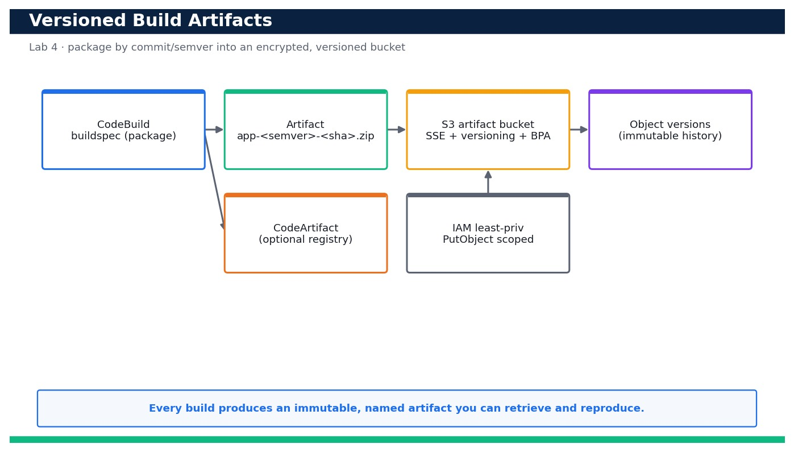
LAB 4 · DAY 1 · LO1 · HANDS-ON
Produce and Store Versioned Build Artifacts with a Buildspec
LAB 4
Day 1 · LO1 · K1, A1
A pipeline is only trustworthy if you can identify and reproduce exactly what it built. In this lab you extend the buildspec to package the app into a versioned artifact named by commit and semantic version, then upload it to an encrypted S3 artifact bucket with Block Public Access and object versioning enabled. You verify each object version, and prove you can retrieve …
YOU'LL BUILD
An encrypted, version-enabled S3 artifact bucket holding immutable, commit/semver-named build artifacts that you can list, retrieve and reproduce.
Tools: AWS CodeBuild, Amazon S3, AWS CodeArtifact, AWS IAM
Reference architecture
OUTCOME & EVIDENCE
Outcome: You can produce a commit/semver-named artifact, store it in an encrypted, versioned, private bucket, list its version history, and download …
Evidence: output showing Status: Enabled.
DevOps Engineering on AWS · TGS-2023040474
© 2026 Tertiary Infotech Academy Pte Ltd
65
Notes:
Lab 4 overview — Extend the buildspec to package versioned artifacts and store them in an encrypted, versioned bucket.
Concept-led briefing only. The full detailed procedure, commands, expected outputs, validation and cleanup live in the Learner Guide and the lab README (not on the slides).
Reference architecture: course-generated diagram for Lab 4.
[Sources]
- AWS Certified DevOps Engineer – Professional (DOP-C02) Exam Guide (docs.aws.amazon.com/pdfs/aws-certification/latest/devops-engineer-professional-02).
- Legacy course deck: WSQ Master Trainer Slides — DevOps Engineering on AWS (v7).

Slide 67
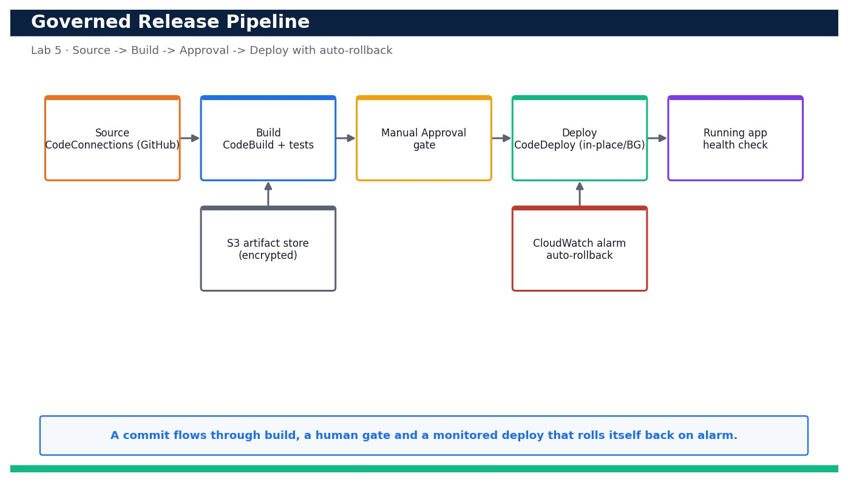
LAB 5 · DAY 1 · LO1 · HANDS-ON
Assemble a CodePipeline with Manual Approval and a Deployment Strategy
LAB 5
Day 1 · LO1 · K1, A1
Now you connect everything into one governed release path. Using a CloudFormation template plus a pipeline definition, you build Source (CodeConnections) -> Build (CodeBuild) -> Manual Approval -> Deploy (CodeDeploy). You choose between …
YOU'LL BUILD
A four-stage CodePipeline (Source -> Build -> Approve -> Deploy) with a manual approval gate, a chosen deployment strategy and alarm-based automatic rollback.
Tools: AWS CodePipeline, CodeBuild, CodeDeploy, CodeConnections, Amazon S3, Amazon CloudWatch, AWS CloudFormation
Reference architecture
OUTCOME & EVIDENCE
Outcome: You can run the pipeline end to end, be blocked at a manual approval until you approve, see the app deployed and healthy, and watch …
Evidence: The CodePipeline view showing Source, Build, Approve and Deploy, paused at the Approve gate.
DevOps Engineering on AWS · TGS-2023040474
© 2026 Tertiary Infotech Academy Pte Ltd
66
Notes:
Lab 5 overview — Wire an end-to-end pipeline with a manual approval gate, a deployment strategy and auto-rollback.
Concept-led briefing only. The full detailed procedure, commands, expected outputs, validation and cleanup live in the Learner Guide and the lab README (not on the slides).
Reference architecture: course-generated diagram for Lab 5.
[Sources]
- AWS Certified DevOps Engineer – Professional (DOP-C02) Exam Guide (docs.aws.amazon.com/pdfs/aws-certification/latest/devops-engineer-professional-02).
- Legacy course deck: WSQ Master Trainer Slides — DevOps Engineering on AWS (v7).

Slide 68
DOMAIN RECAP
Recap — SDLC Automation
• You can now: Stand up a least-privilege AWS CLI/Git workspace and confirm your identity
• You can now: Adopt a trunk-based Git workflow and connect the repository to AWS with CodeConnections
• You can now: Author a buildspec and a CodeBuild project that automatically lints and tests the app
• You can now: Extend the buildspec to package versioned artifacts and store them in an encrypted, versioned bucket
• You can now: Wire an end-to-end pipeline with a manual approval gate, a deployment strategy and auto-rollback
• Continuous Integration — Developers push often; CodeBuild runs the build and tests on every commit so bugs are found early, not at release.
• Continuous Delivery / Deployment — Every green build is releasable; CodePipeline and CodeDeploy move it through dev → test → prod with approvals.
• The AWS developer tools — CodeCommit / CodeBuild / CodeDeploy / CodePipeline / CodeArtifact / CodeGuru compose the managed CI/CD toolchain.
DevOps Engineering on AWS · TGS-2023040474
© 2026 Tertiary Infotech Academy Pte Ltd
67
Notes:
Recap of Domain 01 — SDLC Automation.
[Sources]
- AWS Certified DevOps Engineer – Professional (DOP-C02) Exam Guide (docs.aws.amazon.com/pdfs/aws-certification/latest/devops-engineer-professional-02).
- AWS CodePipeline Documentation (docs.aws.amazon.com/codepipeline).
- Legacy course deck: WSQ Master Trainer Slides — DevOps Engineering on AWS (v7).

Slide 69
02
DOMAIN 02
Configuration Management and IaC
Exam weighting 17% · Infrastructure as Code · reusable templates · multi-account & multi-Region
DevOps Engineering on AWS · TGS-2023040474
© 2026 Tertiary Infotech Academy Pte Ltd
68

Slide 70
DOMAIN 02 · WEIGHTING 17%
Key Concepts — Configuration Management and IaC
Infrastructure as Code
Declare infrastructure in version-controlled templates so environments are repeatable, reviewable and disposable.
CloudFormation
Declarative JSON/YAML stacks with parameters, mappings, outputs, change sets, drift detection and automatic rollback.
1
2
Reusable components
Nested stacks and modules parameterise a pattern once and reuse it across teams and Regions.
CDK vs CloudFormation vs Terraform
CDK generates CloudFormation from real code; Terraform is multi-cloud — all describe desired state.
3
4
Configuration management
Systems Manager (State Manager, Automation, Parameter Store) keeps running instances in their desired configuration.
Multi-account & multi-Region
Organizations, StackSets and Control Tower create, onboard and secure accounts at scale.
5
6
DevOps Engineering on AWS · TGS-2023040474
© 2026 Tertiary Infotech Academy Pte Ltd
69
Notes:
Key concepts for Domain 02 — Configuration Management and IaC.
Infrastructure as Code: Declare infrastructure in version-controlled templates so environments are repeatable, reviewable and disposable.
CloudFormation: Declarative JSON/YAML stacks with parameters, mappings, outputs, change sets, drift detection and automatic rollback.
Reusable components: Nested stacks and modules parameterise a pattern once and reuse it across teams and Regions.
CDK vs CloudFormation vs Terraform: CDK generates CloudFormation from real code; Terraform is multi-cloud — all describe desired state.
Configuration management: Systems Manager (State Manager, Automation, Parameter Store) keeps running instances in their desired configuration.
Multi-account & multi-Region: Organizations, StackSets and Control Tower create, onboard and secure accounts at scale.
[Sources]
- AWS Certified DevOps Engineer – Professional (DOP-C02) Exam Guide (docs.aws.amazon.com/pdfs/aws-certification/latest/devops-engineer-professional-02).
- AWS CloudFormation Documentation (docs.aws.amazon.com/cloudformation).
- Legacy course deck: WSQ Master Trainer Slides — DevOps Engineering on AWS (v7).

Slide 71
DECLARE DESIRED STATE
IaC Options on AWS
Tool
Language
Scope
When to use
CloudFormation
YAML / JSON
AWS-native declarative
Standard AWS IaC, StackSets
AWS CDK
Python / TS / Java
Code → CloudFormation
Reusable, testable constructs
Terraform
HCL
Multi-cloud
Mixed-cloud estates
SAM
YAML
Serverless-focused
Lambda / API / event apps
DevOps Engineering on AWS · TGS-2023040474
© 2026 Tertiary Infotech Academy Pte Ltd
70
Notes:
Domain 02 deep dive — Configuration Management and IaC. Editable AWS-native diagram/table/chart.
[Sources]
- AWS Certified DevOps Engineer – Professional (DOP-C02) Exam Guide (docs.aws.amazon.com/pdfs/aws-certification/latest/devops-engineer-professional-02).
- AWS CloudFormation Documentation (docs.aws.amazon.com/cloudformation).
- Legacy course deck: WSQ Master Trainer Slides — DevOps Engineering on AWS (v7).

Slide 72
DOMAIN 02 · INFRASTRUCTURE AS CODE
CloudFormation — Reusable Stacks
Template
network.yaml / app.yaml
Change Set
preview diff
Stack
managed resources
VPC / Subnets
Parameters
per environment
Drift Detection
EC2 / App
▶ One parameterised template deploys identical dev, test and prod environments; change sets preview, drift detection audits.
DevOps Engineering on AWS · TGS-2023040474
© 2026 Tertiary Infotech Academy Pte Ltd
71
Notes:
Domain 02 deep dive — Configuration Management and IaC. Editable AWS-native diagram/table/chart.
[Sources]
- AWS Certified DevOps Engineer – Professional (DOP-C02) Exam Guide (docs.aws.amazon.com/pdfs/aws-certification/latest/devops-engineer-professional-02).
- AWS CloudFormation Documentation (docs.aws.amazon.com/cloudformation).
- Legacy course deck: WSQ Master Trainer Slides — DevOps Engineering on AWS (v7).

Slide 73
MULTI-ACCOUNT / MULTI-REGION
Configuration Management & Governance at Scale
Nested stacks / modules
Package a pattern once and reuse it across teams.
Systems Manager
State Manager, Automation and Parameter Store keep instances in desired state.
1
2
StackSets
Deploy the same stack across many accounts and Regions.
Organizations & Control Tower
Create, onboard and secure accounts with a landing zone.
3
4
DevOps Engineering on AWS · TGS-2023040474
© 2026 Tertiary Infotech Academy Pte Ltd
72
Notes:
Domain 02 deep dive — Configuration Management and IaC. Editable AWS-native diagram/table/chart.
[Sources]
- AWS Certified DevOps Engineer – Professional (DOP-C02) Exam Guide (docs.aws.amazon.com/pdfs/aws-certification/latest/devops-engineer-professional-02).
- AWS CloudFormation Documentation (docs.aws.amazon.com/cloudformation).
- Legacy course deck: WSQ Master Trainer Slides — DevOps Engineering on AWS (v7).

Slide 74
TEMPLATE STRUCTURE
Anatomy of a CloudFormation Template
Parameters
Inputs that make the template reusable across environments.
Mappings
Static lookup tables (e.g. AMI by Region).
1
2
Conditions
Create resources only when a condition is met.
Resources
The AWS resources to provision (the only required section).
3
4
Outputs
Values to export and import into other stacks.
Metadata
Extra structured information about the template.
5
6
DevOps Engineering on AWS · TGS-2023040474
© 2026 Tertiary Infotech Academy Pte Ltd
73
Notes:
Domain 02 deep dive — Configuration Management and IaC. Editable AWS-native diagram/table/chart.
[Sources]
- AWS Certified DevOps Engineer – Professional (DOP-C02) Exam Guide (docs.aws.amazon.com/pdfs/aws-certification/latest/devops-engineer-professional-02).
- AWS CloudFormation Documentation (docs.aws.amazon.com/cloudformation).
- Legacy course deck: WSQ Master Trainer Slides — DevOps Engineering on AWS (v7).

Slide 75
SAFE CHANGE MANAGEMENT
The Stack Lifecycle
1
2
3
4
5
6
▶
▶
▶
▶
▶
Author
template
Validate
& lint
Create Set /
Change Set
Execute
provision
Detect Drift
audit
Update or
Delete
DevOps Engineering on AWS · TGS-2023040474
© 2026 Tertiary Infotech Academy Pte Ltd
74
Notes:
Domain 02 deep dive — Configuration Management and IaC. Editable AWS-native diagram/table/chart.
[Sources]
- AWS Certified DevOps Engineer – Professional (DOP-C02) Exam Guide (docs.aws.amazon.com/pdfs/aws-certification/latest/devops-engineer-professional-02).
- AWS CloudFormation Documentation (docs.aws.amazon.com/cloudformation).
- Legacy course deck: WSQ Master Trainer Slides — DevOps Engineering on AWS (v7).

Slide 76
CONFIG & SECRETS
Parameter Store vs Secrets Manager
Store
Best for
Rotation
Cost
SSM Parameter Store
Config values & non-secret parameters
Manual
Free (standard)
Secrets Manager
Passwords, API keys, DB credentials
Automatic
Per-secret
DevOps Engineering on AWS · TGS-2023040474
© 2026 Tertiary Infotech Academy Pte Ltd
75
Notes:
Domain 02 deep dive — Configuration Management and IaC. Editable AWS-native diagram/table/chart.
[Sources]
- AWS Certified DevOps Engineer – Professional (DOP-C02) Exam Guide (docs.aws.amazon.com/pdfs/aws-certification/latest/devops-engineer-professional-02).
- AWS CloudFormation Documentation (docs.aws.amazon.com/cloudformation).
- Legacy course deck: WSQ Master Trainer Slides — DevOps Engineering on AWS (v7).

Slide 77
IN DEPTH
Infrastructure as Code — declarative desired state
IN DEPTH
WHY IT MATTERS
Repeatable, reviewable, disposable environments eliminate configuration drift and the 'it works on that server' class of failure.
• You describe the target state of infrastructure in version-controlled templates; the service computes and applies the difference.
• The same template deploys identical dev, test and prod environments — parameters, not copy-paste, capture the differences.
• Infrastructure changes go through code review and the pipeline, just like application code.
FAILURE MODE
Mixing manual console changes with IaC creates drift the template no longer describes — the next deploy can revert or clash with them.
TRADE-OFF / DECISION
Declarative IaC is safe and auditable but less flexible than imperative scripts — use change sets and modules to regain expressiveness.
DevOps Engineering on AWS · TGS-2023040474
© 2026 Tertiary Infotech Academy Pte Ltd
76
Notes:
Infrastructure as Code — declarative desired state.
Why it matters: Repeatable, reviewable, disposable environments eliminate configuration drift and the 'it works on that server' class of failure.
Failure mode: Mixing manual console changes with IaC creates drift the template no longer describes — the next deploy can revert or clash with them.
Trade-off: Declarative IaC is safe and auditable but less flexible than imperative scripts — use change sets and modules to regain expressiveness.
[Sources]
- AWS Certified DevOps Engineer – Professional (DOP-C02) Exam Guide (docs.aws.amazon.com/pdfs/aws-certification/latest/devops-engineer-professional-02).
- AWS CloudFormation Documentation (docs.aws.amazon.com/cloudformation).
- AWS Well-Architected Framework (docs.aws.amazon.com/wellarchitected).

Slide 78
IN DEPTH
CloudFormation stacks, change sets and rollback
IN DEPTH
WHY IT MATTERS
Preview-then-apply plus automatic rollback make infrastructure changes as safe and reversible as a code deployment.
• A stack is a unit of resources created, updated and deleted together from one template.
• A change set previews exactly what an update will add, modify or replace before you execute it.
• On failure, CloudFormation automatically rolls the stack back to its last known-good state.
FAILURE MODE
A resource that must be replaced (not updated in place) can cause downtime or data loss if you don't read the change set's Replacement column.
TRADE-OFF / DECISION
Automatic rollback protects you but can mask the real error — always read the stack Events for the first failing resource.
DevOps Engineering on AWS · TGS-2023040474
© 2026 Tertiary Infotech Academy Pte Ltd
77
Notes:
CloudFormation stacks, change sets and rollback.
Why it matters: Preview-then-apply plus automatic rollback make infrastructure changes as safe and reversible as a code deployment.
Failure mode: A resource that must be replaced (not updated in place) can cause downtime or data loss if you don't read the change set's Replacement column.
Trade-off: Automatic rollback protects you but can mask the real error — always read the stack Events for the first failing resource.
[Sources]
- AWS CloudFormation change sets Documentation (docs.aws.amazon.com/AWSCloudFormation/latest/UserGuide/using-cfn-updating-stacks-changesets.html).
- AWS Certified DevOps Engineer – Professional (DOP-C02) Exam Guide (docs.aws.amazon.com/pdfs/aws-certification/latest/devops-engineer-professional-02).

Slide 79
IN DEPTH
Template anatomy — parameters, mappings, conditions, outputs
IN DEPTH
WHY IT MATTERS
A well-structured template is a reusable product, not a one-off script — one artifact serves many teams and Regions.
• Parameters make a template reusable across environments; Mappings hold static lookups such as AMI-by-Region.
• Conditions create resources only when appropriate (e.g. a NAT gateway only in prod); Outputs export values for other stacks.
• Only the Resources section is mandatory — everything else exists to make templates reusable and composable.
FAILURE MODE
Hard-coded AMI IDs, account numbers or Region strings make a template that only works in the account it was written in.
TRADE-OFF / DECISION
Heavy parameterisation increases flexibility but reduces readability — prefer sensible defaults and SSM public parameters.
DevOps Engineering on AWS · TGS-2023040474
© 2026 Tertiary Infotech Academy Pte Ltd
78
Notes:
Template anatomy — parameters, mappings, conditions, outputs.
Why it matters: A well-structured template is a reusable product, not a one-off script — one artifact serves many teams and Regions.
Failure mode: Hard-coded AMI IDs, account numbers or Region strings make a template that only works in the account it was written in.
Trade-off: Heavy parameterisation increases flexibility but reduces readability — prefer sensible defaults and SSM public parameters.
[Sources]
- AWS CloudFormation template anatomy Documentation (docs.aws.amazon.com/AWSCloudFormation/latest/UserGuide/template-anatomy.html).
- AWS Certified DevOps Engineer – Professional (DOP-C02) Exam Guide (docs.aws.amazon.com/pdfs/aws-certification/latest/devops-engineer-professional-02).

Slide 80
IN DEPTH
Reuse — nested stacks, modules and StackSets
IN DEPTH
WHY IT MATTERS
Reuse turns a proven design into an organisational standard, so every team gets the same secure, compliant baseline.
• Nested stacks and CloudFormation modules package a pattern once and reuse it across many stacks.
• StackSets deploy the same stack across many accounts and Regions from a single operation.
• Cross-stack references and exports let a network stack publish IDs that app stacks import.
FAILURE MODE
Over-nesting creates tightly coupled stacks where one change forces wide, slow updates and hard-to-debug failures.
TRADE-OFF / DECISION
Central StackSets enforce consistency but need governance so account teams aren't blocked waiting on the platform team.
DevOps Engineering on AWS · TGS-2023040474
© 2026 Tertiary Infotech Academy Pte Ltd
79
Notes:
Reuse — nested stacks, modules and StackSets.
Why it matters: Reuse turns a proven design into an organisational standard, so every team gets the same secure, compliant baseline.
Failure mode: Over-nesting creates tightly coupled stacks where one change forces wide, slow updates and hard-to-debug failures.
Trade-off: Central StackSets enforce consistency but need governance so account teams aren't blocked waiting on the platform team.
[Sources]
- AWS StackSets Documentation (docs.aws.amazon.com/AWSCloudFormation/latest/UserGuide/what-is-cfnstacksets.html).
- AWS Certified DevOps Engineer – Professional (DOP-C02) Exam Guide (docs.aws.amazon.com/pdfs/aws-certification/latest/devops-engineer-professional-02).

Slide 81
IN DEPTH
CDK, SAM and Terraform — when to reach for each
IN DEPTH
WHY IT MATTERS
Choosing the right tool matches the team's skills and estate — real code for testable constructs, SAM for serverless, Terraform for multi-cloud.
• The AWS CDK lets you express infrastructure in a general-purpose language and synthesises CloudFormation.
• AWS SAM is a CloudFormation extension optimised for serverless apps.
• Terraform describes desired state in HCL across many clouds and providers.
FAILURE MODE
Adopting CDK without CloudFormation literacy hides what is really deployed and makes drift and failures harder to reason about.
TRADE-OFF / DECISION
Higher-level abstractions boost productivity but add a layer to debug when the generated template misbehaves.
DevOps Engineering on AWS · TGS-2023040474
© 2026 Tertiary Infotech Academy Pte Ltd
80
Notes:
CDK, SAM and Terraform — when to reach for each.
Why it matters: Choosing the right tool matches the team's skills and estate — real code for testable constructs, SAM for serverless, Terraform for multi-cloud.
Failure mode: Adopting CDK without CloudFormation literacy hides what is really deployed and makes drift and failures harder to reason about.
Trade-off: Higher-level abstractions boost productivity but add a layer to debug when the generated template misbehaves.
[Sources]
- AWS CDK Documentation (docs.aws.amazon.com/cdk).
- AWS SAM Documentation (docs.aws.amazon.com/serverless-application-model).
- AWS Certified DevOps Engineer – Professional (DOP-C02) Exam Guide (docs.aws.amazon.com/pdfs/aws-certification/latest/devops-engineer-professional-02).

Slide 82
IN DEPTH
Configuration management with Systems Manager
IN DEPTH
WHY IT MATTERS
Config management closes the gap between 'provisioned' and 'correctly configured and maintained over time'.
• State Manager keeps instances in a defined configuration; Automation documents run repeatable operational runbooks.
• Parameter Store holds configuration and (with Secrets Manager) secrets, versioned and access-controlled.
• Patch Manager and Inventory keep fleets patched and auditable without SSH access.
FAILURE MODE
Treating servers as pets you SSH into and hand-tune reintroduces drift that no template can track.
TRADE-OFF / DECISION
Agent-based management adds an agent to run and secure, but removes bastion hosts and standing SSH access.
DevOps Engineering on AWS · TGS-2023040474
© 2026 Tertiary Infotech Academy Pte Ltd
81
Notes:
Configuration management with Systems Manager.
Why it matters: Config management closes the gap between 'provisioned' and 'correctly configured and maintained over time'.
Failure mode: Treating servers as pets you SSH into and hand-tune reintroduces drift that no template can track.
Trade-off: Agent-based management adds an agent to run and secure, but removes bastion hosts and standing SSH access.
[Sources]
- AWS Systems Manager Documentation (docs.aws.amazon.com/systems-manager).
- AWS Certified DevOps Engineer – Professional (DOP-C02) Exam Guide (docs.aws.amazon.com/pdfs/aws-certification/latest/devops-engineer-professional-02).

Slide 83
IN DEPTH
Drift detection and remediation
IN DEPTH
WHY IT MATTERS
Detecting drift early prevents the slow divergence that eventually makes a stack un-updatable.
• Drift detection compares live resources against the template and reports what changed out-of-band.
• Config rules can watch for the same drift continuously and trigger remediation.
• The fix is to update the template to match intent or revert the resource to the template.
FAILURE MODE
Ignoring drift until an urgent change is needed means your 'safe' update now collides with undocumented manual edits.
TRADE-OFF / DECISION
Strict no-drift policies improve auditability but can slow emergency fixes — provide a documented break-glass path.
DevOps Engineering on AWS · TGS-2023040474
© 2026 Tertiary Infotech Academy Pte Ltd
82
Notes:
Drift detection and remediation.
Why it matters: Detecting drift early prevents the slow divergence that eventually makes a stack un-updatable.
Failure mode: Ignoring drift until an urgent change is needed means your 'safe' update now collides with undocumented manual edits.
Trade-off: Strict no-drift policies improve auditability but can slow emergency fixes — provide a documented break-glass path.
[Sources]
- AWS CloudFormation drift Documentation (docs.aws.amazon.com/AWSCloudFormation/latest/UserGuide/using-cfn-stack-drift.html).
- AWS Certified DevOps Engineer – Professional (DOP-C02) Exam Guide (docs.aws.amazon.com/pdfs/aws-certification/latest/devops-engineer-professional-02).

Slide 84
IN DEPTH
Multi-account governance — Organizations, Control Tower, SCPs
IN DEPTH
WHY IT MATTERS
Account-level isolation plus org-wide guardrails give strong blast-radius control and a consistent, auditable baseline.
• AWS Organizations groups accounts; Service Control Policies set the maximum permissions any account can grant.
• Control Tower stands up a landing zone with guardrails, a shared logging account and account factory.
• New accounts are vended pre-configured to the security and network baseline.
FAILURE MODE
A single shared account for everything makes least-privilege impossible and one mistake blast-radius huge.
TRADE-OFF / DECISION
More accounts improve isolation but add networking and operational overhead — automate account vending to keep it manageable.
DevOps Engineering on AWS · TGS-2023040474
© 2026 Tertiary Infotech Academy Pte Ltd
83
Notes:
Multi-account governance — Organizations, Control Tower, SCPs.
Why it matters: Account-level isolation plus org-wide guardrails give strong blast-radius control and a consistent, auditable baseline.
Failure mode: A single shared account for everything makes least-privilege impossible and one mistake blast-radius huge.
Trade-off: More accounts improve isolation but add networking and operational overhead — automate account vending to keep it manageable.
[Sources]
- AWS Organizations Documentation (docs.aws.amazon.com/organizations).
- AWS Control Tower Documentation (docs.aws.amazon.com/controltower).
- AWS Certified DevOps Engineer – Professional (DOP-C02) Exam Guide (docs.aws.amazon.com/pdfs/aws-certification/latest/devops-engineer-professional-02).

Slide 85
IN DEPTH
Secrets & configuration — Parameter Store vs Secrets Manager
IN DEPTH
WHY IT MATTERS
Externalising configuration and secrets lets one immutable artifact run safely in every environment.
• Parameter Store holds configuration values (and SecureString secrets) with a generous free tier.
• Secrets Manager adds built-in, scheduled rotation and tight integration with RDS and other services.
• Both keep sensitive values out of templates, code and logs, retrieved at deploy/run time by IAM-scoped principals.
FAILURE MODE
Baking a database password into a template or AMI leaks it into every copy and every log line.
TRADE-OFF / DECISION
Automatic rotation is safest but must be tested — a rotation that apps don't reload can cause outages.
DevOps Engineering on AWS · TGS-2023040474
© 2026 Tertiary Infotech Academy Pte Ltd
84
Notes:
Secrets & configuration — Parameter Store vs Secrets Manager.
Why it matters: Externalising configuration and secrets lets one immutable artifact run safely in every environment.
Failure mode: Baking a database password into a template or AMI leaks it into every copy and every log line.
Trade-off: Automatic rotation is safest but must be tested — a rotation that apps don't reload can cause outages.
[Sources]
- AWS Secrets Manager Documentation (docs.aws.amazon.com/secretsmanager).
- AWS SSM Parameter Store Documentation (docs.aws.amazon.com/systems-manager/latest/userguide/systems-manager-parameter-store.html).
- AWS Certified DevOps Engineer – Professional (DOP-C02) Exam Guide (docs.aws.amazon.com/pdfs/aws-certification/latest/devops-engineer-professional-02).

Slide 86
AVOIDING SURPRISE DOWNTIME
Change Set Replacement — Read Before You Execute
Change type
CloudFormation action
Operational risk
Update in place
Modify the existing resource
Low — no replacement
Replacement
Create new, delete old
High — new ID, possible data loss
Add / remove
Create or delete a resource
Medium — check dependencies
No interruption
Property change, resource kept
Low
DevOps Engineering on AWS · TGS-2023040474
© 2026 Tertiary Infotech Academy Pte Ltd
85
Notes:
Comparison — Change Set Replacement — Read Before You Execute.
[Sources]
- AWS CloudFormation update behaviors Documentation (docs.aws.amazon.com/AWSCloudFormation/latest/UserGuide/using-cfn-updating-stacks-update-behaviors.html).
- AWS Certified DevOps Engineer – Professional (DOP-C02) Exam Guide (docs.aws.amazon.com/pdfs/aws-certification/latest/devops-engineer-professional-02).

Slide 87
REPEATABILITY PAYS OFF
Environment Provisioning — Manual vs IaC
WHAT THE DATA SHOWS
IaC collapses environment build time and errors and — most importantly — makes every environment identical, so tests actually predict production.
DevOps Engineering on AWS · TGS-2023040474
© 2026 Tertiary Infotech Academy Pte Ltd
86
Notes:
Environment Provisioning — Manual vs IaC. What the data shows: IaC collapses environment build time and errors and — most importantly — makes every environment identical, so tests actually predict production.
Figures are illustrative teaching values to convey the relationship, not measured benchmarks.
[Sources]
- AWS Certified DevOps Engineer – Professional (DOP-C02) Exam Guide (docs.aws.amazon.com/pdfs/aws-certification/latest/devops-engineer-professional-02).
- AWS Well-Architected Framework (docs.aws.amazon.com/wellarchitected).

Slide 88
WHERE IaC GOES WRONG
IaC Failure Modes & Anti-Patterns
Out-of-band console edits
Drift the template can't see → detect drift; make console read-only in prod.
Hard-coded IDs/Regions
Template only works in one account → parameters + SSM public parameters.
1
2
Giant monolith stack
Slow, risky updates → split by lifecycle and blast radius.
No change-set review
Surprise replacements → always preview before execute.
3
4
Secrets in templates
Leaked credentials → Secrets Manager / SSM SecureString.
Copy-paste per environment
Divergent envs → one template, many parameter sets.
5
6
DevOps Engineering on AWS · TGS-2023040474
© 2026 Tertiary Infotech Academy Pte Ltd
87
Notes:
IaC Failure Modes & Anti-Patterns.
Out-of-band console edits — Drift the template can't see → detect drift; make console read-only in prod.
Hard-coded IDs/Regions — Template only works in one account → parameters + SSM public parameters.
Giant monolith stack — Slow, risky updates → split by lifecycle and blast radius.
No change-set review — Surprise replacements → always preview before execute.
Secrets in templates — Leaked credentials → Secrets Manager / SSM SecureString.
Copy-paste per environment — Divergent envs → one template, many parameter sets.
[Sources]
- AWS Certified DevOps Engineer – Professional (DOP-C02) Exam Guide (docs.aws.amazon.com/pdfs/aws-certification/latest/devops-engineer-professional-02).
- AWS CloudFormation Documentation (docs.aws.amazon.com/cloudformation).

Slide 89
PROVEN PRACTICES
IaC Patterns Worth Adopting
Layered stacks
Separate network, platform and app stacks by change rate.
Landing zone
Control Tower baseline + guardrails for every account.
1
2
Immutable AMIs
Bake with a pipeline (e.g. EC2 Image Builder); replace, don't patch.
Public SSM parameters
Reference latest AMIs without hard-coding IDs.
3
4
Policy as code
Guardrails via SCPs and Config rules, versioned like IaC.
Pipeline-deployed stacks
No manual stack updates in production.
5
6
DevOps Engineering on AWS · TGS-2023040474
© 2026 Tertiary Infotech Academy Pte Ltd
88
Notes:
IaC Patterns Worth Adopting.
Layered stacks — Separate network, platform and app stacks by change rate.
Landing zone — Control Tower baseline + guardrails for every account.
Immutable AMIs — Bake with a pipeline (e.g. EC2 Image Builder); replace, don't patch.
Public SSM parameters — Reference latest AMIs without hard-coding IDs.
Policy as code — Guardrails via SCPs and Config rules, versioned like IaC.
Pipeline-deployed stacks — No manual stack updates in production.
[Sources]
- AWS Well-Architected Framework (docs.aws.amazon.com/wellarchitected).
- AWS Certified DevOps Engineer – Professional (DOP-C02) Exam Guide (docs.aws.amazon.com/pdfs/aws-certification/latest/devops-engineer-professional-02).

Slide 90
STACK DECOMPOSITION
Architecture Decision — One Big Stack or Many?
A
Single stack
B
Layered stacks
C
StackSets across accounts
Small app, one team, one lifecycle. Simple to reason about — but every change risks the whole system and updates get slow as it grows.
Separate network / platform / app by change rate and owner. Smaller blast radius and faster updates — needs disciplined exports/imports.
Same baseline in many accounts/Regions. Enforces consistency at scale — requires central governance and account-team coordination.
DevOps Engineering on AWS · TGS-2023040474
© 2026 Tertiary Infotech Academy Pte Ltd
89
Notes:
Architecture Decision — One Big Stack or Many?.
Option A — Single stack: Small app, one team, one lifecycle. Simple to reason about — but every change risks the whole system and updates get slow as it grows.
Option B — Layered stacks: Separate network / platform / app by change rate and owner. Smaller blast radius and faster updates — needs disciplined exports/imports.
Option C — StackSets across accounts: Same baseline in many accounts/Regions. Enforces consistency at scale — requires central governance and account-team coordination.
[Sources]
- AWS Certified DevOps Engineer – Professional (DOP-C02) Exam Guide (docs.aws.amazon.com/pdfs/aws-certification/latest/devops-engineer-professional-02).
- AWS Well-Architected Framework (docs.aws.amazon.com/wellarchitected).

Slide 91
THE COST OF DRIFT
Scenario — A 'quick' console fix breaks the next deploy
SITUATION
An engineer widens a security group in the console during an incident. Two weeks later, a routine stack update fails or silently reverts the fix.
ANALYSIS
• The live resource no longer matches the template, so CloudFormation's view of desired state is wrong.
• Drift detection would have flagged this the same day; Config rules could have alarmed on the open port immediately.
• The durable fix is to encode the change in the template and re-apply, not to keep patching by hand.
DECISION
Run drift detection on a schedule, alarm on security-group drift via Config, and require that emergency console changes are back-ported into the template within the incident's follow-up.
DevOps Engineering on AWS · TGS-2023040474
© 2026 Tertiary Infotech Academy Pte Ltd
90
Notes:
Scenario: An engineer widens a security group in the console during an incident. Two weeks later, a routine stack update fails or silently reverts the fix.
The live resource no longer matches the template, so CloudFormation's view of desired state is wrong.
Drift detection would have flagged this the same day; Config rules could have alarmed on the open port immediately.
The durable fix is to encode the change in the template and re-apply, not to keep patching by hand.
Decision: Run drift detection on a schedule, alarm on security-group drift via Config, and require that emergency console changes are back-ported into the template within the incident's follow-up.
[Sources]
- AWS CloudFormation drift Documentation (docs.aws.amazon.com/AWSCloudFormation/latest/UserGuide/using-cfn-stack-drift.html).
- AWS Config Documentation (docs.aws.amazon.com/config).

Slide 92
SCALING GOVERNANCE
Scenario — Standing up a compliant new account fast
SITUATION
A new business unit needs an AWS account that already meets the company's security, logging and network standards on day one.
ANALYSIS
• Hand-building the account is slow and error-prone and guarantees it drifts from the standard.
• Control Tower's account factory vends accounts pre-wired to guardrails and centralised logging.
• StackSets push the standard network and security stacks into the new account automatically.
DECISION
Vend the account through Control Tower and apply the baseline via StackSets, so 'compliant by default' is the path of least resistance rather than a later audit finding.
DevOps Engineering on AWS · TGS-2023040474
© 2026 Tertiary Infotech Academy Pte Ltd
91
Notes:
Scenario: A new business unit needs an AWS account that already meets the company's security, logging and network standards on day one.
Hand-building the account is slow and error-prone and guarantees it drifts from the standard.
Control Tower's account factory vends accounts pre-wired to guardrails and centralised logging.
StackSets push the standard network and security stacks into the new account automatically.
Decision: Vend the account through Control Tower and apply the baseline via StackSets, so 'compliant by default' is the path of least resistance rather than a later audit finding.
[Sources]
- AWS Control Tower Documentation (docs.aws.amazon.com/controltower).
- AWS StackSets Documentation (docs.aws.amazon.com/AWSCloudFormation/latest/UserGuide/what-is-cfnstacksets.html).

Slide 93
ONE ARTIFACT, MANY ENVIRONMENTS
Worked Analysis — Parameterising One Template for Three Environments
Instance size by env
dev t3.micro, staging t3.small, prod m5.large — a single InstanceType parameter.
High availability by env
A Condition creates the Multi-AZ standby and NAT redundancy only when EnvName = prod.
AMI without hard-coding
An SSM public parameter resolves the latest patched Amazon Linux AMI at deploy time.
Secrets by env
Each environment references its own Secrets Manager secret; none appear in the template.
TAKEAWAY
The differences between environments become a short parameter file — the template itself is identical, so staging genuinely predicts production.
DevOps Engineering on AWS · TGS-2023040474
© 2026 Tertiary Infotech Academy Pte Ltd
92
Notes:
Worked Analysis — Parameterising One Template for Three Environments.
Instance size by env — dev t3.micro, staging t3.small, prod m5.large — a single InstanceType parameter.
High availability by env — A Condition creates the Multi-AZ standby and NAT redundancy only when EnvName = prod.
AMI without hard-coding — An SSM public parameter resolves the latest patched Amazon Linux AMI at deploy time.
Secrets by env — Each environment references its own Secrets Manager secret; none appear in the template.
Takeaway: The differences between environments become a short parameter file — the template itself is identical, so staging genuinely predicts production.
[Sources]
- AWS Certified DevOps Engineer – Professional (DOP-C02) Exam Guide (docs.aws.amazon.com/pdfs/aws-certification/latest/devops-engineer-professional-02).
- AWS CloudFormation Documentation (docs.aws.amazon.com/cloudformation).

Slide 94
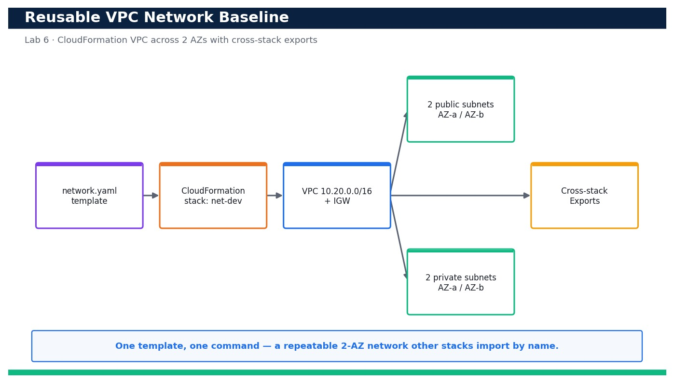
LAB 6 · DAY 2 · LO2 · HANDS-ON
Deploy a Reusable VPC Network Baseline with CloudFormation
LAB 6
Day 2 · LO2 · K3, A3
Your team keeps building VPCs by hand and no two look alike. In this lab you codify a golden network baseline as a single CloudFormation template — a VPC with two public and two private subnets spread across two Availability Zones, an Internet Gateway and route tables — and publish its identifiers as …
YOU'LL BUILD
A version-controlled network.yaml that deploys a 2-AZ VPC (2 public + 2 private subnets, IGW, route tables) and publishes VpcId, subnet IDs and the VPC CIDR as reusable cross-stack Exports.
Tools: AWS CloudFormation, Amazon VPC, Amazon EC2
Reference architecture
OUTCOME & EVIDENCE
Outcome: Deploying network.yaml with parameters-dev.json produces a reusable 2-AZ VPC whose IDs are published as cross-stack Exports …
Evidence: describe-stacks output showing net-dev at CREATE_COMPLETE with the Outputs tab populated.
DevOps Engineering on AWS · TGS-2023040474
© 2026 Tertiary Infotech Academy Pte Ltd
93
Notes:
Lab 6 overview — Author, validate and deploy a reusable VPC network baseline with CloudFormation and publish cross-stack exports (LO2, K3, A3).
Concept-led briefing only. The full detailed procedure, commands, expected outputs, validation and cleanup live in the Learner Guide and the lab README (not on the slides).
Reference architecture: course-generated diagram for Lab 6.
[Sources]
- AWS Certified DevOps Engineer – Professional (DOP-C02) Exam Guide (docs.aws.amazon.com/pdfs/aws-certification/latest/devops-engineer-professional-02).
- Legacy course deck: WSQ Master Trainer Slides — DevOps Engineering on AWS (v7).

Slide 95
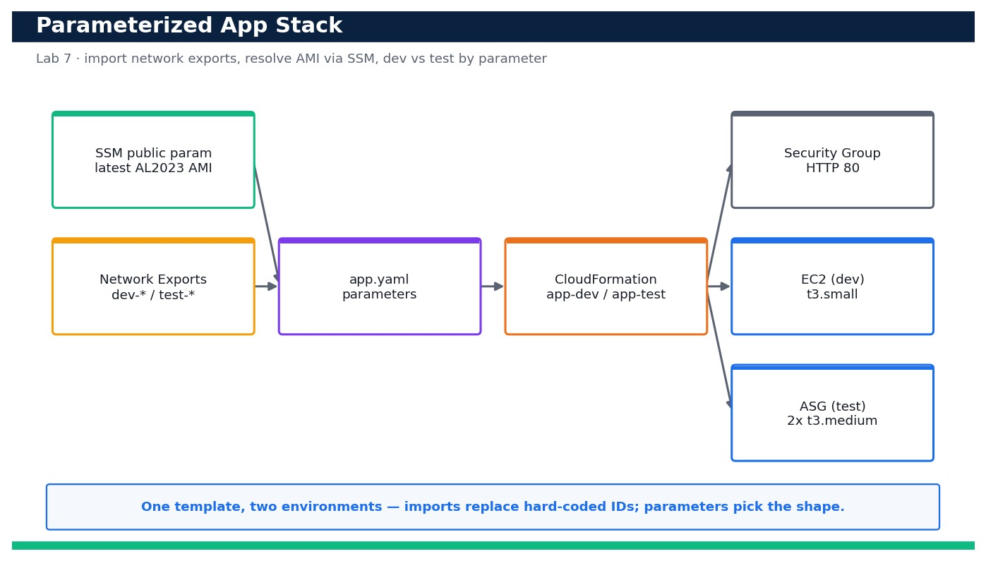
LAB 7 · DAY 2 · LO2 · HANDS-ON
Deploy a Parameterized Application Stack that Imports Network Exports
LAB 7
Day 2 · LO2 · K3, A3
With the network baseline from Lab 6 in place, you now deploy the application tier on top of it — without copy-pasting a single subnet or VPC ID. The app template uses Fn::ImportValue to …
YOU'LL BUILD
A parameterized app.yaml that imports the network exports, resolves the latest AMI via SSM and deploys a security group plus either a single EC2 instance (dev) or an Auto Scaling group (test) from the same template.
Tools: AWS CloudFormation, Amazon EC2, AWS Systems Manager (SSM public parameters)
Reference architecture
OUTCOME & EVIDENCE
Outcome: The same app.yaml, deployed with parameters.json, yields a dev single instance, and with params-test.json yields a multi-AZ Auto Scaling …
Evidence: describe-stacks output showing app-dev and app-test both at a *_COMPLETE status.
DevOps Engineering on AWS · TGS-2023040474
© 2026 Tertiary Infotech Academy Pte Ltd
94
Notes:
Lab 7 overview — Deploy a parameterized application stack that consumes cross-stack exports and reuse it for dev and test via parameter files (LO2, K3, A3).
Concept-led briefing only. The full detailed procedure, commands, expected outputs, validation and cleanup live in the Learner Guide and the lab README (not on the slides).
Reference architecture: course-generated diagram for Lab 7.
[Sources]
- AWS Certified DevOps Engineer – Professional (DOP-C02) Exam Guide (docs.aws.amazon.com/pdfs/aws-certification/latest/devops-engineer-professional-02).
- Legacy course deck: WSQ Master Trainer Slides — DevOps Engineering on AWS (v7).

Slide 96
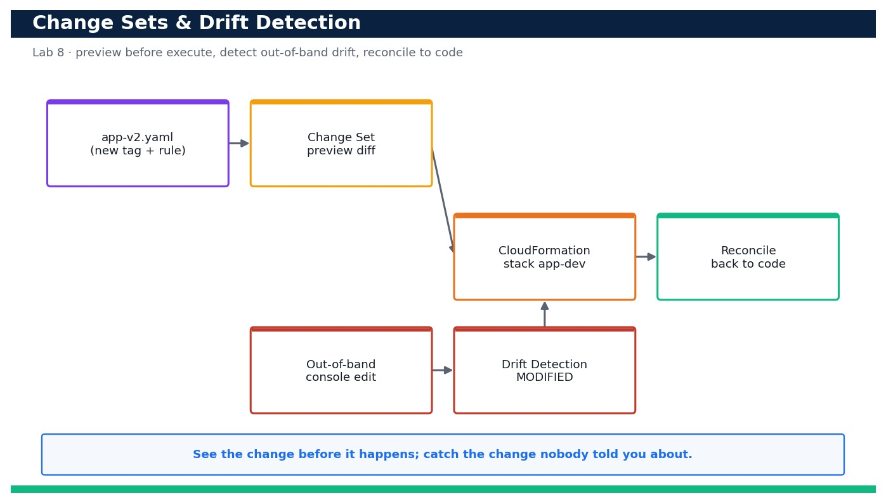
LAB 8 · DAY 2 · LO2 · HANDS-ON
Preview Changes with Change Sets and Detect & Reconcile Drift
LAB 8
Day 2 · LO2 · K3, A3
Production changes are risky when you cannot see them coming, and infrastructure silently drifts when people click in the console. In this lab you take the app stack from Lab 7, generate a change set to preview a before-you-execute diff, execute it, then deliberately make an out-of-band change directly on a …
YOU'LL BUILD
A repeatable workflow: create-change-set.sh renders a reviewable preview of a stack change, and drift-check.sh detects and reports out-of-band drift so you can reconcile infrastructure back to code.
Tools: AWS CloudFormation
Reference architecture
OUTCOME & EVIDENCE
Outcome: A change set previews the modification (added tag + narrowed rule) with no unexpected replacements before it is executed; an …
Evidence: describe-change-set output showing the previewed changes with Replacement=False (no destructive changes).
DevOps Engineering on AWS · TGS-2023040474
© 2026 Tertiary Infotech Academy Pte Ltd
95
Notes:
Lab 8 overview — Preview a stack modification safely with a change set before executing, then detect out-of-band drift and reconcile it (LO2, K3, A3).
Concept-led briefing only. The full detailed procedure, commands, expected outputs, validation and cleanup live in the Learner Guide and the lab README (not on the slides).
Reference architecture: course-generated diagram for Lab 8.
[Sources]
- AWS Certified DevOps Engineer – Professional (DOP-C02) Exam Guide (docs.aws.amazon.com/pdfs/aws-certification/latest/devops-engineer-professional-02).
- Legacy course deck: WSQ Master Trainer Slides — DevOps Engineering on AWS (v7).

Slide 97
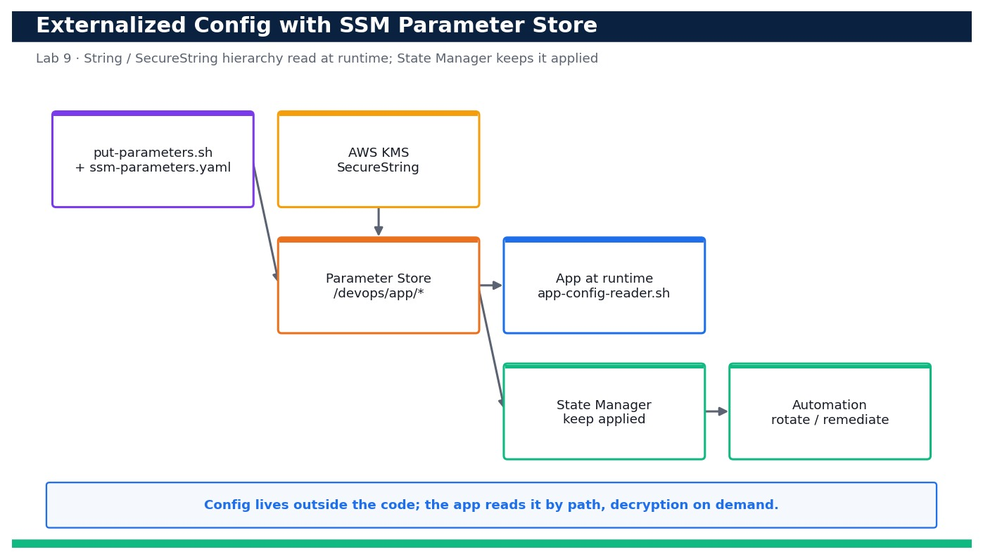
LAB 9 · DAY 2 · LO2 · HANDS-ON
Externalize Configuration with SSM Parameter Store
LAB 9
Day 2 · LO2 · K3, A3
Hard-coding configuration and credentials into code and templates is a recipe for leaks and rebuilds. In this lab you externalize your application's configuration into AWS Systems Manager Parameter Store — plain String and String List …
YOU'LL BUILD
A /devops/app/* parameter hierarchy in SSM (String, StringList and KMS-encrypted SecureString) plus an app-config-reader.sh that pulls the whole configuration at runtime with decryption.
Tools: AWS Systems Manager (Parameter Store, State Manager, Automation), AWS KMS, AWS CloudFormation
Reference architecture
OUTCOME & EVIDENCE
Outcome: An application reads all of its configuration from the /devops/app/* Parameter Store hierarchy at runtime — plain values in the clear and the …
Evidence: get-parameters-by-path output showing the /devops/app hierarchy with String, StringList and SecureString types.
DevOps Engineering on AWS · TGS-2023040474
© 2026 Tertiary Infotech Academy Pte Ltd
96
Notes:
Lab 9 overview — Externalize application configuration into SSM Parameter Store (String and SecureString), read it at runtime, and compare Parameter Store with Secrets Manager (LO2, K3, A3).
Concept-led briefing only. The full detailed procedure, commands, expected outputs, validation and cleanup live in the Learner Guide and the lab README (not on the slides).
Reference architecture: course-generated diagram for Lab 9.
[Sources]
- AWS Certified DevOps Engineer – Professional (DOP-C02) Exam Guide (docs.aws.amazon.com/pdfs/aws-certification/latest/devops-engineer-professional-02).
- Legacy course deck: WSQ Master Trainer Slides — DevOps Engineering on AWS (v7).

Slide 98
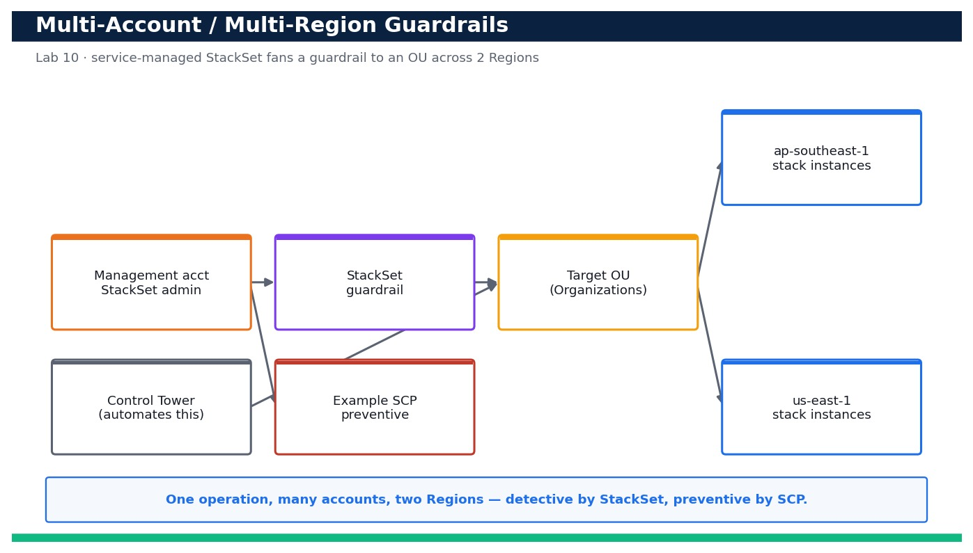
LAB 10 · DAY 2 · LO2 · HANDS-ON
Multi-Account, Multi-Region Guardrails with CloudFormation StackSets
LAB 10
Day 2 · LO2 · K3, A3
Scaling infrastructure to many accounts by hand does not work. In this lab you build a governance blueprint: using CloudFormation StackSets with AWS Organizations service-managed permissions, you deploy a detective …
YOU'LL BUILD
A StackSet (service-managed) that fans a guardrail stack out to an OU across two Regions in one operation, plus an example SCP that enforces the same guardrail preventively.
Tools: AWS CloudFormation StackSets, AWS Organizations, AWS Control Tower (concept)
Reference architecture
OUTCOME & EVIDENCE
Outcome: From the management account you deploy one guardrail stack to an entire OU across two Regions in a single StackSet operation (detective …
Evidence: list-stack-instances output showing the guardrail CURRENT in each account across both Regions.
DevOps Engineering on AWS · TGS-2023040474
© 2026 Tertiary Infotech Academy Pte Ltd
97
Notes:
Lab 10 overview — Design and deploy a multi-account, multi-Region guardrail using CloudFormation StackSets with AWS Organizations service-managed permissions, and express a preventive guardrail as an SCP (LO2, K3, A3).
Concept-led briefing only. The full detailed procedure, commands, expected outputs, validation and cleanup live in the Learner Guide and the lab README (not on the slides).
Reference architecture: course-generated diagram for Lab 10.
[Sources]
- AWS Certified DevOps Engineer – Professional (DOP-C02) Exam Guide (docs.aws.amazon.com/pdfs/aws-certification/latest/devops-engineer-professional-02).
- Legacy course deck: WSQ Master Trainer Slides — DevOps Engineering on AWS (v7).

Slide 99
DOMAIN RECAP
Recap — Configuration Management and IaC
• You can now: Author, validate and deploy a reusable VPC network baseline with CloudFormation and publish cross-stack exports (LO2, K3, A3)
• You can now: Deploy a parameterized application stack that consumes cross-stack exports and reuse it for dev and test via parameter files (LO2, K3, A3)
• You can now: Preview a stack modification safely with a change set before executing, then detect out-of-band drift and reconcile it (LO2, K3, A3)
• You can now: Externalize application configuration into SSM Parameter Store (String and SecureString), read it at runtime, and compare Parameter Store with Secrets Manager (LO2, K3, A3)
• You can now: Design and deploy a multi-account, multi-Region guardrail using CloudFormation StackSets with AWS Organizations service-managed permissions, and express a preventive guardrail as an SCP (LO2, K3, A3)
• Infrastructure as Code — Declare infrastructure in version-controlled templates so environments are repeatable, reviewable and disposable.
• CloudFormation — Declarative JSON/YAML stacks with parameters, mappings, outputs, change sets, drift detection and automatic rollback.
• Reusable components — Nested stacks and modules parameterise a pattern once and reuse it across teams and Regions.
DevOps Engineering on AWS · TGS-2023040474
© 2026 Tertiary Infotech Academy Pte Ltd
98
Notes:
Recap of Domain 02 — Configuration Management and IaC.
[Sources]
- AWS Certified DevOps Engineer – Professional (DOP-C02) Exam Guide (docs.aws.amazon.com/pdfs/aws-certification/latest/devops-engineer-professional-02).
- AWS CloudFormation Documentation (docs.aws.amazon.com/cloudformation).
- Legacy course deck: WSQ Master Trainer Slides — DevOps Engineering on AWS (v7).

Slide 100
03
DOMAIN 03
Resilient Cloud Solutions
Exam weighting 15% · High availability · scalability · automated recovery (RTO/RPO)
DevOps Engineering on AWS · TGS-2023040474
© 2026 Tertiary Infotech Academy Pte Ltd
99

Slide 101
DOMAIN 03 · WEIGHTING 15%
Key Concepts — Resilient Cloud Solutions
High availability
Spread compute across multiple Availability Zones behind an Elastic Load Balancer so one AZ failure is survivable.
Elasticity & Auto Scaling
Auto Scaling groups add and remove capacity on demand using target-tracking and step scaling policies.
1
2
Decoupling
SQS, SNS and EventBridge decouple producers from consumers so components fail and scale independently.
RTO & RPO
Recovery Time / Point Objectives drive the DR pattern: backup & restore, pilot light, warm standby or multi-site active/active.
3
4
Data durability
Multi-AZ RDS, DynamoDB global tables, S3 cross-Region replication and automated snapshots protect state.
Automated recovery
EC2 auto-recovery, ASG health checks and Route 53 health-check failover restore service without human action.
5
6
DevOps Engineering on AWS · TGS-2023040474
© 2026 Tertiary Infotech Academy Pte Ltd
100
Notes:
Key concepts for Domain 03 — Resilient Cloud Solutions.
High availability: Spread compute across multiple Availability Zones behind an Elastic Load Balancer so one AZ failure is survivable.
Elasticity & Auto Scaling: Auto Scaling groups add and remove capacity on demand using target-tracking and step scaling policies.
Decoupling: SQS, SNS and EventBridge decouple producers from consumers so components fail and scale independently.
RTO & RPO: Recovery Time / Point Objectives drive the DR pattern: backup & restore, pilot light, warm standby or multi-site active/active.
Data durability: Multi-AZ RDS, DynamoDB global tables, S3 cross-Region replication and automated snapshots protect state.
Automated recovery: EC2 auto-recovery, ASG health checks and Route 53 health-check failover restore service without human action.
[Sources]
- AWS Certified DevOps Engineer – Professional (DOP-C02) Exam Guide (docs.aws.amazon.com/pdfs/aws-certification/latest/devops-engineer-professional-02).
- AWS Well-Architected Framework (docs.aws.amazon.com/wellarchitected).
- Legacy course deck: WSQ Master Trainer Slides — DevOps Engineering on AWS (v7).

Slide 102
DOMAIN 03 · RESILIENCE
Highly Available, Auto-Scaling Architecture
Users
Route 53
DNS + health checks
Application
Load Balancer
AZ-A
EC2 (ASG)
Multi-AZ RDS
AZ-B
EC2 (ASG)
▶ Traffic spreads across two AZs behind the ALB; the Auto Scaling group self-heals and Multi-AZ RDS protects data.
DevOps Engineering on AWS · TGS-2023040474
© 2026 Tertiary Infotech Academy Pte Ltd
101
Notes:
Domain 03 deep dive — Resilient Cloud Solutions. Editable AWS-native diagram/table/chart.
[Sources]
- AWS Certified DevOps Engineer – Professional (DOP-C02) Exam Guide (docs.aws.amazon.com/pdfs/aws-certification/latest/devops-engineer-professional-02).
- AWS Well-Architected Framework (docs.aws.amazon.com/wellarchitected).
- Legacy course deck: WSQ Master Trainer Slides — DevOps Engineering on AWS (v7).

Slide 103
MEETING RTO / RPO
Disaster Recovery Strategies
Pattern
RTO
RPO
Cost
Backup & Restore
Hours
Hours
$
Pilot Light
10s of min
Minutes
$$
Warm Standby
Minutes
Seconds
$$$
Multi-site Active/Active
Near-zero
Near-zero
$$$$
DevOps Engineering on AWS · TGS-2023040474
© 2026 Tertiary Infotech Academy Pte Ltd
102
Notes:
Domain 03 deep dive — Resilient Cloud Solutions. Editable AWS-native diagram/table/chart.
[Sources]
- AWS Certified DevOps Engineer – Professional (DOP-C02) Exam Guide (docs.aws.amazon.com/pdfs/aws-certification/latest/devops-engineer-professional-02).
- AWS Well-Architected Framework (docs.aws.amazon.com/wellarchitected).
- Legacy course deck: WSQ Master Trainer Slides — DevOps Engineering on AWS (v7).

Slide 104
LOWER IS BETTER
DR Patterns — Approximate Recovery Time (RTO)
WHAT THE DATA SHOWS
As you move from backup/restore to active/active, RTO falls from hours to near-zero — at rising cost.
DevOps Engineering on AWS · TGS-2023040474
© 2026 Tertiary Infotech Academy Pte Ltd
103
Notes:
DR Patterns — Approximate Recovery Time (RTO). What the data shows: As you move from backup/restore to active/active, RTO falls from hours to near-zero — at rising cost.
Figures are illustrative teaching values to convey the relationship, not measured benchmarks.

Slide 105
DESIGN PRINCIPLES
Building for Resilience
Multi-AZ by default
Never depend on a single Availability Zone.
Elastic Load Balancing
Distribute traffic and route around unhealthy targets.
1
2
Auto Scaling
Match capacity to demand; replace failed instances automatically.
Decouple with queues
SQS / SNS / EventBridge let components fail independently.
3
4
DevOps Engineering on AWS · TGS-2023040474
© 2026 Tertiary Infotech Academy Pte Ltd
104
Notes:
Domain 03 deep dive — Resilient Cloud Solutions. Editable AWS-native diagram/table/chart.
[Sources]
- AWS Certified DevOps Engineer – Professional (DOP-C02) Exam Guide (docs.aws.amazon.com/pdfs/aws-certification/latest/devops-engineer-professional-02).
- AWS Well-Architected Framework (docs.aws.amazon.com/wellarchitected).
- Legacy course deck: WSQ Master Trainer Slides — DevOps Engineering on AWS (v7).

Slide 106
MATCHING CAPACITY TO DEMAND
Auto Scaling Policy Types
Policy
How it decides
Use when
Target tracking
Keep a metric at a target (e.g. 50% CPU)
Default, simplest
Step scaling
Add/remove capacity by alarm breach size
Fine-grained control
Scheduled
Scale at known times
Predictable traffic patterns
Predictive
ML forecasts demand ahead of time
Recurring cyclical load
DevOps Engineering on AWS · TGS-2023040474
© 2026 Tertiary Infotech Academy Pte Ltd
105
Notes:
Domain 03 deep dive — Resilient Cloud Solutions. Editable AWS-native diagram/table/chart.
[Sources]
- AWS Certified DevOps Engineer – Professional (DOP-C02) Exam Guide (docs.aws.amazon.com/pdfs/aws-certification/latest/devops-engineer-professional-02).
- AWS Well-Architected Framework (docs.aws.amazon.com/wellarchitected).
- Legacy course deck: WSQ Master Trainer Slides — DevOps Engineering on AWS (v7).

Slide 107
DISTRIBUTING TRAFFIC
Elastic Load Balancer Types
Type
Layer
Best for
Application LB (ALB)
HTTP/HTTPS (L7)
Web apps, path/host routing
Network LB (NLB)
TCP/UDP (L4)
Ultra-low latency, static IP
Gateway LB (GWLB)
L3 gateway
Inline security appliances
DevOps Engineering on AWS · TGS-2023040474
© 2026 Tertiary Infotech Academy Pte Ltd
106
Notes:
Domain 03 deep dive — Resilient Cloud Solutions. Editable AWS-native diagram/table/chart.
[Sources]
- AWS Certified DevOps Engineer – Professional (DOP-C02) Exam Guide (docs.aws.amazon.com/pdfs/aws-certification/latest/devops-engineer-professional-02).
- AWS Well-Architected Framework (docs.aws.amazon.com/wellarchitected).
- Legacy course deck: WSQ Master Trainer Slides — DevOps Engineering on AWS (v7).

Slide 108
DURABILITY & RECOVERY
Protecting Your Data
Multi-AZ RDS
Synchronous standby with automatic failover.
DynamoDB global tables
Multi-Region, active-active replication.
1
2
S3 cross-Region replication
Durable object copies in another Region.
Automated snapshots
Point-in-time recovery for RDS/EBS.
3
4
DevOps Engineering on AWS · TGS-2023040474
© 2026 Tertiary Infotech Academy Pte Ltd
107
Notes:
Domain 03 deep dive — Resilient Cloud Solutions. Editable AWS-native diagram/table/chart.
[Sources]
- AWS Certified DevOps Engineer – Professional (DOP-C02) Exam Guide (docs.aws.amazon.com/pdfs/aws-certification/latest/devops-engineer-professional-02).
- AWS Well-Architected Framework (docs.aws.amazon.com/wellarchitected).
- Legacy course deck: WSQ Master Trainer Slides — DevOps Engineering on AWS (v7).

Slide 109
IN DEPTH
High availability across Availability Zones
IN DEPTH
WHY IT MATTERS
Multi-AZ is the cheapest, highest-leverage resilience decision — most real outages are single-AZ or single-instance, both survivable.
• Availability Zones are physically isolated data centres within a Region with independent power, cooling and networking.
• Spreading compute across at least two AZs behind an Elastic Load Balancer lets the system survive a full AZ failure.
• Stateless application tiers make AZ-level redundancy trivial — any instance can serve any request.
FAILURE MODE
A single-AZ deployment, or a stateful session pinned to one instance, turns a routine hardware failure into a customer-visible outage.
TRADE-OFF / DECISION
Cross-AZ traffic incurs latency and data-transfer cost — a fair price for surviving an AZ loss.
DevOps Engineering on AWS · TGS-2023040474
© 2026 Tertiary Infotech Academy Pte Ltd
108
Notes:
High availability across Availability Zones.
Why it matters: Multi-AZ is the cheapest, highest-leverage resilience decision — most real outages are single-AZ or single-instance, both survivable.
Failure mode: A single-AZ deployment, or a stateful session pinned to one instance, turns a routine hardware failure into a customer-visible outage.
Trade-off: Cross-AZ traffic incurs latency and data-transfer cost — a fair price for surviving an AZ loss.
[Sources]
- AWS Certified DevOps Engineer – Professional (DOP-C02) Exam Guide (docs.aws.amazon.com/pdfs/aws-certification/latest/devops-engineer-professional-02).
- AWS Well-Architected Framework (docs.aws.amazon.com/wellarchitected).
- AWS Regions and AZs Documentation (docs.aws.amazon.com/AWSEC2/latest/UserGuide/using-regions-availability-zones.html).

Slide 110
IN DEPTH
Elasticity and Auto Scaling
IN DEPTH
WHY IT MATTERS
Elasticity matches cost to demand and provides self-healing — a terminated instance is silently replaced.
• Auto Scaling groups add and remove instances to match demand and replace unhealthy ones automatically.
• Target tracking holds a metric (e.g. 50% CPU) at target; step and scheduled policies handle spikes and known patterns; predictive scaling forecasts demand.
• Health checks (EC2 and ELB) let the group cull and replace bad instances without human action.
FAILURE MODE
Scaling on the wrong metric (CPU for an I/O-bound app) leaves you slow under load and over-provisioned when idle.
TRADE-OFF / DECISION
Aggressive scaling reacts fast but can thrash — tune cooldowns and warm-up so the group settles.
DevOps Engineering on AWS · TGS-2023040474
© 2026 Tertiary Infotech Academy Pte Ltd
109
Notes:
Elasticity and Auto Scaling.
Why it matters: Elasticity matches cost to demand and provides self-healing — a terminated instance is silently replaced.
Failure mode: Scaling on the wrong metric (CPU for an I/O-bound app) leaves you slow under load and over-provisioned when idle.
Trade-off: Aggressive scaling reacts fast but can thrash — tune cooldowns and warm-up so the group settles.
[Sources]
- AWS EC2 Auto Scaling Documentation (docs.aws.amazon.com/autoscaling).
- AWS Certified DevOps Engineer – Professional (DOP-C02) Exam Guide (docs.aws.amazon.com/pdfs/aws-certification/latest/devops-engineer-professional-02).
- AWS Well-Architected Framework (docs.aws.amazon.com/wellarchitected).

Slide 111
IN DEPTH
Load balancer types and when to use them
IN DEPTH
WHY IT MATTERS
Choosing the right layer-7 or layer-4 balancer shapes routing, TLS termination, latency and cost.
• Application Load Balancer routes HTTP/HTTPS with host/path rules and works well with containers and Lambda targets.
• Network Load Balancer handles TCP/UDP at ultra-low latency with static IPs.
• Gateway Load Balancer inserts inline security appliances transparently.
FAILURE MODE
Forcing an L7 ALB where you need raw TCP throughput or a static IP adds latency and misses the requirement.
TRADE-OFF / DECISION
ALB gives rich routing at higher per-request processing; NLB gives raw speed with fewer features.
DevOps Engineering on AWS · TGS-2023040474
© 2026 Tertiary Infotech Academy Pte Ltd
110
Notes:
Load balancer types and when to use them.
Why it matters: Choosing the right layer-7 or layer-4 balancer shapes routing, TLS termination, latency and cost.
Failure mode: Forcing an L7 ALB where you need raw TCP throughput or a static IP adds latency and misses the requirement.
Trade-off: ALB gives rich routing at higher per-request processing; NLB gives raw speed with fewer features.
[Sources]
- AWS Elastic Load Balancing Documentation (docs.aws.amazon.com/elasticloadbalancing).
- AWS Certified DevOps Engineer – Professional (DOP-C02) Exam Guide (docs.aws.amazon.com/pdfs/aws-certification/latest/devops-engineer-professional-02).

Slide 112
IN DEPTH
Decoupling with queues, topics and events
IN DEPTH
WHY IT MATTERS
Loose coupling converts synchronous, cascading failures into asynchronous backlogs the system can recover from.
• SQS buffers work between producers and consumers so a slow or failed consumer doesn't drop requests.
• SNS fans a message out to many subscribers; EventBridge routes events by content to many targets.
• Decoupled components fail and scale independently and absorb spikes as backlog rather than errors.
FAILURE MODE
A synchronous call chain means one slow downstream service ties up threads and cascades into a full outage.
TRADE-OFF / DECISION
Asynchronous designs add eventual-consistency and idempotency concerns — consumers must handle duplicates and out-of-order delivery.
DevOps Engineering on AWS · TGS-2023040474
© 2026 Tertiary Infotech Academy Pte Ltd
111
Notes:
Decoupling with queues, topics and events.
Why it matters: Loose coupling converts synchronous, cascading failures into asynchronous backlogs the system can recover from.
Failure mode: A synchronous call chain means one slow downstream service ties up threads and cascades into a full outage.
Trade-off: Asynchronous designs add eventual-consistency and idempotency concerns — consumers must handle duplicates and out-of-order delivery.
[Sources]
- AWS SQS Documentation (docs.aws.amazon.com/AWSSimpleQueueService).
- AWS EventBridge Documentation (docs.aws.amazon.com/eventbridge).
- AWS Well-Architected Framework (docs.aws.amazon.com/wellarchitected).

Slide 113
IN DEPTH
RTO and RPO drive the DR pattern
IN DEPTH
WHY IT MATTERS
Naming RTO/RPO turns 'make it resilient' into a concrete, testable and budgetable design target.
• Recovery Time Objective is how quickly you must restore service; Recovery Point Objective is how much data you can afford to lose.
• Backup & restore, pilot light, warm standby and multi-site active/active trade rising cost for falling RTO/RPO.
• The right pattern is a business decision priced against the cost of downtime.
FAILURE MODE
Buying active/active for a back-office app wastes money; choosing backup-and-restore for a payment system risks the business.
TRADE-OFF / DECISION
Lower RTO/RPO means more running (and paid-for) standby capacity — match spend to the revenue at risk.
DevOps Engineering on AWS · TGS-2023040474
© 2026 Tertiary Infotech Academy Pte Ltd
112
Notes:
RTO and RPO drive the DR pattern.
Why it matters: Naming RTO/RPO turns 'make it resilient' into a concrete, testable and budgetable design target.
Failure mode: Buying active/active for a back-office app wastes money; choosing backup-and-restore for a payment system risks the business.
Trade-off: Lower RTO/RPO means more running (and paid-for) standby capacity — match spend to the revenue at risk.
[Sources]
- AWS Disaster Recovery Documentation (docs.aws.amazon.com/whitepapers/latest/disaster-recovery-workloads-on-aws).
- AWS Certified DevOps Engineer – Professional (DOP-C02) Exam Guide (docs.aws.amazon.com/pdfs/aws-certification/latest/devops-engineer-professional-02).
- AWS Well-Architected Framework (docs.aws.amazon.com/wellarchitected).

Slide 114
IN DEPTH
Data durability and multi-Region protection
IN DEPTH
WHY IT MATTERS
Compute is replaceable; data is not — durable, recoverable state is the foundation everything else rebuilds on.
• Multi-AZ RDS keeps a synchronous standby with automatic failover; read replicas add scale and cross-Region copies.
• DynamoDB global tables replicate active-active across Regions; S3 offers cross-Region replication and eleven-nines durability.
• Automated snapshots and point-in-time recovery protect against data corruption and mistakes.
FAILURE MODE
A single-AZ database or un-tested backups mean the app tier can be perfectly redundant yet still lose the business's data.
TRADE-OFF / DECISION
Synchronous replication protects data but adds write latency; cross-Region copies add cost and lag.
DevOps Engineering on AWS · TGS-2023040474
© 2026 Tertiary Infotech Academy Pte Ltd
113
Notes:
Data durability and multi-Region protection.
Why it matters: Compute is replaceable; data is not — durable, recoverable state is the foundation everything else rebuilds on.
Failure mode: A single-AZ database or un-tested backups mean the app tier can be perfectly redundant yet still lose the business's data.
Trade-off: Synchronous replication protects data but adds write latency; cross-Region copies add cost and lag.
[Sources]
- AWS RDS Multi-AZ Documentation (docs.aws.amazon.com/AmazonRDS/latest/UserGuide/Concepts.MultiAZ.html).
- AWS DynamoDB global tables Documentation (docs.aws.amazon.com/amazondynamodb/latest/developerguide/GlobalTables.html).
- AWS Certified DevOps Engineer – Professional (DOP-C02) Exam Guide (docs.aws.amazon.com/pdfs/aws-certification/latest/devops-engineer-professional-02).

Slide 115
IN DEPTH
Automated recovery and self-healing
IN DEPTH
WHY IT MATTERS
Automating recovery shrinks MTTR toward zero for the common failures and frees humans for the novel ones.
• ASG health checks replace failed instances; EC2 auto-recovery restores impaired instances.
• Route 53 health checks fail traffic over to a healthy Region or endpoint.
• The goal is that routine failures are handled by the system, not by a pager.
FAILURE MODE
Manual failover runbooks that are never rehearsed fail exactly when you need them, under incident pressure.
TRADE-OFF / DECISION
Automated failover must guard against flapping and split-brain — tune thresholds and use health checks carefully.
DevOps Engineering on AWS · TGS-2023040474
© 2026 Tertiary Infotech Academy Pte Ltd
114
Notes:
Automated recovery and self-healing.
Why it matters: Automating recovery shrinks MTTR toward zero for the common failures and frees humans for the novel ones.
Failure mode: Manual failover runbooks that are never rehearsed fail exactly when you need them, under incident pressure.
Trade-off: Automated failover must guard against flapping and split-brain — tune thresholds and use health checks carefully.
[Sources]
- AWS Route 53 health checks Documentation (docs.aws.amazon.com/Route53/latest/DeveloperGuide/dns-failover.html).
- AWS Certified DevOps Engineer – Professional (DOP-C02) Exam Guide (docs.aws.amazon.com/pdfs/aws-certification/latest/devops-engineer-professional-02).
- AWS Well-Architected Framework (docs.aws.amazon.com/wellarchitected).

Slide 116
IN DEPTH
Designing for graceful degradation
IN DEPTH
WHY IT MATTERS
Graceful degradation keeps the most important user journeys working even when parts of the system are unhealthy.
• Under stress a resilient system sheds load, serves cached or default responses and protects its core function.
• Timeouts, retries with backoff and jitter, and circuit breakers stop failures from amplifying.
• Bulkheads isolate resources so one hot tenant or feature can't starve the rest.
FAILURE MODE
Unbounded retries during an incident create a retry storm that turns a brownout into a full outage.
TRADE-OFF / DECISION
Serving degraded responses reduces functionality temporarily to preserve availability — usually the right call.
DevOps Engineering on AWS · TGS-2023040474
© 2026 Tertiary Infotech Academy Pte Ltd
115
Notes:
Designing for graceful degradation.
Why it matters: Graceful degradation keeps the most important user journeys working even when parts of the system are unhealthy.
Failure mode: Unbounded retries during an incident create a retry storm that turns a brownout into a full outage.
Trade-off: Serving degraded responses reduces functionality temporarily to preserve availability — usually the right call.
[Sources]
- AWS Well-Architected Framework (docs.aws.amazon.com/wellarchitected).
- AWS Builders' Library Documentation (docs.aws.amazon.com/builders-library).
- AWS Certified DevOps Engineer – Professional (DOP-C02) Exam Guide (docs.aws.amazon.com/pdfs/aws-certification/latest/devops-engineer-professional-02).

Slide 117
PRICING RESILIENCE
Disaster Recovery Patterns — Cost vs Recovery
Pattern
RTO
RPO
Relative cost
Backup & Restore
Hours
Hours
$
Pilot Light
Tens of minutes
Minutes
$$
Warm Standby
Minutes
Seconds
$$$
Multi-site Active/Active
Near-zero
Near-zero
$$$$
DevOps Engineering on AWS · TGS-2023040474
© 2026 Tertiary Infotech Academy Pte Ltd
116
Notes:
Comparison — Disaster Recovery Patterns — Cost vs Recovery.
[Sources]
- AWS Disaster Recovery Documentation (docs.aws.amazon.com/whitepapers/latest/disaster-recovery-workloads-on-aws).
- AWS Certified DevOps Engineer – Professional (DOP-C02) Exam Guide (docs.aws.amazon.com/pdfs/aws-certification/latest/devops-engineer-professional-02).

Slide 118
WHY MULTI-AZ
Availability Math — Adding a Second AZ
WHAT THE DATA SHOWS
Most availability gain comes from the first jump to multi-AZ; multi-Region adds resilience against rare Region events at much higher cost.
DevOps Engineering on AWS · TGS-2023040474
© 2026 Tertiary Infotech Academy Pte Ltd
117
Notes:
Availability Math — Adding a Second AZ. What the data shows: Most availability gain comes from the first jump to multi-AZ; multi-Region adds resilience against rare Region events at much higher cost.
Figures are illustrative teaching values to convey the relationship, not measured benchmarks.
[Sources]
- AWS Well-Architected Framework (docs.aws.amazon.com/wellarchitected).
- AWS Certified DevOps Engineer – Professional (DOP-C02) Exam Guide (docs.aws.amazon.com/pdfs/aws-certification/latest/devops-engineer-professional-02).

Slide 119
ELASTICITY IN ACTION
Auto Scaling Under a Load Spike
WHAT THE DATA SHOWS
Target tracking follows demand up and back down, so capacity tracks load — you pay for peak only while the peak lasts.
DevOps Engineering on AWS · TGS-2023040474
© 2026 Tertiary Infotech Academy Pte Ltd
118
Notes:
Auto Scaling Under a Load Spike. What the data shows: Target tracking follows demand up and back down, so capacity tracks load — you pay for peak only while the peak lasts.
Figures are illustrative teaching values to convey the relationship, not measured benchmarks.
[Sources]
- AWS EC2 Auto Scaling Documentation (docs.aws.amazon.com/autoscaling).
- AWS Certified DevOps Engineer – Professional (DOP-C02) Exam Guide (docs.aws.amazon.com/pdfs/aws-certification/latest/devops-engineer-professional-02).

Slide 120
HOW 'HA' SYSTEMS STILL FALL OVER
Resilience Failure Modes & Anti-Patterns
Single-AZ database
App tier redundant, data tier isn't → Multi-AZ RDS / global tables.
Sticky in-memory sessions
One instance loss logs everyone out → externalise session state.
1
2
Retry storms
Unbounded retries amplify an outage → backoff + jitter + circuit breakers.
Untested failover
Runbook fails under pressure → game-days and automated failover.
3
4
Scaling on wrong metric
Slow under load, wasteful when idle → scale on the true constraint.
No health-check depth
LB routes to a process that's up but broken → deep health checks.
5
6
DevOps Engineering on AWS · TGS-2023040474
© 2026 Tertiary Infotech Academy Pte Ltd
119
Notes:
Resilience Failure Modes & Anti-Patterns.
Single-AZ database — App tier redundant, data tier isn't → Multi-AZ RDS / global tables.
Sticky in-memory sessions — One instance loss logs everyone out → externalise session state.
Retry storms — Unbounded retries amplify an outage → backoff + jitter + circuit breakers.
Untested failover — Runbook fails under pressure → game-days and automated failover.
Scaling on wrong metric — Slow under load, wasteful when idle → scale on the true constraint.
No health-check depth — LB routes to a process that's up but broken → deep health checks.
[Sources]
- AWS Well-Architected Framework (docs.aws.amazon.com/wellarchitected).
- AWS Certified DevOps Engineer – Professional (DOP-C02) Exam Guide (docs.aws.amazon.com/pdfs/aws-certification/latest/devops-engineer-professional-02).

Slide 121
PROVEN PRACTICES
Resilience Patterns Worth Adopting
Multi-AZ by default
Never depend on a single Availability Zone.
Stateless tiers
Push state to RDS/DynamoDB/ElastiCache so any instance is disposable.
1
2
Backoff with jitter
Spread retries to avoid synchronised load.
Circuit breaker
Stop calling a failing dependency; fail fast and recover.
3
4
Health-check failover
Route 53 / ELB route around unhealthy targets.
Game-days
Rehearse failure so recovery is routine, not heroic.
5
6
DevOps Engineering on AWS · TGS-2023040474
© 2026 Tertiary Infotech Academy Pte Ltd
120
Notes:
Resilience Patterns Worth Adopting.
Multi-AZ by default — Never depend on a single Availability Zone.
Stateless tiers — Push state to RDS/DynamoDB/ElastiCache so any instance is disposable.
Backoff with jitter — Spread retries to avoid synchronised load.
Circuit breaker — Stop calling a failing dependency; fail fast and recover.
Health-check failover — Route 53 / ELB route around unhealthy targets.
Game-days — Rehearse failure so recovery is routine, not heroic.
[Sources]
- AWS Well-Architected Framework (docs.aws.amazon.com/wellarchitected).
- AWS Builders' Library Documentation (docs.aws.amazon.com/builders-library).

Slide 122
MATCH SPEND TO RISK
Architecture Decision — Which DR Pattern?
A
Backup & Restore
B
Pilot Light / Warm Standby
C
Multi-site Active/Active
Non-critical or easily rebuilt workloads. Cheapest — but recovery takes hours and loses recent data.
Important workloads needing minutes-scale recovery. A scaled-down copy runs ready to promote — moderate standing cost.
Revenue-critical systems that can't be down. Near-zero RTO/RPO — at roughly double the running cost and real complexity.
DevOps Engineering on AWS · TGS-2023040474
© 2026 Tertiary Infotech Academy Pte Ltd
121
Notes:
Architecture Decision — Which DR Pattern?.
Option A — Backup & Restore: Non-critical or easily rebuilt workloads. Cheapest — but recovery takes hours and loses recent data.
Option B — Pilot Light / Warm Standby: Important workloads needing minutes-scale recovery. A scaled-down copy runs ready to promote — moderate standing cost.
Option C — Multi-site Active/Active: Revenue-critical systems that can't be down. Near-zero RTO/RPO — at roughly double the running cost and real complexity.
[Sources]
- AWS Disaster Recovery Documentation (docs.aws.amazon.com/whitepapers/latest/disaster-recovery-workloads-on-aws).
- AWS Certified DevOps Engineer – Professional (DOP-C02) Exam Guide (docs.aws.amazon.com/pdfs/aws-certification/latest/devops-engineer-professional-02).

Slide 123
DESIGNING FOR AZ LOSS
Scenario — Surviving an Availability Zone outage
SITUATION
An AZ becomes impaired. Half the fleet is there, and the primary database node runs in it.
ANALYSIS
• Because compute is stateless behind an ALB across two AZs, the load balancer simply stops routing to the failed AZ.
• The Auto Scaling group launches replacement instances in the healthy AZ to restore capacity.
• Multi-AZ RDS fails over to the synchronous standby in the other AZ automatically.
DECISION
No human action is required for the common case — the design absorbs an AZ loss. Confirm capacity headroom so the healthy AZ can carry full load during the event.
DevOps Engineering on AWS · TGS-2023040474
© 2026 Tertiary Infotech Academy Pte Ltd
122
Notes:
Scenario: An AZ becomes impaired. Half the fleet is there, and the primary database node runs in it.
Because compute is stateless behind an ALB across two AZs, the load balancer simply stops routing to the failed AZ.
The Auto Scaling group launches replacement instances in the healthy AZ to restore capacity.
Multi-AZ RDS fails over to the synchronous standby in the other AZ automatically.
Decision: No human action is required for the common case — the design absorbs an AZ loss. Confirm capacity headroom so the healthy AZ can carry full load during the event.
[Sources]
- AWS Well-Architected Framework (docs.aws.amazon.com/wellarchitected).
- AWS RDS Multi-AZ Documentation (docs.aws.amazon.com/AmazonRDS/latest/UserGuide/Concepts.MultiAZ.html).

Slide 124
ELASTICITY UNDER PRESSURE
Scenario — A Black-Friday traffic spike
SITUATION
Traffic will rise 6x for a few hours during a sale, then return to normal.
ANALYSIS
• Fixed capacity sized for the peak wastes money the other 360 days; sized for normal, it falls over during the sale.
• Scheduled scaling pre-warms capacity just before the known event; target tracking then follows real demand.
• Decoupling checkout with SQS lets bursts queue instead of failing when a downstream service saturates.
DECISION
Combine scheduled pre-scaling for the known start time with target-tracking for the actual curve, and buffer spiky writes through a queue so load is absorbed as backlog.
DevOps Engineering on AWS · TGS-2023040474
© 2026 Tertiary Infotech Academy Pte Ltd
123
Notes:
Scenario: Traffic will rise 6x for a few hours during a sale, then return to normal.
Fixed capacity sized for the peak wastes money the other 360 days; sized for normal, it falls over during the sale.
Scheduled scaling pre-warms capacity just before the known event; target tracking then follows real demand.
Decoupling checkout with SQS lets bursts queue instead of failing when a downstream service saturates.
Decision: Combine scheduled pre-scaling for the known start time with target-tracking for the actual curve, and buffer spiky writes through a queue so load is absorbed as backlog.
[Sources]
- AWS EC2 Auto Scaling Documentation (docs.aws.amazon.com/autoscaling).
- AWS SQS Documentation (docs.aws.amazon.com/AWSSimpleQueueService).

Slide 125
FROM SLA TO ARCHITECTURE
Worked Analysis — Reading an RTO/RPO Requirement
'Restore within 15 minutes' (RTO)
Rules out backup & restore (hours). Warm standby or pilot light needed.
'Lose at most a few seconds' (RPO)
Requires synchronous or near-real-time replication — Multi-AZ RDS or global tables.
'Survive a Region event'
Forces a cross-Region strategy, not just multi-AZ.
Budget is limited
Pilot light: minimal always-on footprint, scaled up on failover — a pragmatic middle.
TAKEAWAY
Each phrase in the requirement eliminates patterns until one fits — resilience design is requirement-driven, not taste-driven.
DevOps Engineering on AWS · TGS-2023040474
© 2026 Tertiary Infotech Academy Pte Ltd
124
Notes:
Worked Analysis — Reading an RTO/RPO Requirement.
'Restore within 15 minutes' (RTO) — Rules out backup & restore (hours). Warm standby or pilot light needed.
'Lose at most a few seconds' (RPO) — Requires synchronous or near-real-time replication — Multi-AZ RDS or global tables.
'Survive a Region event' — Forces a cross-Region strategy, not just multi-AZ.
Budget is limited — Pilot light: minimal always-on footprint, scaled up on failover — a pragmatic middle.
Takeaway: Each phrase in the requirement eliminates patterns until one fits — resilience design is requirement-driven, not taste-driven.
[Sources]
- AWS Disaster Recovery Documentation (docs.aws.amazon.com/whitepapers/latest/disaster-recovery-workloads-on-aws).
- AWS Certified DevOps Engineer – Professional (DOP-C02) Exam Guide (docs.aws.amazon.com/pdfs/aws-certification/latest/devops-engineer-professional-02).

Slide 126
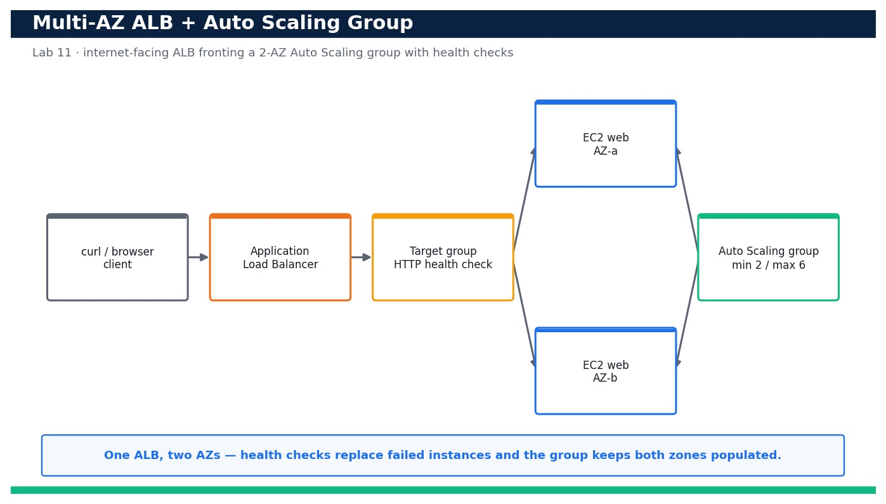
LAB 11 · DAY 3 · LO3 · HANDS-ON
Deploy a Multi-AZ Application Load Balancer with an Auto Scaling Group
LAB 11
Day 3 · LO3 · K2, K4, A2
A single instance in a single Availability Zone is a single point of failure. In this lab you codify a highly available web tier as one CloudFormation template: an internet-facing Application Load …
YOU'LL BUILD
A running multi-AZ stack — an ALB, a target group with health checks, a launch template and an Auto Scaling group (min 2 / max 6) spread across two AZs — whose DNS name serves traffic from instances in both AZs.
Tools: Amazon EC2, Elastic Load Balancing (ELBv2 / ALB), AWS Auto Scaling, AWS CloudFormation
Reference architecture
OUTCOME & EVIDENCE
Outcome: Curling the ALB DNS name 20 times returns responses from two distinct instances located in two different Availability Zones, target health …
Evidence: describe-stacks output showing stack ha-web at CREATE_COMPLETE with AlbDnsName and AsgName in the Outputs.
DevOps Engineering on AWS · TGS-2023040474
© 2026 Tertiary Infotech Academy Pte Ltd
125
Notes:
Lab 11 overview — Deploy a highly available multi-AZ Application Load Balancer fronting an Auto Scaling group and prove requests are served from both Availability Zones (LO3, K2, K4, A2).
Concept-led briefing only. The full detailed procedure, commands, expected outputs, validation and cleanup live in the Learner Guide and the lab README (not on the slides).
Reference architecture: course-generated diagram for Lab 11.
[Sources]
- AWS Certified DevOps Engineer – Professional (DOP-C02) Exam Guide (docs.aws.amazon.com/pdfs/aws-certification/latest/devops-engineer-professional-02).
- Legacy course deck: WSQ Master Trainer Slides — DevOps Engineering on AWS (v7).

Slide 127
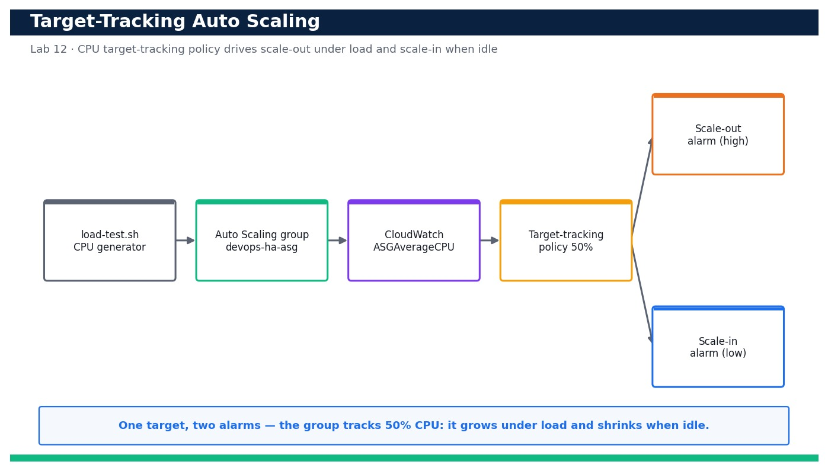
LAB 12 · DAY 3 · LO3 · HANDS-ON
Attach Target-Tracking Auto Scaling and Validate Scale-Out Under Load
LAB 12
Day 3 · LO3 · K2, K4, A2
A static two-instance web tier survives an AZ failure but not a traffic spike. In this lab you attach a target-tracking scaling policy that keeps average CPU at 50% to the Auto Scaling group you built in Lab 11, generate CPU load on the instances, and watch CloudWatch alarms trip and the group scale out. When the …
YOU'LL BUILD
A target-tracking scaling policy (50% average CPU) on devops-ha-asg with its two auto-created CloudWatch alarms, plus a repeatable load test that drives observable scale-out and scale-in.
Tools: AWS Auto Scaling, Amazon CloudWatch, Amazon EC2
Reference architecture
OUTCOME & EVIDENCE
Outcome: Under generated CPU load the AlarmHigh trips, the group scales out above two instances, and when the load stops the AlarmLow trips and …
Evidence: describe-policies output showing cpu-target-tracking-50 attached with TargetValue 50.0.
DevOps Engineering on AWS · TGS-2023040474
© 2026 Tertiary Infotech Academy Pte Ltd
126
Notes:
Lab 12 overview — Attach a target-tracking scaling policy to an Auto Scaling group and validate automatic scale-out under generated load and scale-in when the load stops (LO3, K2, K4, A2).
Concept-led briefing only. The full detailed procedure, commands, expected outputs, validation and cleanup live in the Learner Guide and the lab README (not on the slides).
Reference architecture: course-generated diagram for Lab 12.
[Sources]
- AWS Certified DevOps Engineer – Professional (DOP-C02) Exam Guide (docs.aws.amazon.com/pdfs/aws-certification/latest/devops-engineer-professional-02).
- Legacy course deck: WSQ Master Trainer Slides — DevOps Engineering on AWS (v7).

Slide 128
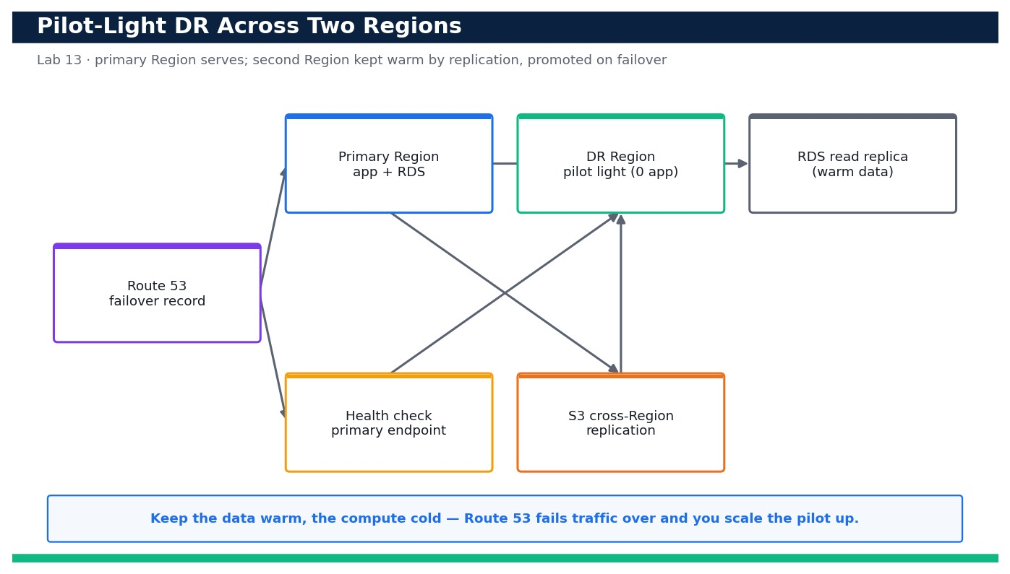
LAB 13 · DAY 3 · LO3 · HANDS-ON
Select a DR Strategy by RTO/RPO and Implement a Pilot-Light Skeleton
LAB 13
Day 3 · LO3 · K2, K4, A2
Not every workload needs active-active — and not every business can accept a day-long restore. In this lab you complete an RTO/RPO worksheet, compare the four AWS DR …
YOU'LL BUILD
A completed DR selection worksheet plus a deployed pilot-light skeleton in a second Region (minimal VPC, a scaled-to-zero app tier and an S3 cross-Region replication path) fronted by a Route 53 failover record set.
Tools: Amazon Route 53, Amazon RDS, AWS CloudFormation, Amazon S3 (Cross-Region Replication)
Reference architecture
OUTCOME & EVIDENCE
Outcome: A test object uploaded to the primary bucket appears in the DR Region bucket (data is warm), and the DR Auto Scaling group can be …
Evidence: The completed dr-plan.md worksheet showing the workload RTO/RPO and the justified strategy choice.
DevOps Engineering on AWS · TGS-2023040474
© 2026 Tertiary Infotech Academy Pte Ltd
127
Notes:
Lab 13 overview — Compare the four AWS disaster-recovery strategies against RTO/RPO targets, select an appropriate pattern, and implement a pilot-light skeleton in a second Region (LO3, K2, K4, A2).
Concept-led briefing only. The full detailed procedure, commands, expected outputs, validation and cleanup live in the Learner Guide and the lab README (not on the slides).
Reference architecture: course-generated diagram for Lab 13.
[Sources]
- AWS Certified DevOps Engineer – Professional (DOP-C02) Exam Guide (docs.aws.amazon.com/pdfs/aws-certification/latest/devops-engineer-professional-02).
- Legacy course deck: WSQ Master Trainer Slides — DevOps Engineering on AWS (v7).

Slide 129
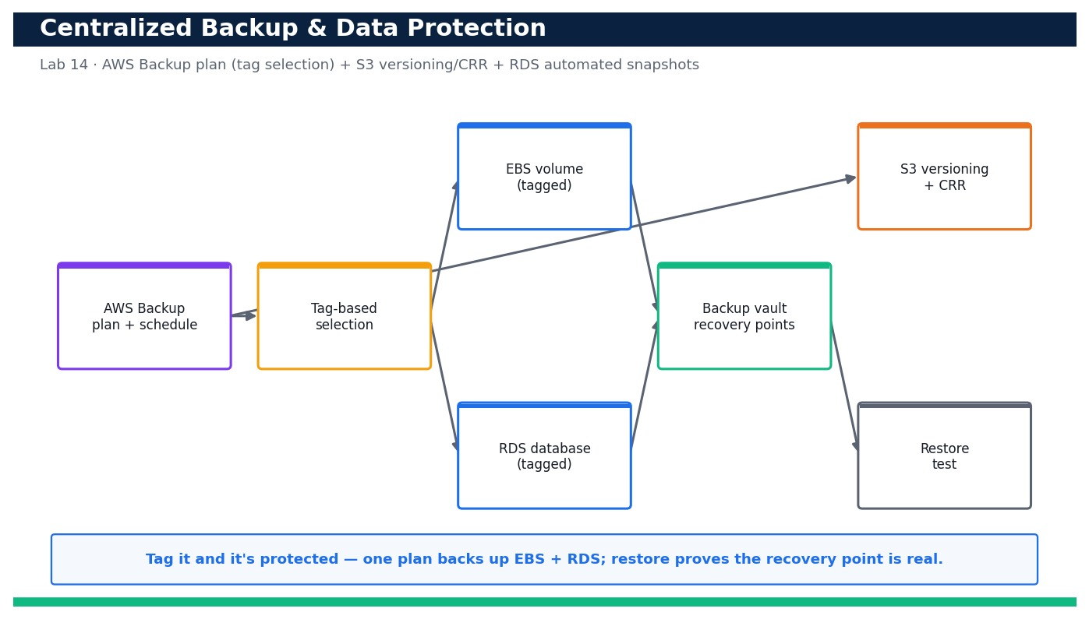
LAB 14 · DAY 3 · LO3 · HANDS-ON
Automate Backup, Restore and Data Protection with AWS Backup
LAB 14
Day 3 · LO3 · K2, K4, A2
Resilience is not only about staying up — it is about getting your data back. In this lab you build a centralized AWS Backup plan with a scheduled rule and a tag-based resource selection so every tagged EBS volume and RDS database is backed up automatically. You then run an on-demand backup, restore …
YOU'LL BUILD
An AWS Backup plan with a tag-based selection protecting EBS and RDS, a verified restore from a recovery point, plus S3 versioning + cross-Region replication and RDS automated snapshots enabled.
Tools: AWS Backup, Amazon RDS, Amazon S3, Amazon EBS
Reference architecture
OUTCOME & EVIDENCE
Outcome: An on-demand backup produces a COMPLETED recovery point that restores cleanly into a new EBS volume, S3 retains multiple object …
Evidence: get-backup-plan output showing devops-daily-plan with its daily rule and 35-day lifecycle.
DevOps Engineering on AWS · TGS-2023040474
© 2026 Tertiary Infotech Academy Pte Ltd
128
Notes:
Lab 14 overview — Automate centralized backups with AWS Backup (plan + tag-based selection), test a restore, and add S3 versioning with cross-Region replication and RDS automated snapshots for defense in depth (LO3, K2, K4, A2).
Concept-led briefing only. The full detailed procedure, commands, expected outputs, validation and cleanup live in the Learner Guide and the lab README (not on the slides).
Reference architecture: course-generated diagram for Lab 14.
[Sources]
- AWS Certified DevOps Engineer – Professional (DOP-C02) Exam Guide (docs.aws.amazon.com/pdfs/aws-certification/latest/devops-engineer-professional-02).
- Legacy course deck: WSQ Master Trainer Slides — DevOps Engineering on AWS (v7).

Slide 130
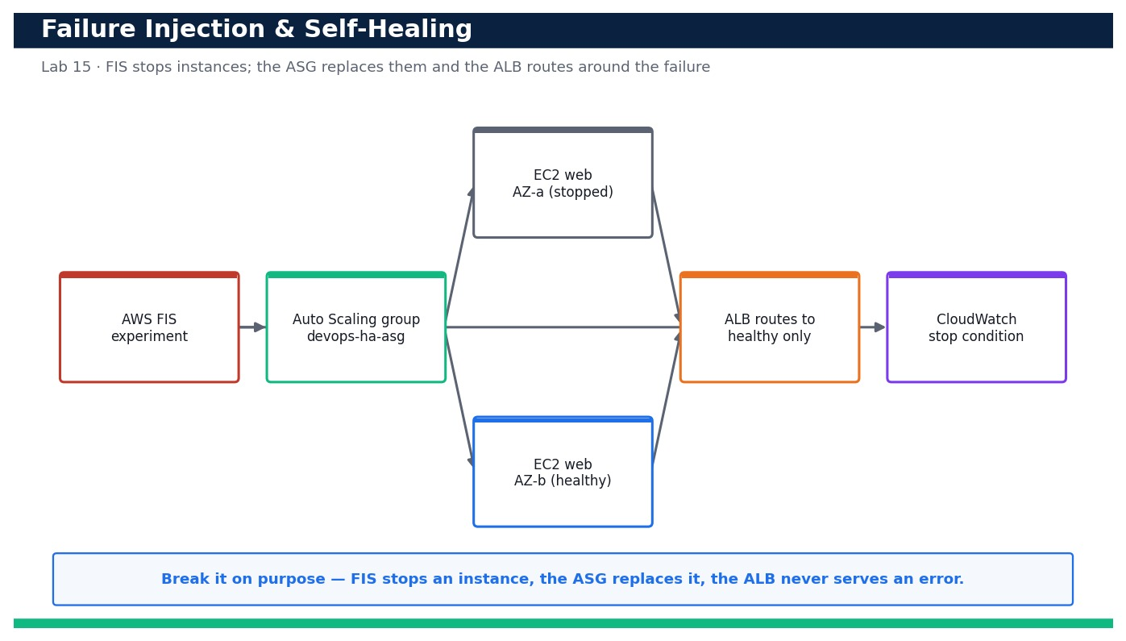
LAB 15 · DAY 3 · LO3 · HANDS-ON
Inject Failure and Verify Self-Healing with AWS FIS
LAB 15
Day 3 · LO3 · K2, K4, A2
A resilient design is only proven when you break it on purpose. In this lab you first terminate an instance manually and watch the Auto Scaling group launch a replacement to restore …
YOU'LL BUILD
A verified self-healing web tier: a manual instance termination is auto-replaced by the Auto Scaling group, and an AWS FIS experiment stops instances while the ALB continues to serve traffic with zero errors.
Tools: AWS Fault Injection Service (FIS), AWS Auto Scaling, Amazon EC2, Amazon CloudWatch
Reference architecture
OUTCOME & EVIDENCE
Outcome: Terminating an instance and running a FIS stop-instances experiment both leave the ALB serving HTTP 200 with zero sustained 5XX …
Evidence: describe-scaling-activities output showing a successful 'Launching a new EC2 instance' after the manual termination.
DevOps Engineering on AWS · TGS-2023040474
© 2026 Tertiary Infotech Academy Pte Ltd
129
Notes:
Lab 15 overview — Prove the multi-AZ tier self-heals by terminating an instance and watching the Auto Scaling group replace it, then run an AWS FIS experiment and confirm the ALB routes around the impaired instances (LO3, K2, K4, A2).
Concept-led briefing only. The full detailed procedure, commands, expected outputs, validation and cleanup live in the Learner Guide and the lab README (not on the slides).
Reference architecture: course-generated diagram for Lab 15.
[Sources]
- AWS Certified DevOps Engineer – Professional (DOP-C02) Exam Guide (docs.aws.amazon.com/pdfs/aws-certification/latest/devops-engineer-professional-02).
- Legacy course deck: WSQ Master Trainer Slides — DevOps Engineering on AWS (v7).

Slide 131
DOMAIN RECAP
Recap — Resilient Cloud Solutions
• You can now: Deploy a highly available multi-AZ Application Load Balancer fronting an Auto Scaling group and prove requests are served from both Availability Zones (LO3, K2, K4, A2)
• You can now: Attach a target-tracking scaling policy to an Auto Scaling group and validate automatic scale-out under generated load and scale-in when the load stops (LO3, K2, K4, A2)
• You can now: Compare the four AWS disaster-recovery strategies against RTO/RPO targets, select an appropriate pattern, and implement a pilot-light skeleton in a second Region (LO3, K2, K4, A2)
• You can now: Automate centralized backups with AWS Backup (plan + tag-based selection), test a restore, and add S3 versioning with cross-Region replication and RDS automated snapshots for defense in depth (LO3, K2, K4, A2)
• You can now: Prove the multi-AZ tier self-heals by terminating an instance and watching the Auto Scaling group replace it, then run an AWS FIS experiment and confirm the ALB routes around the impaired instances (LO3, K2, K4, A2)
• High availability — Spread compute across multiple Availability Zones behind an Elastic Load Balancer so one AZ failure is survivable.
• Elasticity & Auto Scaling — Auto Scaling groups add and remove capacity on demand using target-tracking and step scaling policies.
• Decoupling — SQS, SNS and EventBridge decouple producers from consumers so components fail and scale independently.
DevOps Engineering on AWS · TGS-2023040474
© 2026 Tertiary Infotech Academy Pte Ltd
130
Notes:
Recap of Domain 03 — Resilient Cloud Solutions.
[Sources]
- AWS Certified DevOps Engineer – Professional (DOP-C02) Exam Guide (docs.aws.amazon.com/pdfs/aws-certification/latest/devops-engineer-professional-02).
- AWS Well-Architected Framework (docs.aws.amazon.com/wellarchitected).
- Legacy course deck: WSQ Master Trainer Slides — DevOps Engineering on AWS (v7).

Slide 132
04
DOMAIN 04
Monitoring and Logging
Exam weighting 15% · Metrics · logs · dashboards · alarms · automated event management
DevOps Engineering on AWS · TGS-2023040474
© 2026 Tertiary Infotech Academy Pte Ltd
131

Slide 133

RESILIENCE & OBSERVABILITY
Monitoring and Logging
▶ Resilience and observability working together to keep services healthy
DevOps Engineering on AWS · TGS-2023040474
© 2026 Tertiary Infotech Academy Pte Ltd
132
Notes:
Resilience and observability working together to keep services healthy
Illustration created for this course with AI image generation (ImageGen).
[Sources]
- Legacy course deck: WSQ Master Trainer Slides — DevOps Engineering on AWS (v7).

Slide 134
DOMAIN 04 · WEIGHTING 15%
Key Concepts — Monitoring and Logging
CloudWatch metrics
Namespaces, dimensions and custom metrics measure system and application health over time.
CloudWatch Logs
Log groups, streams, subscription filters and metric filters turn raw logs into searchable, alertable signals.
1
2
Dashboards
A single pane of glass correlates metrics, logs and alarms for fast troubleshooting.
Alarms & composite alarms
Thresholds and anomaly detection notify SNS or trigger auto-remediation before users are affected.
3
4
Tracing & insights
X-Ray traces distributed requests; CloudWatch Logs Insights and Container/Lambda Insights find the root cause.
Aggregation at scale
Cross-account observability, the CloudWatch agent and OpenTelemetry centralise telemetry from many sources.
5
6
DevOps Engineering on AWS · TGS-2023040474
© 2026 Tertiary Infotech Academy Pte Ltd
133
Notes:
Key concepts for Domain 04 — Monitoring and Logging.
CloudWatch metrics: Namespaces, dimensions and custom metrics measure system and application health over time.
CloudWatch Logs: Log groups, streams, subscription filters and metric filters turn raw logs into searchable, alertable signals.
Dashboards: A single pane of glass correlates metrics, logs and alarms for fast troubleshooting.
Alarms & composite alarms: Thresholds and anomaly detection notify SNS or trigger auto-remediation before users are affected.
Tracing & insights: X-Ray traces distributed requests; CloudWatch Logs Insights and Container/Lambda Insights find the root cause.
Aggregation at scale: Cross-account observability, the CloudWatch agent and OpenTelemetry centralise telemetry from many sources.
[Sources]
- AWS Certified DevOps Engineer – Professional (DOP-C02) Exam Guide (docs.aws.amazon.com/pdfs/aws-certification/latest/devops-engineer-professional-02).
- AWS CloudWatch Documentation (docs.aws.amazon.com/AmazonCloudWatch).
- Legacy course deck: WSQ Master Trainer Slides — DevOps Engineering on AWS (v7).

Slide 135
DOMAIN 04 · OBSERVABILITY
Monitoring & Logging Pipeline
App + EC2
CloudWatch agent
CloudWatch Logs
log groups
Metric Filters
/ Logs Insights
Dashboards
CloudWatch Metrics
+ custom metrics
Alarms
SNS notify
▶ Logs and metrics feed dashboards and alarms; alarms notify SNS and trigger the incident response in Domain 05.
DevOps Engineering on AWS · TGS-2023040474
© 2026 Tertiary Infotech Academy Pte Ltd
134
Notes:
Domain 04 deep dive — Monitoring and Logging. Editable AWS-native diagram/table/chart.
[Sources]
- AWS Certified DevOps Engineer – Professional (DOP-C02) Exam Guide (docs.aws.amazon.com/pdfs/aws-certification/latest/devops-engineer-professional-02).
- AWS CloudWatch Documentation (docs.aws.amazon.com/AmazonCloudWatch).
- Legacy course deck: WSQ Master Trainer Slides — DevOps Engineering on AWS (v7).

Slide 136
KNOW YOUR SIGNALS
The Three Pillars of Observability
Metrics
Numeric time-series — CPU, latency, error rate, request count.
Logs
Event records — application, system and access logs in CloudWatch Logs.
1
2
Traces
Request paths across services with AWS X-Ray.
Dashboards & alarms
Correlate all three; alarm on anomalies before users notice.
3
4
DevOps Engineering on AWS · TGS-2023040474
© 2026 Tertiary Infotech Academy Pte Ltd
135
Notes:
Domain 04 deep dive — Monitoring and Logging. Editable AWS-native diagram/table/chart.
[Sources]
- AWS Certified DevOps Engineer – Professional (DOP-C02) Exam Guide (docs.aws.amazon.com/pdfs/aws-certification/latest/devops-engineer-professional-02).
- AWS CloudWatch Documentation (docs.aws.amazon.com/AmazonCloudWatch).
- Legacy course deck: WSQ Master Trainer Slides — DevOps Engineering on AWS (v7).

Slide 137
READING THE SIGNALS
Alarm Thresholds — Healthy vs Incident
WHAT THE DATA SHOWS
When p90 latency crosses the alarm threshold, CloudWatch fires and the automated response kicks in.
DevOps Engineering on AWS · TGS-2023040474
© 2026 Tertiary Infotech Academy Pte Ltd
136
Notes:
Alarm Thresholds — Healthy vs Incident. What the data shows: When p90 latency crosses the alarm threshold, CloudWatch fires and the automated response kicks in.
Figures are illustrative teaching values to convey the relationship, not measured benchmarks.

Slide 138
THE METRICS MODEL
Anatomy of CloudWatch
Namespaces
Group metrics by service (AWS/EC2, custom app namespaces).
Dimensions
Name/value pairs that identify a metric (InstanceId, etc.).
1
2
Statistics & periods
Aggregate over time — Average, Sum, p90, p99.
Alarms & composite
Trigger on thresholds or anomaly detection; combine with AND/OR.
3
4
DevOps Engineering on AWS · TGS-2023040474
© 2026 Tertiary Infotech Academy Pte Ltd
137
Notes:
Domain 04 deep dive — Monitoring and Logging. Editable AWS-native diagram/table/chart.
[Sources]
- AWS Certified DevOps Engineer – Professional (DOP-C02) Exam Guide (docs.aws.amazon.com/pdfs/aws-certification/latest/devops-engineer-professional-02).
- AWS CloudWatch Documentation (docs.aws.amazon.com/AmazonCloudWatch).
- Legacy course deck: WSQ Master Trainer Slides — DevOps Engineering on AWS (v7).

Slide 139
TURNING LOGS INTO SIGNALS
The Logs-to-Action Pipeline
1
2
3
4
5
6
▶
▶
▶
▶
▶
CloudWatch agent
collects
Log group
stores
Metric filter
extracts
Metric
published
Alarm
evaluates
SNS / action
notifies
DevOps Engineering on AWS · TGS-2023040474
© 2026 Tertiary Infotech Academy Pte Ltd
138
Notes:
Domain 04 deep dive — Monitoring and Logging. Editable AWS-native diagram/table/chart.
[Sources]
- AWS Certified DevOps Engineer – Professional (DOP-C02) Exam Guide (docs.aws.amazon.com/pdfs/aws-certification/latest/devops-engineer-professional-02).
- AWS CloudWatch Documentation (docs.aws.amazon.com/AmazonCloudWatch).
- Legacy course deck: WSQ Master Trainer Slides — DevOps Engineering on AWS (v7).

Slide 140
DEEPER TROUBLESHOOTING
CloudWatch Insights Tools
Tool
What it shows
Logs Insights
Query and analyse log data with a purpose-built language
Container Insights
Metrics & logs for ECS/EKS/Fargate
Lambda Insights
Performance & cold-start metrics for functions
AWS X-Ray
Distributed traces across microservices
DevOps Engineering on AWS · TGS-2023040474
© 2026 Tertiary Infotech Academy Pte Ltd
139
Notes:
Domain 04 deep dive — Monitoring and Logging. Editable AWS-native diagram/table/chart.
[Sources]
- AWS Certified DevOps Engineer – Professional (DOP-C02) Exam Guide (docs.aws.amazon.com/pdfs/aws-certification/latest/devops-engineer-professional-02).
- AWS CloudWatch Documentation (docs.aws.amazon.com/AmazonCloudWatch).
- Legacy course deck: WSQ Master Trainer Slides — DevOps Engineering on AWS (v7).

Slide 141
IN DEPTH
The three pillars — metrics, logs, traces
IN DEPTH
WHY IT MATTERS
Each pillar answers a different question — 'is it broken?', 'why?', and 'where?' — and you need all three to troubleshoot fast.
• Metrics are cheap numeric time-series for trends and alarms; logs are detailed event records for context; traces follow one request across services.
• CloudWatch provides metrics and logs; X-Ray provides distributed traces.
• You alarm on metrics, investigate with logs, and localise with traces.
FAILURE MODE
Logging everything but graphing nothing leaves you searching text during an outage instead of seeing the problem at a glance.
TRADE-OFF / DECISION
High-cardinality metrics and verbose logs cost money and can slow queries — sample and aggregate deliberately.
DevOps Engineering on AWS · TGS-2023040474
© 2026 Tertiary Infotech Academy Pte Ltd
140
Notes:
The three pillars — metrics, logs, traces.
Why it matters: Each pillar answers a different question — 'is it broken?', 'why?', and 'where?' — and you need all three to troubleshoot fast.
Failure mode: Logging everything but graphing nothing leaves you searching text during an outage instead of seeing the problem at a glance.
Trade-off: High-cardinality metrics and verbose logs cost money and can slow queries — sample and aggregate deliberately.
[Sources]
- AWS CloudWatch Documentation (docs.aws.amazon.com/AmazonCloudWatch).
- AWS X-Ray Documentation (docs.aws.amazon.com/xray).
- AWS Certified DevOps Engineer – Professional (DOP-C02) Exam Guide (docs.aws.amazon.com/pdfs/aws-certification/latest/devops-engineer-professional-02).

Slide 142
IN DEPTH
CloudWatch metrics model — namespaces, dimensions, statistics
IN DEPTH
WHY IT MATTERS
Understanding dimensions and percentiles is what separates 'average looks fine' from seeing the p99 pain real users feel.
• Metrics live in namespaces (AWS/EC2, custom app namespaces) and are identified by dimensions such as InstanceId.
• Statistics (Average, Sum, p90, p99) and periods aggregate raw data points over time.
• Custom and high-resolution metrics capture application-level signals AWS can't see.
FAILURE MODE
Alarming on Average hides tail latency — the average is healthy while your slowest 1% of users are timing out.
TRADE-OFF / DECISION
Percentiles and high-resolution metrics cost more but reveal problems averages mask.
DevOps Engineering on AWS · TGS-2023040474
© 2026 Tertiary Infotech Academy Pte Ltd
141
Notes:
CloudWatch metrics model — namespaces, dimensions, statistics.
Why it matters: Understanding dimensions and percentiles is what separates 'average looks fine' from seeing the p99 pain real users feel.
Failure mode: Alarming on Average hides tail latency — the average is healthy while your slowest 1% of users are timing out.
Trade-off: Percentiles and high-resolution metrics cost more but reveal problems averages mask.
[Sources]
- AWS CloudWatch metrics Documentation (docs.aws.amazon.com/AmazonCloudWatch/latest/monitoring/working_with_metrics.html).
- AWS Certified DevOps Engineer – Professional (DOP-C02) Exam Guide (docs.aws.amazon.com/pdfs/aws-certification/latest/devops-engineer-professional-02).

Slide 143
IN DEPTH
Turning logs into signals
IN DEPTH
WHY IT MATTERS
A metric filter converts unsearchable text into an alarmable metric, so logs drive automated response, not just post-hoc reading.
• CloudWatch Logs stores log groups and streams; metric filters extract numbers (e.g. ERROR count) from log text.
• Subscription filters stream logs in real time to Lambda, OpenSearch or Kinesis for processing.
• Logs Insights queries large volumes with a purpose-built query language.
FAILURE MODE
Relying on humans to eyeball logs means problems are found only after users complain.
TRADE-OFF / DECISION
Extracting many metrics from logs adds cost and complexity — extract the few that drive alarms and dashboards.
DevOps Engineering on AWS · TGS-2023040474
© 2026 Tertiary Infotech Academy Pte Ltd
142
Notes:
Turning logs into signals.
Why it matters: A metric filter converts unsearchable text into an alarmable metric, so logs drive automated response, not just post-hoc reading.
Failure mode: Relying on humans to eyeball logs means problems are found only after users complain.
Trade-off: Extracting many metrics from logs adds cost and complexity — extract the few that drive alarms and dashboards.
[Sources]
- AWS CloudWatch Logs Documentation (docs.aws.amazon.com/AmazonCloudWatch/latest/logs/WhatIsCloudWatchLogs.html).
- AWS Certified DevOps Engineer – Professional (DOP-C02) Exam Guide (docs.aws.amazon.com/pdfs/aws-certification/latest/devops-engineer-professional-02).

Slide 144
IN DEPTH
Alarms, composite alarms and anomaly detection
IN DEPTH
WHY IT MATTERS
Well-designed alarms notify on real, actionable conditions and feed the automated incident response in Domain 5.
• Alarms evaluate a metric against a threshold over N periods and change state (OK/ALARM/INSUFFICIENT_DATA).
• Composite alarms combine several alarms with AND/OR to cut noise and express real conditions.
• Anomaly detection bands adapt to normal daily/weekly patterns instead of a fixed line.
FAILURE MODE
Too many noisy single-metric alarms cause alert fatigue; responders learn to ignore the pager.
TRADE-OFF / DECISION
Anomaly detection reduces false alarms but needs a learning period and can miss slow, gradual regressions.
DevOps Engineering on AWS · TGS-2023040474
© 2026 Tertiary Infotech Academy Pte Ltd
143
Notes:
Alarms, composite alarms and anomaly detection.
Why it matters: Well-designed alarms notify on real, actionable conditions and feed the automated incident response in Domain 5.
Failure mode: Too many noisy single-metric alarms cause alert fatigue; responders learn to ignore the pager.
Trade-off: Anomaly detection reduces false alarms but needs a learning period and can miss slow, gradual regressions.
[Sources]
- AWS CloudWatch alarms Documentation (docs.aws.amazon.com/AmazonCloudWatch/latest/monitoring/AlarmThatSendsEmail.html).
- AWS Certified DevOps Engineer – Professional (DOP-C02) Exam Guide (docs.aws.amazon.com/pdfs/aws-certification/latest/devops-engineer-professional-02).

Slide 145
IN DEPTH
Dashboards and the single pane of glass
IN DEPTH
WHY IT MATTERS
During an incident a good dashboard turns minutes of hunting into seconds of seeing — it is a force multiplier for MTTR.
• Dashboards correlate metrics, logs and alarm state so responders see the whole system in one view.
• Service and cross-account dashboards aggregate telemetry from many sources.
• The best dashboards are organised around user journeys and the golden signals, not raw resource lists.
FAILURE MODE
A wall of 200 unlabelled graphs is as useless as none — no one can spot the anomaly under pressure.
TRADE-OFF / DECISION
Curated dashboards need maintenance as the system changes — stale dashboards mislead.
DevOps Engineering on AWS · TGS-2023040474
© 2026 Tertiary Infotech Academy Pte Ltd
144
Notes:
Dashboards and the single pane of glass.
Why it matters: During an incident a good dashboard turns minutes of hunting into seconds of seeing — it is a force multiplier for MTTR.
Failure mode: A wall of 200 unlabelled graphs is as useless as none — no one can spot the anomaly under pressure.
Trade-off: Curated dashboards need maintenance as the system changes — stale dashboards mislead.
[Sources]
- AWS CloudWatch dashboards Documentation (docs.aws.amazon.com/AmazonCloudWatch/latest/monitoring/CloudWatch_Dashboards.html).
- AWS Certified DevOps Engineer – Professional (DOP-C02) Exam Guide (docs.aws.amazon.com/pdfs/aws-certification/latest/devops-engineer-professional-02).

Slide 146
IN DEPTH
Distributed tracing with X-Ray
IN DEPTH
WHY IT MATTERS
In microservices, a symptom (slow checkout) and its cause (a slow third-party call three hops away) are far apart — tracing connects them.
• X-Ray captures a trace per request and a service map of dependencies and latencies.
• Traces reveal which downstream call in a chain is slow or failing.
• Sampling keeps overhead and cost bounded on high-traffic services.
FAILURE MODE
Without tracing, teams blame each other's services because no one can see the end-to-end request path.
TRADE-OFF / DECISION
Full tracing is expensive at scale — sampling trades completeness for affordable, representative visibility.
DevOps Engineering on AWS · TGS-2023040474
© 2026 Tertiary Infotech Academy Pte Ltd
145
Notes:
Distributed tracing with X-Ray.
Why it matters: In microservices, a symptom (slow checkout) and its cause (a slow third-party call three hops away) are far apart — tracing connects them.
Failure mode: Without tracing, teams blame each other's services because no one can see the end-to-end request path.
Trade-off: Full tracing is expensive at scale — sampling trades completeness for affordable, representative visibility.
[Sources]
- AWS X-Ray Documentation (docs.aws.amazon.com/xray/latest/devguide).
- AWS Certified DevOps Engineer – Professional (DOP-C02) Exam Guide (docs.aws.amazon.com/pdfs/aws-certification/latest/devops-engineer-professional-02).

Slide 147
IN DEPTH
Observability at scale — agents, OpenTelemetry, cross-account
IN DEPTH
WHY IT MATTERS
A consistent collection standard across a large estate makes telemetry comparable and centrally queryable.
• The CloudWatch agent and the AWS Distro for OpenTelemetry collect host and application telemetry.
• Container Insights and Lambda Insights add curated metrics for ECS/EKS and functions.
• Cross-account observability centralises telemetry from many accounts into a monitoring account.
FAILURE MODE
Every team inventing its own metrics and log formats makes cross-service correlation impossible.
TRADE-OFF / DECISION
Centralisation eases correlation but concentrates cost and access — govern the monitoring account carefully.
DevOps Engineering on AWS · TGS-2023040474
© 2026 Tertiary Infotech Academy Pte Ltd
146
Notes:
Observability at scale — agents, OpenTelemetry, cross-account.
Why it matters: A consistent collection standard across a large estate makes telemetry comparable and centrally queryable.
Failure mode: Every team inventing its own metrics and log formats makes cross-service correlation impossible.
Trade-off: Centralisation eases correlation but concentrates cost and access — govern the monitoring account carefully.
[Sources]
- AWS CloudWatch agent Documentation (docs.aws.amazon.com/AmazonCloudWatch/latest/monitoring/Install-CloudWatch-Agent.html).
- AWS OpenTelemetry (ADOT) Documentation (docs.aws.amazon.com/otel).
- AWS Certified DevOps Engineer – Professional (DOP-C02) Exam Guide (docs.aws.amazon.com/pdfs/aws-certification/latest/devops-engineer-professional-02).

Slide 148
IN DEPTH
The golden signals and SLOs
IN DEPTH
WHY IT MATTERS
Tying monitoring to SLOs focuses attention on what users actually experience and gives an objective 'are we healthy?' answer.
• Latency, traffic, errors and saturation are the golden signals that describe almost any service's health.
• Service Level Objectives set target thresholds (e.g. 99.9% of requests < 300ms) and an error budget.
• Alarms and dashboards are built to protect the SLO, not to watch every raw resource metric.
FAILURE MODE
Alerting on CPU while the SLO quietly burns means you page on non-issues and miss the user-facing failure.
TRADE-OFF / DECISION
Strict SLOs drive reliability work but can slow feature delivery — the error budget is the negotiated balance.
DevOps Engineering on AWS · TGS-2023040474
© 2026 Tertiary Infotech Academy Pte Ltd
147
Notes:
The golden signals and SLOs.
Why it matters: Tying monitoring to SLOs focuses attention on what users actually experience and gives an objective 'are we healthy?' answer.
Failure mode: Alerting on CPU while the SLO quietly burns means you page on non-issues and miss the user-facing failure.
Trade-off: Strict SLOs drive reliability work but can slow feature delivery — the error budget is the negotiated balance.
[Sources]
- AWS Well-Architected Framework (docs.aws.amazon.com/wellarchitected).
- DORA / Google Cloud, Accelerate State of DevOps (dora.dev).
- AWS CloudWatch Documentation (docs.aws.amazon.com/AmazonCloudWatch).

Slide 149
DEEPER TROUBLESHOOTING
CloudWatch Insight Tools — Pick the Right Lens
Tool
What it shows
Reach for it when
Logs Insights
Ad-hoc queries over log data
You need the 'why' from raw events
Container Insights
Curated ECS/EKS/Fargate metrics
A container platform is slow
Lambda Insights
Function perf & cold starts
Serverless latency/cost issues
X-Ray
End-to-end request traces
Latency spans many services
DevOps Engineering on AWS · TGS-2023040474
© 2026 Tertiary Infotech Academy Pte Ltd
148
Notes:
Comparison — CloudWatch Insight Tools — Pick the Right Lens.
[Sources]
- AWS CloudWatch Documentation (docs.aws.amazon.com/AmazonCloudWatch).
- AWS X-Ray Documentation (docs.aws.amazon.com/xray).
- AWS Certified DevOps Engineer – Professional (DOP-C02) Exam Guide (docs.aws.amazon.com/pdfs/aws-certification/latest/devops-engineer-professional-02).

Slide 150
WHY p99 MATTERS
Average Hides the Tail — Latency Percentiles
WHAT THE DATA SHOWS
The average looks healthy at 140ms while the p99 user waits nearly a second — always alarm on the percentile your users feel.
DevOps Engineering on AWS · TGS-2023040474
© 2026 Tertiary Infotech Academy Pte Ltd
149
Notes:
Average Hides the Tail — Latency Percentiles. What the data shows: The average looks healthy at 140ms while the p99 user waits nearly a second — always alarm on the percentile your users feel.
Figures are illustrative teaching values to convey the relationship, not measured benchmarks.
[Sources]
- AWS CloudWatch metrics Documentation (docs.aws.amazon.com/AmazonCloudWatch/latest/monitoring/working_with_metrics.html).
- AWS Well-Architected Framework (docs.aws.amazon.com/wellarchitected).

Slide 151
BLIND SPOTS THAT HURT
Monitoring Failure Modes & Anti-Patterns
Alarm on average
Tail latency hidden → alarm on p90/p99.
Alert fatigue
Noisy alarms ignored → composite alarms, SLO-based alerting.
1
2
Logs but no metrics
Manual searching in incidents → metric filters + dashboards.
No traces in microservices
Cross-team blame → adopt X-Ray/OTel.
3
4
Vanity dashboards
200 graphs, no signal → golden-signals layout.
Unmonitored dependencies
Third-party outage invisible → synthetic canaries.
5
6
DevOps Engineering on AWS · TGS-2023040474
© 2026 Tertiary Infotech Academy Pte Ltd
150
Notes:
Monitoring Failure Modes & Anti-Patterns.
Alarm on average — Tail latency hidden → alarm on p90/p99.
Alert fatigue — Noisy alarms ignored → composite alarms, SLO-based alerting.
Logs but no metrics — Manual searching in incidents → metric filters + dashboards.
No traces in microservices — Cross-team blame → adopt X-Ray/OTel.
Vanity dashboards — 200 graphs, no signal → golden-signals layout.
Unmonitored dependencies — Third-party outage invisible → synthetic canaries.
[Sources]
- AWS Well-Architected Framework (docs.aws.amazon.com/wellarchitected).
- AWS Certified DevOps Engineer – Professional (DOP-C02) Exam Guide (docs.aws.amazon.com/pdfs/aws-certification/latest/devops-engineer-professional-02).

Slide 152
PROVEN PRACTICES
Observability Patterns Worth Adopting
Golden-signals dashboards
Latency, traffic, errors, saturation per service.
SLOs + error budgets
Objective health and a delivery/reliability balance.
1
2
Structured logging
JSON logs with correlation IDs for Logs Insights.
Synthetic canaries
Probe key journeys before real users hit failures.
3
4
Metric filters → alarms
Turn log events into automated response.
Centralised observability
Cross-account monitoring account.
5
6
DevOps Engineering on AWS · TGS-2023040474
© 2026 Tertiary Infotech Academy Pte Ltd
151
Notes:
Observability Patterns Worth Adopting.
Golden-signals dashboards — Latency, traffic, errors, saturation per service.
SLOs + error budgets — Objective health and a delivery/reliability balance.
Structured logging — JSON logs with correlation IDs for Logs Insights.
Synthetic canaries — Probe key journeys before real users hit failures.
Metric filters → alarms — Turn log events into automated response.
Centralised observability — Cross-account monitoring account.
[Sources]
- AWS Well-Architected Framework (docs.aws.amazon.com/wellarchitected).
- DORA / Google Cloud, Accelerate State of DevOps (dora.dev).
- AWS CloudWatch Synthetics Documentation (docs.aws.amazon.com/AmazonCloudWatch/latest/monitoring/CloudWatch_Synthetics_Canaries.html).

Slide 153
SIGNAL vs NOISE
Architecture Decision — What Should Page a Human?
A
Page immediately
B
Ticket / review later
C
Auto-remediate, don't page
SLO-burning, user-facing symptoms (error rate, latency breach). Actionable now — keep these few and trustworthy.
Trends and capacity signals (rising saturation). Important but not urgent — dashboards and weekly review.
Known, safe fixes (restart, scale, isolate). Let EventBridge + Lambda handle it and notify, not wake, the team.
DevOps Engineering on AWS · TGS-2023040474
© 2026 Tertiary Infotech Academy Pte Ltd
152
Notes:
Architecture Decision — What Should Page a Human?.
Option A — Page immediately: SLO-burning, user-facing symptoms (error rate, latency breach). Actionable now — keep these few and trustworthy.
Option B — Ticket / review later: Trends and capacity signals (rising saturation). Important but not urgent — dashboards and weekly review.
Option C — Auto-remediate, don't page: Known, safe fixes (restart, scale, isolate). Let EventBridge + Lambda handle it and notify, not wake, the team.
[Sources]
- AWS Well-Architected Framework (docs.aws.amazon.com/wellarchitected).
- AWS Certified DevOps Engineer – Professional (DOP-C02) Exam Guide (docs.aws.amazon.com/pdfs/aws-certification/latest/devops-engineer-professional-02).

Slide 154
TRUST THE RIGHT SIGNAL
Scenario — 'Everything is green' but users complain
SITUATION
Dashboards show CPU and memory healthy, yet support reports slow checkouts.
ANALYSIS
• Resource metrics are averages and miss the user-facing symptom; the SLO is about request latency, not CPU.
• A p99 latency metric and a Logs Insights query on the checkout path would reveal the slow requests.
• An X-Ray service map would localise the slow downstream call.
DECISION
Re-orient alerting around the golden signals and the SLO (p99 latency, error rate), and add tracing so the next 'green but slow' is visible and localisable in seconds.
DevOps Engineering on AWS · TGS-2023040474
© 2026 Tertiary Infotech Academy Pte Ltd
153
Notes:
Scenario: Dashboards show CPU and memory healthy, yet support reports slow checkouts.
Resource metrics are averages and miss the user-facing symptom; the SLO is about request latency, not CPU.
A p99 latency metric and a Logs Insights query on the checkout path would reveal the slow requests.
An X-Ray service map would localise the slow downstream call.
Decision: Re-orient alerting around the golden signals and the SLO (p99 latency, error rate), and add tracing so the next 'green but slow' is visible and localisable in seconds.
[Sources]
- AWS X-Ray Documentation (docs.aws.amazon.com/xray).
- AWS CloudWatch Documentation (docs.aws.amazon.com/AmazonCloudWatch).

Slide 155
REDUCING NOISE
Scenario — Taming an alert storm
SITUATION
A single database blip fires 40 alarms across dependent services and the on-call mutes the channel.
ANALYSIS
• Many single-metric alarms describe the same root cause, creating noise and fatigue.
• A composite alarm can express 'DB unhealthy AND app errors rising' and suppress the downstream chatter.
• SLO-based alerting pages on user impact, not on every correlated resource wobble.
DECISION
Consolidate with composite alarms and alert on SLO burn, so one meaningful page fires instead of forty — restoring trust in the pager.
DevOps Engineering on AWS · TGS-2023040474
© 2026 Tertiary Infotech Academy Pte Ltd
154
Notes:
Scenario: A single database blip fires 40 alarms across dependent services and the on-call mutes the channel.
Many single-metric alarms describe the same root cause, creating noise and fatigue.
A composite alarm can express 'DB unhealthy AND app errors rising' and suppress the downstream chatter.
SLO-based alerting pages on user impact, not on every correlated resource wobble.
Decision: Consolidate with composite alarms and alert on SLO burn, so one meaningful page fires instead of forty — restoring trust in the pager.
[Sources]
- AWS Composite alarms Documentation (docs.aws.amazon.com/AmazonCloudWatch/latest/monitoring/Create_Composite_Alarm.html).
- AWS Well-Architected Framework (docs.aws.amazon.com/wellarchitected).

Slide 156
THE LOGS-TO-ACTION PATH
Worked Analysis — From Log Line to Alarm
Raw log: 'ERROR checkout timeout'
Unstructured text — invisible to metrics and alarms as-is.
Metric filter extracts AppErrorCount
A numeric metric now exists in a custom namespace.
Alarm: Sum > 5 in 1 minute
The metric becomes an actionable state change.
Alarm → SNS/EventBridge
Notifies responders and can trigger auto-remediation (Domain 5).
TAKEAWAY
Observability is a pipeline: capture → extract → alarm → act. Each stage turns raw data into faster recovery.
DevOps Engineering on AWS · TGS-2023040474
© 2026 Tertiary Infotech Academy Pte Ltd
155
Notes:
Worked Analysis — From Log Line to Alarm.
Raw log: 'ERROR checkout timeout' — Unstructured text — invisible to metrics and alarms as-is.
Metric filter extracts AppErrorCount — A numeric metric now exists in a custom namespace.
Alarm: Sum > 5 in 1 minute — The metric becomes an actionable state change.
Alarm → SNS/EventBridge — Notifies responders and can trigger auto-remediation (Domain 5).
Takeaway: Observability is a pipeline: capture → extract → alarm → act. Each stage turns raw data into faster recovery.
[Sources]
- AWS CloudWatch Logs metric filters Documentation (docs.aws.amazon.com/AmazonCloudWatch/latest/logs/MonitoringLogData.html).
- AWS Certified DevOps Engineer – Professional (DOP-C02) Exam Guide (docs.aws.amazon.com/pdfs/aws-certification/latest/devops-engineer-professional-02).

Slide 157
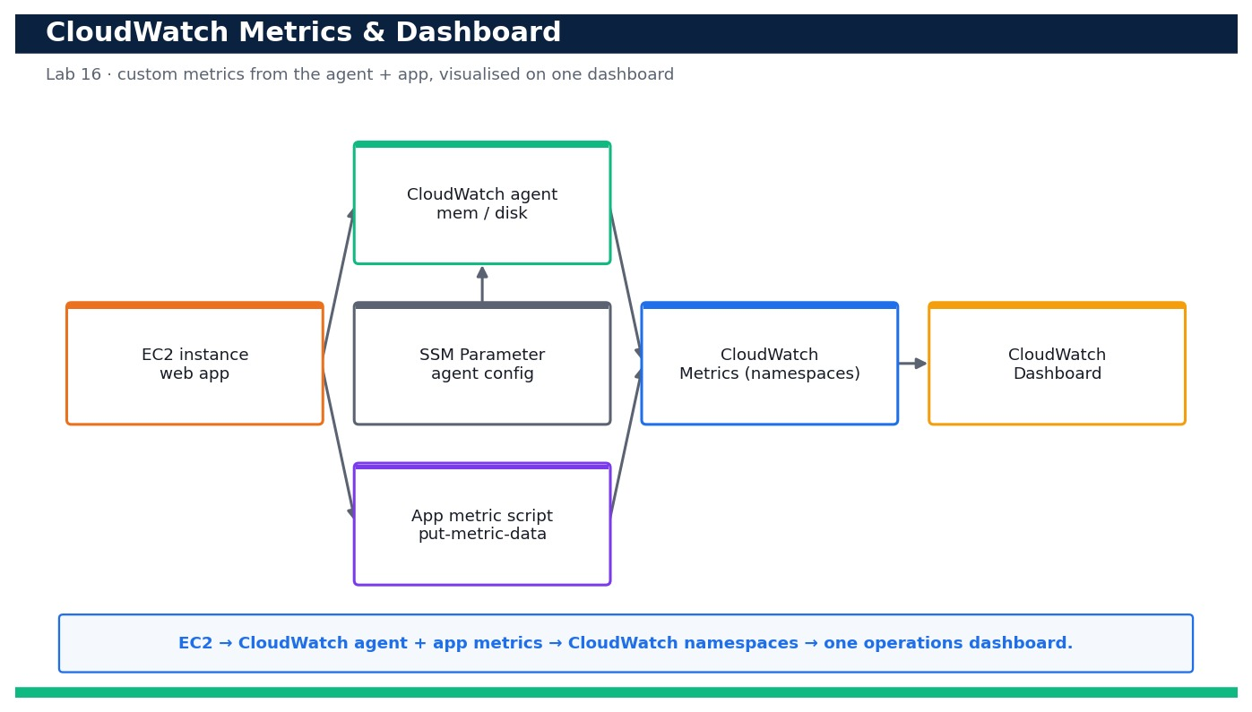
LAB 16 · DAY 4 · LO4 · HANDS-ON
Collect Custom Metrics with the CloudWatch Agent and Build an Operations Dashboard
LAB 16
Day 4 · LO4 · K5, A6
Your team runs a web app on EC2 but only has the default hypervisor CPU metric — you are blind to memory pressure, disk usage and application latency. In this lab you install and configure the CloudWatch agent to publish memory and disk …
YOU'LL BUILD
A running CloudWatch agent emitting memory/disk custom metrics, a script publishing app latency/request/error metrics, and a CloudWatch dashboard visualising CPU, p90 latency, errors and request count.
Tools: Amazon CloudWatch, CloudWatch agent, Amazon EC2, AWS Systems Manager (SSM Parameter Store), IAM
Reference architecture
OUTCOME & EVIDENCE
Outcome: Publishing a fresh batch of samples with put-metric.sh causes the latency (p90), request-count and error-count widgets to move within one …
Evidence: Output of showing the agent running.
DevOps Engineering on AWS · TGS-2023040474
© 2026 Tertiary Infotech Academy Pte Ltd
156
Notes:
Lab 16 overview — Instrument an EC2 workload with memory/disk and application metrics, then visualise CPU, latency, errors and request count on a CloudWatch dashboard (LO4, K5, A6).
Concept-led briefing only. The full detailed procedure, commands, expected outputs, validation and cleanup live in the Learner Guide and the lab README (not on the slides).
Reference architecture: course-generated diagram for Lab 16.
[Sources]
- AWS Certified DevOps Engineer – Professional (DOP-C02) Exam Guide (docs.aws.amazon.com/pdfs/aws-certification/latest/devops-engineer-professional-02).
- Legacy course deck: WSQ Master Trainer Slides — DevOps Engineering on AWS (v7).

Slide 158
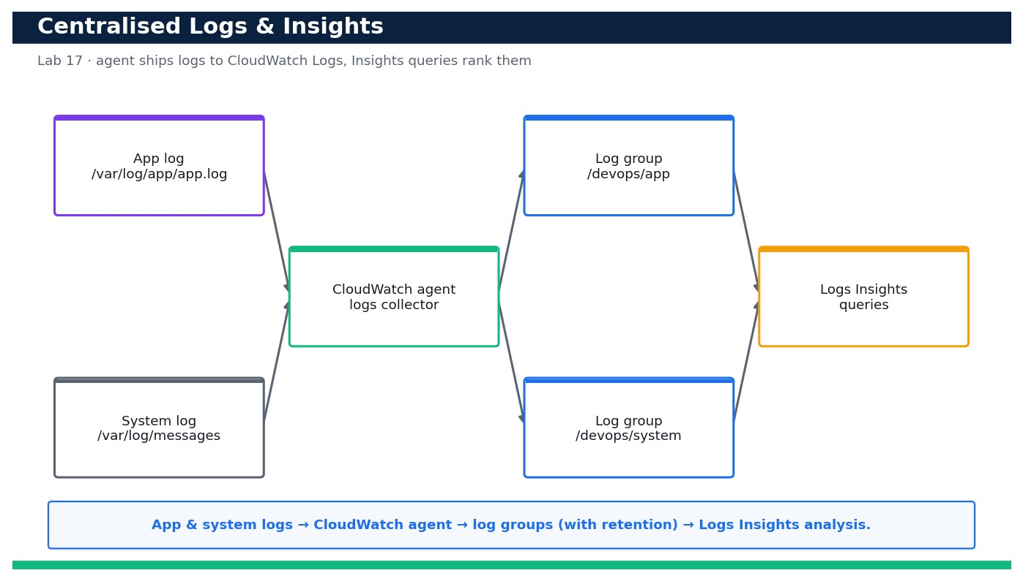
LAB 17 · DAY 4 · LO4 · HANDS-ON
Centralise Logs in CloudWatch Logs and Analyse Them with Logs Insights
LAB 17
Day 4 · LO4 · K5, A6
When an incident hits, grepping across scattered instances wastes precious minutes. In this lab you centralise your application and system logs into CloudWatch Logs — creating log groups with a sensible retention policy and extending the …
YOU'LL BUILD
Centralised app and system log groups (with retention) fed by the CloudWatch agent, plus a set of saved Logs Insights queries that surface the slowest and most error-prone requests.
Tools: Amazon CloudWatch Logs, CloudWatch Logs Insights, CloudWatch agent, Amazon EC2, IAM
Reference architecture
OUTCOME & EVIDENCE
Outcome: Running the 'slowest requests' and 'errors by path' Insights queries over the last 30 minutes returns concrete endpoints ordered by …
Evidence: output showing /devops/app and /devops/system with retentionInDays 14.
DevOps Engineering on AWS · TGS-2023040474
© 2026 Tertiary Infotech Academy Pte Ltd
157
Notes:
Lab 17 overview — Ship application and system logs into CloudWatch Logs with retention, then use Logs Insights queries to find the slowest and most error-prone requests (LO4, K5, A6).
Concept-led briefing only. The full detailed procedure, commands, expected outputs, validation and cleanup live in the Learner Guide and the lab README (not on the slides).
Reference architecture: course-generated diagram for Lab 17.
[Sources]
- AWS Certified DevOps Engineer – Professional (DOP-C02) Exam Guide (docs.aws.amazon.com/pdfs/aws-certification/latest/devops-engineer-professional-02).
- Legacy course deck: WSQ Master Trainer Slides — DevOps Engineering on AWS (v7).

Slide 159
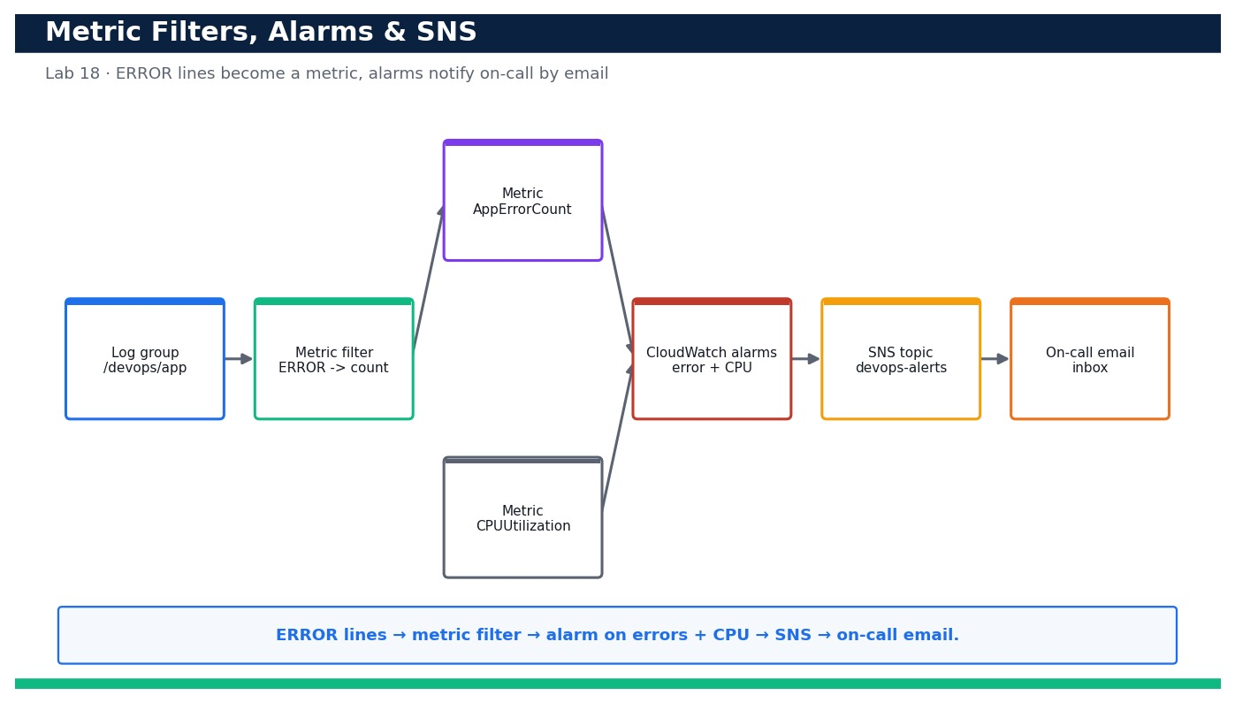
LAB 18 · DAY 4 · LO4 · HANDS-ON
Turn Logs into Signals: Metric Filters, CloudWatch Alarms and SNS Notifications
LAB 18
Day 4 · LO4 · K5, A6
Logs are only useful if they page someone when things go wrong. In this lab you turn the centralised app logs from Lab 17 into a signal: a CloudWatch Logs metric filter counts ERROR lines into a metric, then two alarms — one on the error metric …
YOU'LL BUILD
A metric filter converting ERROR log lines into a CloudWatch metric, two alarms (errors and high CPU) wired to an SNS topic with a confirmed email subscription, and a demonstrated ALARM-state email notification.
Tools: Amazon CloudWatch (metric filters + alarms), Amazon CloudWatch Logs, Amazon SNS, AWS CloudFormation, IAM
Reference architecture
OUTCOME & EVIDENCE
Outcome: After you generate ERROR log lines, the metric filter increments AppErrorCount, the devops-app-errors alarm transitions to ALARM, and …
Evidence: output showing app-error-count attached to /devops/app.
DevOps Engineering on AWS · TGS-2023040474
© 2026 Tertiary Infotech Academy Pte Ltd
158
Notes:
Lab 18 overview — Create a metric filter that counts ERROR log lines, alarm on that metric and on high CPU, and notify an on-call engineer by email via SNS (LO4, K5, A6).
Concept-led briefing only. The full detailed procedure, commands, expected outputs, validation and cleanup live in the Learner Guide and the lab README (not on the slides).
Reference architecture: course-generated diagram for Lab 18.
[Sources]
- AWS Certified DevOps Engineer – Professional (DOP-C02) Exam Guide (docs.aws.amazon.com/pdfs/aws-certification/latest/devops-engineer-professional-02).
- Legacy course deck: WSQ Master Trainer Slides — DevOps Engineering on AWS (v7).

Slide 160
DOMAIN RECAP
Recap — Monitoring and Logging
• You can now: Instrument an EC2 workload with memory/disk and application metrics, then visualise CPU, latency, errors and request count on a CloudWatch dashboard (LO4, K5, A6)
• You can now: Ship application and system logs into CloudWatch Logs with retention, then use Logs Insights queries to find the slowest and most error-prone requests (LO4, K5, A6)
• You can now: Create a metric filter that counts ERROR log lines, alarm on that metric and on high CPU, and notify an on-call engineer by email via SNS (LO4, K5, A6)
• CloudWatch metrics — Namespaces, dimensions and custom metrics measure system and application health over time.
• CloudWatch Logs — Log groups, streams, subscription filters and metric filters turn raw logs into searchable, alertable signals.
• Dashboards — A single pane of glass correlates metrics, logs and alarms for fast troubleshooting.
DevOps Engineering on AWS · TGS-2023040474
© 2026 Tertiary Infotech Academy Pte Ltd
159
Notes:
Recap of Domain 04 — Monitoring and Logging.
[Sources]
- AWS Certified DevOps Engineer – Professional (DOP-C02) Exam Guide (docs.aws.amazon.com/pdfs/aws-certification/latest/devops-engineer-professional-02).
- AWS CloudWatch Documentation (docs.aws.amazon.com/AmazonCloudWatch).
- Legacy course deck: WSQ Master Trainer Slides — DevOps Engineering on AWS (v7).

Slide 161
05
DOMAIN 05
Incident and Event Response
Exam weighting 14% · Event sources · automated response · configuration change · troubleshooting
DevOps Engineering on AWS · TGS-2023040474
© 2026 Tertiary Infotech Academy Pte Ltd
160

Slide 162
DOMAIN 05 · WEIGHTING 14%
Key Concepts — Incident and Event Response
Event-driven operations
EventBridge routes events from AWS services and applications to targets that act automatically.
Notify & act
SNS notifies people; Lambda, Systems Manager Automation and Step Functions take the remediating action.
1
2
Auto-remediation
AWS Config rules and EventBridge patterns detect drift and fix it — tag, isolate, restart or roll back.
Runbooks & playbooks
Systems Manager documents codify the response so incidents are handled consistently and fast.
3
4
Deployment failure response
CloudWatch alarms roll back CodeDeploy; pipeline stages stop and alert on failure.
Troubleshooting
Correlate metrics, logs, traces and CloudTrail events to find and fix system and application failures.
5
6
DevOps Engineering on AWS · TGS-2023040474
© 2026 Tertiary Infotech Academy Pte Ltd
161
Notes:
Key concepts for Domain 05 — Incident and Event Response.
Event-driven operations: EventBridge routes events from AWS services and applications to targets that act automatically.
Notify & act: SNS notifies people; Lambda, Systems Manager Automation and Step Functions take the remediating action.
Auto-remediation: AWS Config rules and EventBridge patterns detect drift and fix it — tag, isolate, restart or roll back.
Runbooks & playbooks: Systems Manager documents codify the response so incidents are handled consistently and fast.
Deployment failure response: CloudWatch alarms roll back CodeDeploy; pipeline stages stop and alert on failure.
Troubleshooting: Correlate metrics, logs, traces and CloudTrail events to find and fix system and application failures.
[Sources]
- AWS Certified DevOps Engineer – Professional (DOP-C02) Exam Guide (docs.aws.amazon.com/pdfs/aws-certification/latest/devops-engineer-professional-02).
- AWS EventBridge Documentation (docs.aws.amazon.com/eventbridge).
- Legacy course deck: WSQ Master Trainer Slides — DevOps Engineering on AWS (v7).

Slide 163
DOMAIN 05 · RESPOND
Event-Driven Incident Response
Event source
CloudWatch / EC2 / Config
EventBridge
rule + pattern
SNS
notify responders
Lambda
auto-remediate
SSM Automation
runbook
Healthy state
restored
▶ EventBridge routes the event to notify people and trigger a Lambda/SSM runbook that fixes the issue automatically.
DevOps Engineering on AWS · TGS-2023040474
© 2026 Tertiary Infotech Academy Pte Ltd
162
Notes:
Domain 05 deep dive — Incident and Event Response. Editable AWS-native diagram/table/chart.
[Sources]
- AWS Certified DevOps Engineer – Professional (DOP-C02) Exam Guide (docs.aws.amazon.com/pdfs/aws-certification/latest/devops-engineer-professional-02).
- AWS EventBridge Documentation (docs.aws.amazon.com/eventbridge).
- Legacy course deck: WSQ Master Trainer Slides — DevOps Engineering on AWS (v7).

Slide 164
THE RESPONSE LOOP
From Detection to Remediation
Detect
CloudWatch alarms, Config rules and service events signal a problem.
Route
EventBridge matches the event pattern and fans out to targets.
1
2
Notify
SNS alerts on-call responders by email / chat / SMS.
Remediate
Lambda or SSM Automation runs the runbook — restart, isolate, roll back.
3
4
Roll back
CloudWatch alarms auto-roll-back a bad CodeDeploy deployment.
Learn
Blameless review; codify the fix into the runbook.
5
6
DevOps Engineering on AWS · TGS-2023040474
© 2026 Tertiary Infotech Academy Pte Ltd
163
Notes:
Domain 05 deep dive — Incident and Event Response. Editable AWS-native diagram/table/chart.
[Sources]
- AWS Certified DevOps Engineer – Professional (DOP-C02) Exam Guide (docs.aws.amazon.com/pdfs/aws-certification/latest/devops-engineer-professional-02).
- AWS EventBridge Documentation (docs.aws.amazon.com/eventbridge).
- Legacy course deck: WSQ Master Trainer Slides — DevOps Engineering on AWS (v7).

Slide 165
WHY AUTOMATE RESPONSE
Automation Cuts Mean Time To Recover
WHAT THE DATA SHOWS
Event-driven automation collapses MTTR from over an hour to a few minutes across every phase.
DevOps Engineering on AWS · TGS-2023040474
© 2026 Tertiary Infotech Academy Pte Ltd
164
Notes:
Automation Cuts Mean Time To Recover. What the data shows: Event-driven automation collapses MTTR from over an hour to a few minutes across every phase.
Figures are illustrative teaching values to convey the relationship, not measured benchmarks.

Slide 166
THE EVENT ROUTER
Amazon EventBridge Concepts
Event bus
Receives events from AWS services, SaaS and your apps.
Rules & patterns
Match events by source, type and detail.
1
2
Targets
Route matched events to Lambda, SNS, SQS, Step Functions…
Scheduler
Run tasks on a cron/rate schedule at scale.
3
4
DevOps Engineering on AWS · TGS-2023040474
© 2026 Tertiary Infotech Academy Pte Ltd
165
Notes:
Domain 05 deep dive — Incident and Event Response. Editable AWS-native diagram/table/chart.
[Sources]
- AWS Certified DevOps Engineer – Professional (DOP-C02) Exam Guide (docs.aws.amazon.com/pdfs/aws-certification/latest/devops-engineer-professional-02).
- AWS EventBridge Documentation (docs.aws.amazon.com/eventbridge).
- Legacy course deck: WSQ Master Trainer Slides — DevOps Engineering on AWS (v7).

Slide 167
CODIFYING THE RESPONSE
Runbooks vs Playbooks
Automate the known
Guide the unknown
• Runbook
– Step-by-step operational procedure
– Often codified as SSM Automation documents
– Automates a known, repeatable fix
• Playbook
– Broader incident-response guidance
– Roles, comms and decision points
– Used for novel or major incidents
DevOps Engineering on AWS · TGS-2023040474
© 2026 Tertiary Infotech Academy Pte Ltd
166
Notes:
Domain 05 deep dive — Incident and Event Response. Editable AWS-native diagram/table/chart.
[Sources]
- AWS Certified DevOps Engineer – Professional (DOP-C02) Exam Guide (docs.aws.amazon.com/pdfs/aws-certification/latest/devops-engineer-professional-02).
- AWS EventBridge Documentation (docs.aws.amazon.com/eventbridge).
- Legacy course deck: WSQ Master Trainer Slides — DevOps Engineering on AWS (v7).

Slide 168
FAIL SAFELY
Responding to Deployment Failures
Alarm-based rollback
CloudWatch alarms auto-roll-back a bad CodeDeploy deployment.
Pipeline stop
A failed stage halts CodePipeline and alerts the team.
1
2
Circuit breaker
ECS deployment circuit breaker reverts failed rollouts.
Blue/green switch-back
Instantly shift traffic back to the last good fleet.
3
4
DevOps Engineering on AWS · TGS-2023040474
© 2026 Tertiary Infotech Academy Pte Ltd
167
Notes:
Domain 05 deep dive — Incident and Event Response. Editable AWS-native diagram/table/chart.
[Sources]
- AWS Certified DevOps Engineer – Professional (DOP-C02) Exam Guide (docs.aws.amazon.com/pdfs/aws-certification/latest/devops-engineer-professional-02).
- AWS EventBridge Documentation (docs.aws.amazon.com/eventbridge).
- Legacy course deck: WSQ Master Trainer Slides — DevOps Engineering on AWS (v7).

Slide 169
IN DEPTH
Event-driven operations with EventBridge
IN DEPTH
WHY IT MATTERS
Events let operations react the instant something changes, instead of polling or waiting for a human to notice.
• EventBridge receives events from AWS services, SaaS partners and your applications on event buses.
• Rules match events by source, detail-type and content pattern and route them to targets.
• Targets include Lambda, SNS, SQS, Step Functions and Systems Manager Automation.
FAILURE MODE
Over-broad event patterns match far more than intended and trigger remediation on benign events.
TRADE-OFF / DECISION
Fine-grained rules are precise but numerous to manage; broad rules are simple but risk false triggers.
DevOps Engineering on AWS · TGS-2023040474
© 2026 Tertiary Infotech Academy Pte Ltd
168
Notes:
Event-driven operations with EventBridge.
Why it matters: Events let operations react the instant something changes, instead of polling or waiting for a human to notice.
Failure mode: Over-broad event patterns match far more than intended and trigger remediation on benign events.
Trade-off: Fine-grained rules are precise but numerous to manage; broad rules are simple but risk false triggers.
[Sources]
- AWS EventBridge Documentation (docs.aws.amazon.com/eventbridge/latest/userguide).
- AWS Certified DevOps Engineer – Professional (DOP-C02) Exam Guide (docs.aws.amazon.com/pdfs/aws-certification/latest/devops-engineer-professional-02).

Slide 170
IN DEPTH
Notify people, trigger machines
IN DEPTH
WHY IT MATTERS
Separating 'notify' from 'act' means the automated fix starts immediately while humans stay informed and can intervene.
• SNS notifies humans by email, SMS or chat; it also fans out to multiple subscribers.
• Lambda, Systems Manager Automation and Step Functions take the actual remediating action.
• The two paths run in parallel: tell the responders and start the fix simultaneously.
FAILURE MODE
Notifying without automating leaves recovery gated on human reaction time at 3am.
TRADE-OFF / DECISION
Automating actions demands tight IAM scoping and validation so a bad event can't trigger a harmful action.
DevOps Engineering on AWS · TGS-2023040474
© 2026 Tertiary Infotech Academy Pte Ltd
169
Notes:
Notify people, trigger machines.
Why it matters: Separating 'notify' from 'act' means the automated fix starts immediately while humans stay informed and can intervene.
Failure mode: Notifying without automating leaves recovery gated on human reaction time at 3am.
Trade-off: Automating actions demands tight IAM scoping and validation so a bad event can't trigger a harmful action.
[Sources]
- AWS SNS Documentation (docs.aws.amazon.com/sns).
- AWS Systems Manager Automation Documentation (docs.aws.amazon.com/systems-manager/latest/userguide/systems-manager-automation.html).
- AWS Certified DevOps Engineer – Professional (DOP-C02) Exam Guide (docs.aws.amazon.com/pdfs/aws-certification/latest/devops-engineer-professional-02).

Slide 171
IN DEPTH
Auto-remediation with Config and Automation
IN DEPTH
WHY IT MATTERS
Continuous detection plus automated remediation keeps the environment compliant without waiting for a human review cycle.
• AWS Config detects non-compliant or drifted resources and can invoke an SSM Automation remediation.
• Common auto-fixes: re-enable encryption, remove a public S3 setting, isolate an instance, re-tag resources.
• Every remediation is logged for audit and can require approval for higher-risk actions.
FAILURE MODE
Auto-remediating without guardrails can fight a legitimate change or mask a deeper problem instead of fixing it.
TRADE-OFF / DECISION
Immediate auto-fix is fast but can hide recurring root causes — track remediation frequency as a signal.
DevOps Engineering on AWS · TGS-2023040474
© 2026 Tertiary Infotech Academy Pte Ltd
170
Notes:
Auto-remediation with Config and Automation.
Why it matters: Continuous detection plus automated remediation keeps the environment compliant without waiting for a human review cycle.
Failure mode: Auto-remediating without guardrails can fight a legitimate change or mask a deeper problem instead of fixing it.
Trade-off: Immediate auto-fix is fast but can hide recurring root causes — track remediation frequency as a signal.
[Sources]
- AWS Config remediation Documentation (docs.aws.amazon.com/config/latest/developerguide/remediation.html).
- AWS Certified DevOps Engineer – Professional (DOP-C02) Exam Guide (docs.aws.amazon.com/pdfs/aws-certification/latest/devops-engineer-professional-02).

Slide 172
IN DEPTH
Runbooks and playbooks
IN DEPTH
WHY IT MATTERS
Runbooks turn hard-won incident knowledge into repeatable automation; playbooks coordinate the human response to the unknown.
• A runbook is a precise, often-automated procedure for a known problem (SSM Automation documents encode these).
• A playbook is broader human guidance for novel or major incidents — roles, comms and decision points.
• Codifying responses makes them consistent, fast and improvable after every incident.
FAILURE MODE
Tribal knowledge in one engineer's head fails the moment that person is on leave during an incident.
TRADE-OFF / DECISION
Automated runbooks must be maintained as the system changes, or they confidently do the wrong thing.
DevOps Engineering on AWS · TGS-2023040474
© 2026 Tertiary Infotech Academy Pte Ltd
171
Notes:
Runbooks and playbooks.
Why it matters: Runbooks turn hard-won incident knowledge into repeatable automation; playbooks coordinate the human response to the unknown.
Failure mode: Tribal knowledge in one engineer's head fails the moment that person is on leave during an incident.
Trade-off: Automated runbooks must be maintained as the system changes, or they confidently do the wrong thing.
[Sources]
- AWS Systems Manager runbooks Documentation (docs.aws.amazon.com/systems-manager/latest/userguide/automation-documents.html).
- AWS Certified DevOps Engineer – Professional (DOP-C02) Exam Guide (docs.aws.amazon.com/pdfs/aws-certification/latest/devops-engineer-professional-02).

Slide 173
IN DEPTH
Deployment-failure response
IN DEPTH
WHY IT MATTERS
Wiring release health into automated rollback keeps a bad deployment from becoming a prolonged outage.
• CloudWatch alarms can trigger CodeDeploy automatic rollback when a new release misbehaves.
• A failed pipeline stage halts CodePipeline and alerts the team rather than continuing to prod.
• The ECS deployment circuit breaker reverts a failed rollout; blue/green switches traffic back instantly.
FAILURE MODE
Deployments with no health signal or rollback path require a manual, stressful, error-prone recovery.
TRADE-OFF / DECISION
Fast auto-rollback is safe but can oscillate if the health signal is noisy — tune alarm sensitivity.
DevOps Engineering on AWS · TGS-2023040474
© 2026 Tertiary Infotech Academy Pte Ltd
172
Notes:
Deployment-failure response.
Why it matters: Wiring release health into automated rollback keeps a bad deployment from becoming a prolonged outage.
Failure mode: Deployments with no health signal or rollback path require a manual, stressful, error-prone recovery.
Trade-off: Fast auto-rollback is safe but can oscillate if the health signal is noisy — tune alarm sensitivity.
[Sources]
- AWS CodeDeploy rollback Documentation (docs.aws.amazon.com/codedeploy/latest/userguide/deployments-rollback-and-redeploy.html).
- AWS ECS circuit breaker Documentation (docs.aws.amazon.com/AmazonECS/latest/developerguide/deployment-circuit-breaker.html).
- AWS Certified DevOps Engineer – Professional (DOP-C02) Exam Guide (docs.aws.amazon.com/pdfs/aws-certification/latest/devops-engineer-professional-02).

Slide 174
IN DEPTH
Troubleshooting methodically across signals
IN DEPTH
WHY IT MATTERS
A disciplined, signal-driven method finds root cause faster than guessing and prevents fixing symptoms only.
• Correlate metrics (what changed), logs (what the app said), traces (where it slowed) and CloudTrail (who changed what).
• Start from the user-facing symptom and the SLO, then narrow by time and by service.
• CloudTrail often reveals that an incident began with a configuration or permission change.
FAILURE MODE
Restarting things at random during an incident can clear the symptom while leaving the cause to recur.
TRADE-OFF / DECISION
Thorough diagnosis takes minutes you may feel you don't have — but mis-diagnosis costs more.
DevOps Engineering on AWS · TGS-2023040474
© 2026 Tertiary Infotech Academy Pte Ltd
173
Notes:
Troubleshooting methodically across signals.
Why it matters: A disciplined, signal-driven method finds root cause faster than guessing and prevents fixing symptoms only.
Failure mode: Restarting things at random during an incident can clear the symptom while leaving the cause to recur.
Trade-off: Thorough diagnosis takes minutes you may feel you don't have — but mis-diagnosis costs more.
[Sources]
- AWS CloudTrail Documentation (docs.aws.amazon.com/awscloudtrail).
- AWS CloudWatch Documentation (docs.aws.amazon.com/AmazonCloudWatch).
- AWS Certified DevOps Engineer – Professional (DOP-C02) Exam Guide (docs.aws.amazon.com/pdfs/aws-certification/latest/devops-engineer-professional-02).

Slide 175
IN DEPTH
Blameless post-incident review
IN DEPTH
WHY IT MATTERS
Treating incidents as learning — not fault — turns each outage into durable resilience and better automation.
• After recovery, a blameless review reconstructs the timeline and identifies systemic causes.
• Action items harden the system: new alarms, a new runbook, a guardrail, or a design change.
• The fix is codified so the same incident cannot recur silently.
FAILURE MODE
Blaming individuals drives problems underground; people stop reporting near-misses and the system stops improving.
TRADE-OFF / DECISION
Reviews cost time and candour — the payoff is compounding reliability over many incidents.
DevOps Engineering on AWS · TGS-2023040474
© 2026 Tertiary Infotech Academy Pte Ltd
174
Notes:
Blameless post-incident review.
Why it matters: Treating incidents as learning — not fault — turns each outage into durable resilience and better automation.
Failure mode: Blaming individuals drives problems underground; people stop reporting near-misses and the system stops improving.
Trade-off: Reviews cost time and candour — the payoff is compounding reliability over many incidents.
[Sources]
- DORA / Google Cloud, Accelerate State of DevOps (dora.dev).
- AWS Well-Architected Framework (docs.aws.amazon.com/wellarchitected).
- AWS Builders' Library Documentation (docs.aws.amazon.com/builders-library).

Slide 176
IN DEPTH
Orchestrating complex responses with Step Functions
IN DEPTH
WHY IT MATTERS
Some incidents need a workflow, not a single action — orchestration gives reliable, observable, multi-step recovery.
• Step Functions coordinate multi-step remediations with retries, branching and error handling.
• State machines make a response auditable and resumable rather than a fragile chain of Lambdas.
• Human-approval states can pause automation for a decision on higher-risk actions.
FAILURE MODE
A tangle of Lambdas invoking Lambdas becomes impossible to trace or safely modify.
TRADE-OFF / DECISION
Orchestration adds a service to design and cost, justified when the response has real branching and steps.
DevOps Engineering on AWS · TGS-2023040474
© 2026 Tertiary Infotech Academy Pte Ltd
175
Notes:
Orchestrating complex responses with Step Functions.
Why it matters: Some incidents need a workflow, not a single action — orchestration gives reliable, observable, multi-step recovery.
Failure mode: A tangle of Lambdas invoking Lambdas becomes impossible to trace or safely modify.
Trade-off: Orchestration adds a service to design and cost, justified when the response has real branching and steps.
[Sources]
- AWS Step Functions Documentation (docs.aws.amazon.com/step-functions).
- AWS Certified DevOps Engineer – Professional (DOP-C02) Exam Guide (docs.aws.amazon.com/pdfs/aws-certification/latest/devops-engineer-professional-02).

Slide 177
CODIFYING THE RESPONSE
Runbook vs Playbook — Know the Difference
Aspect
Runbook
Playbook
Scope
One known, repeatable fix
Broader incident guidance
Form
Often automated (SSM Automation)
Human roles, comms, decisions
Best for
'Disk full → expand volume'
Novel or major incidents
Outcome
Fast, consistent auto-recovery
Coordinated human response
DevOps Engineering on AWS · TGS-2023040474
© 2026 Tertiary Infotech Academy Pte Ltd
176
Notes:
Comparison — Runbook vs Playbook — Know the Difference.
[Sources]
- AWS Systems Manager Documentation (docs.aws.amazon.com/systems-manager).
- AWS Certified DevOps Engineer – Professional (DOP-C02) Exam Guide (docs.aws.amazon.com/pdfs/aws-certification/latest/devops-engineer-professional-02).

Slide 178
WHY AUTOMATE RESPONSE
Automation Cuts MTTR Across Every Phase
WHAT THE DATA SHOWS
Event-driven automation collapses mean-time-to-recover from over an hour to a few minutes — most of the saving is in detection and remediation.
DevOps Engineering on AWS · TGS-2023040474
© 2026 Tertiary Infotech Academy Pte Ltd
177
Notes:
Automation Cuts MTTR Across Every Phase. What the data shows: Event-driven automation collapses mean-time-to-recover from over an hour to a few minutes — most of the saving is in detection and remediation.
Figures are illustrative teaching values to convey the relationship, not measured benchmarks.
[Sources]
- DORA / Google Cloud, Accelerate State of DevOps (dora.dev).
- AWS Certified DevOps Engineer – Professional (DOP-C02) Exam Guide (docs.aws.amazon.com/pdfs/aws-certification/latest/devops-engineer-professional-02).

Slide 179
WHAT SLOWS RECOVERY
Incident-Response Failure Modes & Anti-Patterns
Over-broad event patterns
Remediation on benign events → precise patterns, test them.
Notify-only, no automation
Recovery gated on human reaction → wire the fix.
1
2
Unscoped remediation IAM
A bad event does damage → least-privilege action roles.
Tribal knowledge
Fix lives in one head → codify runbooks.
3
4
Random restarts
Symptom cleared, cause remains → signal-driven diagnosis.
No post-incident learning
Same outage recurs → blameless review + action items.
5
6
DevOps Engineering on AWS · TGS-2023040474
© 2026 Tertiary Infotech Academy Pte Ltd
178
Notes:
Incident-Response Failure Modes & Anti-Patterns.
Over-broad event patterns — Remediation on benign events → precise patterns, test them.
Notify-only, no automation — Recovery gated on human reaction → wire the fix.
Unscoped remediation IAM — A bad event does damage → least-privilege action roles.
Tribal knowledge — Fix lives in one head → codify runbooks.
Random restarts — Symptom cleared, cause remains → signal-driven diagnosis.
No post-incident learning — Same outage recurs → blameless review + action items.
[Sources]
- AWS Certified DevOps Engineer – Professional (DOP-C02) Exam Guide (docs.aws.amazon.com/pdfs/aws-certification/latest/devops-engineer-professional-02).
- AWS EventBridge Documentation (docs.aws.amazon.com/eventbridge).

Slide 180
PROVEN PRACTICES
Response Patterns Worth Adopting
Detect → route → notify+act
EventBridge fans out to people and automation.
Alarm-based rollback
Release health auto-reverts bad deploys.
1
2
Automated runbooks
SSM Automation for known fixes.
Guarded auto-remediation
Config → remediation with approval for risky actions.
3
4
Orchestrated recovery
Step Functions for multi-step responses.
Blameless reviews
Every incident hardens the system.
5
6
DevOps Engineering on AWS · TGS-2023040474
© 2026 Tertiary Infotech Academy Pte Ltd
179
Notes:
Response Patterns Worth Adopting.
Detect → route → notify+act — EventBridge fans out to people and automation.
Alarm-based rollback — Release health auto-reverts bad deploys.
Automated runbooks — SSM Automation for known fixes.
Guarded auto-remediation — Config → remediation with approval for risky actions.
Orchestrated recovery — Step Functions for multi-step responses.
Blameless reviews — Every incident hardens the system.
[Sources]
- AWS Well-Architected Framework (docs.aws.amazon.com/wellarchitected).
- AWS Certified DevOps Engineer – Professional (DOP-C02) Exam Guide (docs.aws.amazon.com/pdfs/aws-certification/latest/devops-engineer-professional-02).

Slide 181
RESPONSE STRATEGY
Architecture Decision — Automate the Fix or Page a Human?
A
Fully automate
B
Automate with approval
C
Notify only
Known cause, safe and reversible fix, frequent occurrence. Fastest recovery — needs tight IAM and validation.
Higher-risk action or ambiguous trigger. Step Functions pauses for a human yes/no before acting.
Novel or unclear incidents. Page the on-call with rich context; automation isn't safe until the pattern is understood.
DevOps Engineering on AWS · TGS-2023040474
© 2026 Tertiary Infotech Academy Pte Ltd
180
Notes:
Architecture Decision — Automate the Fix or Page a Human?.
Option A — Fully automate: Known cause, safe and reversible fix, frequent occurrence. Fastest recovery — needs tight IAM and validation.
Option B — Automate with approval: Higher-risk action or ambiguous trigger. Step Functions pauses for a human yes/no before acting.
Option C — Notify only: Novel or unclear incidents. Page the on-call with rich context; automation isn't safe until the pattern is understood.
[Sources]
- AWS Certified DevOps Engineer – Professional (DOP-C02) Exam Guide (docs.aws.amazon.com/pdfs/aws-certification/latest/devops-engineer-professional-02).
- AWS Step Functions Documentation (docs.aws.amazon.com/step-functions).

Slide 182
DETECT AND AUTO-REMEDIATE
Scenario — A public S3 bucket appears at 2am
SITUATION
Someone changes a bucket to public. Data exposure risk is immediate; no engineer is awake.
ANALYSIS
• AWS Config's s3-bucket-public-read-prohibited rule detects the non-compliant state within minutes.
• An EventBridge rule on the Config compliance-change event can trigger an SSM Automation remediation.
• The remediation re-applies Block Public Access and SNS notifies the security channel.
DECISION
Wire Config → EventBridge → SSM Automation to auto-remediate and notify, so the exposure window is minutes and unattended — with the action logged for the morning review.
DevOps Engineering on AWS · TGS-2023040474
© 2026 Tertiary Infotech Academy Pte Ltd
181
Notes:
Scenario: Someone changes a bucket to public. Data exposure risk is immediate; no engineer is awake.
AWS Config's s3-bucket-public-read-prohibited rule detects the non-compliant state within minutes.
An EventBridge rule on the Config compliance-change event can trigger an SSM Automation remediation.
The remediation re-applies Block Public Access and SNS notifies the security channel.
Decision: Wire Config → EventBridge → SSM Automation to auto-remediate and notify, so the exposure window is minutes and unattended — with the action logged for the morning review.
[Sources]
- AWS Config remediation Documentation (docs.aws.amazon.com/config/latest/developerguide/remediation.html).
- AWS EventBridge Documentation (docs.aws.amazon.com/eventbridge).

Slide 183
RELEASE-HEALTH AUTOMATION
Scenario — A deploy degrades error rate
SITUATION
Minutes after a rollout, the error-rate alarm crosses threshold.
ANALYSIS
• The alarm can be an automatic rollback trigger for the CodeDeploy deployment, no human needed.
• EventBridge can also notify the team and open an incident record for context.
• A post-incident action is to move the service to canary so 5% catches this next time.
DECISION
Bind the error-rate alarm to CodeDeploy auto-rollback and notify in parallel; recovery becomes automatic and the follow-up hardens the pipeline.
DevOps Engineering on AWS · TGS-2023040474
© 2026 Tertiary Infotech Academy Pte Ltd
182
Notes:
Scenario: Minutes after a rollout, the error-rate alarm crosses threshold.
The alarm can be an automatic rollback trigger for the CodeDeploy deployment, no human needed.
EventBridge can also notify the team and open an incident record for context.
A post-incident action is to move the service to canary so 5% catches this next time.
Decision: Bind the error-rate alarm to CodeDeploy auto-rollback and notify in parallel; recovery becomes automatic and the follow-up hardens the pipeline.
[Sources]
- AWS CodeDeploy rollback Documentation (docs.aws.amazon.com/codedeploy/latest/userguide/deployments-rollback-and-redeploy.html).
- AWS Certified DevOps Engineer – Professional (DOP-C02) Exam Guide (docs.aws.amazon.com/pdfs/aws-certification/latest/devops-engineer-professional-02).

Slide 184
EVENT TO RECOVERY
Worked Analysis — Anatomy of an Automated Response
Signal
CloudWatch alarm / Config finding / service event fires.
Route
EventBridge rule matches the event pattern precisely.
Notify
SNS informs responders with context — they watch, not scramble.
Act & verify
Lambda/SSM runbook remediates; a follow-up check confirms healthy state, else escalates.
TAKEAWAY
A good response is a small, testable pipeline — precise trigger, parallel notify-and-act, and a verification step that escalates if the fix didn't hold.
DevOps Engineering on AWS · TGS-2023040474
© 2026 Tertiary Infotech Academy Pte Ltd
183
Notes:
Worked Analysis — Anatomy of an Automated Response.
Signal — CloudWatch alarm / Config finding / service event fires.
Route — EventBridge rule matches the event pattern precisely.
Notify — SNS informs responders with context — they watch, not scramble.
Act & verify — Lambda/SSM runbook remediates; a follow-up check confirms healthy state, else escalates.
Takeaway: A good response is a small, testable pipeline — precise trigger, parallel notify-and-act, and a verification step that escalates if the fix didn't hold.
[Sources]
- AWS EventBridge Documentation (docs.aws.amazon.com/eventbridge).
- AWS Systems Manager Automation Documentation (docs.aws.amazon.com/systems-manager/latest/userguide/systems-manager-automation.html).
- AWS Certified DevOps Engineer – Professional (DOP-C02) Exam Guide (docs.aws.amazon.com/pdfs/aws-certification/latest/devops-engineer-professional-02).

Slide 185
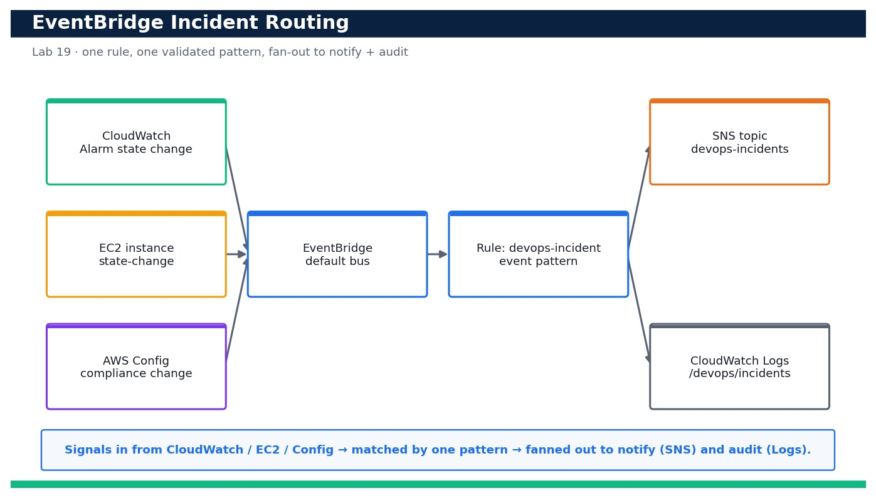
LAB 19 · DAY 4 · LO5 · HANDS-ON
Route Incidents with Amazon EventBridge
LAB 19
Day 4 · LO5 · K7, A5
Your team wants a single 'routing brain' for operational incidents so that a CloudWatch alarm firing, an EC2 instance changing state, or an AWS Config compliance change all land in the …
YOU'LL BUILD
An enabled EventBridge rule on the default bus whose validated event pattern matches CloudWatch Alarm state changes, EC2 state-change notifications and AWS Config compliance-change events, fanning out to an SNS topic (notify) and a CloudWatch …
Tools: Amazon EventBridge, Amazon SNS, Amazon CloudWatch, CloudWatch Logs, IAM
Reference architecture
OUTCOME & EVIDENCE
Outcome: You author a precise multi-source event pattern, prove it matches CloudWatch Alarm and EC2 events but rejects an unrelated S3 event …
Evidence: The three results showing true / true / false for the alarm, EC2 and unrelated samples.
DevOps Engineering on AWS · TGS-2023040474
© 2026 Tertiary Infotech Academy Pte Ltd
184
Notes:
Lab 19 overview — Build an EventBridge rule that matches incident signals and fans them out to notify and log targets (LO5, K7, A5).
Concept-led briefing only. The full detailed procedure, commands, expected outputs, validation and cleanup live in the Learner Guide and the lab README (not on the slides).
Reference architecture: course-generated diagram for Lab 19.
[Sources]
- AWS Certified DevOps Engineer – Professional (DOP-C02) Exam Guide (docs.aws.amazon.com/pdfs/aws-certification/latest/devops-engineer-professional-02).
- Legacy course deck: WSQ Master Trainer Slides — DevOps Engineering on AWS (v7).

Slide 186
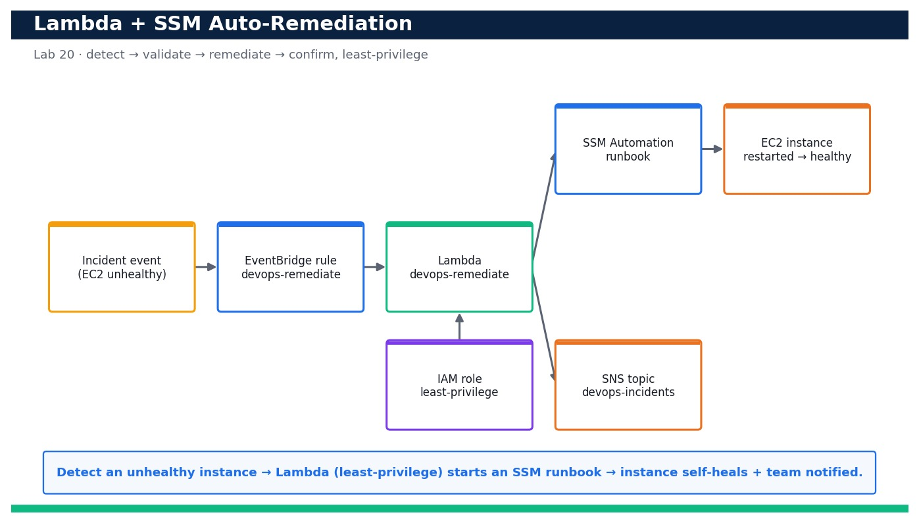
LAB 20 · DAY 4 · LO5 · HANDS-ON
Automated Remediation with Lambda and Systems Manager
LAB 20
Day 4 · LO5 · K7, A5
Notification alone does not resolve an incident — the on-call engineer still has to act. In this lab you close the loop: an EventBridge rule detects an unhealthy/stopped EC2 instance …
YOU'LL BUILD
A CloudFormation-deployed auto-remediation stack (EventBridge rule + least-privilege Lambda + SSM Automation runbook + SNS notify) that, on an unhealthy-instance event, restarts the instance automatically and returns it to a running/healthy state — proven …
Tools: AWS Lambda, AWS Systems Manager Automation, Amazon EventBridge, AWS IAM, Amazon CloudWatch Logs, Amazon SNS …
Reference architecture
OUTCOME & EVIDENCE
Outcome: You stop the test instance to create an incident, EventBridge invokes the least-privilege Lambda, the Lambda starts the SSM …
Evidence: output proving the Lambda role is least-privilege (scoped runbook + tag-conditioned EC2, no broad wildcards).
DevOps Engineering on AWS · TGS-2023040474
© 2026 Tertiary Infotech Academy Pte Ltd
185
Notes:
Lab 20 overview — Wire an EventBridge target to a least-privilege Lambda that triggers an SSM Automation runbook so an unhealthy resource self-heals (LO5, K7, A5).
Concept-led briefing only. The full detailed procedure, commands, expected outputs, validation and cleanup live in the Learner Guide and the lab README (not on the slides).
Reference architecture: course-generated diagram for Lab 20.
[Sources]
- AWS Certified DevOps Engineer – Professional (DOP-C02) Exam Guide (docs.aws.amazon.com/pdfs/aws-certification/latest/devops-engineer-professional-02).
- Legacy course deck: WSQ Master Trainer Slides — DevOps Engineering on AWS (v7).

Slide 187
DOMAIN RECAP
Recap — Incident and Event Response
• You can now: Build an EventBridge rule that matches incident signals and fans them out to notify and log targets (LO5, K7, A5)
• You can now: Wire an EventBridge target to a least-privilege Lambda that triggers an SSM Automation runbook so an unhealthy resource self-heals (LO5, K7, A5)
• Event-driven operations — EventBridge routes events from AWS services and applications to targets that act automatically.
• Notify & act — SNS notifies people; Lambda, Systems Manager Automation and Step Functions take the remediating action.
• Auto-remediation — AWS Config rules and EventBridge patterns detect drift and fix it — tag, isolate, restart or roll back.
DevOps Engineering on AWS · TGS-2023040474
© 2026 Tertiary Infotech Academy Pte Ltd
186
Notes:
Recap of Domain 05 — Incident and Event Response.
[Sources]
- AWS Certified DevOps Engineer – Professional (DOP-C02) Exam Guide (docs.aws.amazon.com/pdfs/aws-certification/latest/devops-engineer-professional-02).
- AWS EventBridge Documentation (docs.aws.amazon.com/eventbridge).
- Legacy course deck: WSQ Master Trainer Slides — DevOps Engineering on AWS (v7).

Slide 188
06
DOMAIN 06
Security and Compliance
Exam weighting 17% · Identity & access at scale · data protection · security monitoring & audit
DevOps Engineering on AWS · TGS-2023040474
© 2026 Tertiary Infotech Academy Pte Ltd
187

Slide 189

SECURITY & COMPLIANCE
Security and Compliance
▶ Security and compliance as continuous, automated guardrails
DevOps Engineering on AWS · TGS-2023040474
© 2026 Tertiary Infotech Academy Pte Ltd
188
Notes:
Security and compliance as continuous, automated guardrails
Illustration created for this course with AI image generation (ImageGen).
[Sources]
- Legacy course deck: WSQ Master Trainer Slides — DevOps Engineering on AWS (v7).

Slide 190
DOMAIN 06 · WEIGHTING 17%
Key Concepts — Security and Compliance
Identity & access management
IAM users, roles, policies and permission boundaries enforce least privilege; roles beat long-lived keys.
IAM at scale
Organizations SCPs, IAM Identity Center and federation manage access across many accounts.
1
2
Data protection
KMS encryption, Secrets Manager, S3 Block Public Access and TLS protect data at rest and in transit.
Detective controls
CloudTrail, AWS Config, GuardDuty and Security Hub record, assess and score the account's posture.
3
4
Automated compliance
Config rules and conformance packs continuously check resources against a technical blueprint.
Governance blueprint
A landing zone plus guardrails give a documented, auditable security and compliance baseline.
5
6
DevOps Engineering on AWS · TGS-2023040474
© 2026 Tertiary Infotech Academy Pte Ltd
189
Notes:
Key concepts for Domain 06 — Security and Compliance.
Identity & access management: IAM users, roles, policies and permission boundaries enforce least privilege; roles beat long-lived keys.
IAM at scale: Organizations SCPs, IAM Identity Center and federation manage access across many accounts.
Data protection: KMS encryption, Secrets Manager, S3 Block Public Access and TLS protect data at rest and in transit.
Detective controls: CloudTrail, AWS Config, GuardDuty and Security Hub record, assess and score the account's posture.
Automated compliance: Config rules and conformance packs continuously check resources against a technical blueprint.
Governance blueprint: A landing zone plus guardrails give a documented, auditable security and compliance baseline.
[Sources]
- AWS Certified DevOps Engineer – Professional (DOP-C02) Exam Guide (docs.aws.amazon.com/pdfs/aws-certification/latest/devops-engineer-professional-02).
- AWS IAM Documentation (docs.aws.amazon.com/IAM/latest/UserGuide).
- Legacy course deck: WSQ Master Trainer Slides — DevOps Engineering on AWS (v7).

Slide 191
DOMAIN 06 · SECURE & AUDIT
Security & Compliance Blueprint
IAM
least-privilege roles
CloudTrail
audit log
AWS Config
rules + drift
Security Hub /
GuardDuty
KMS + Secrets
encryption
Auto-remediate
/ notify
▶ Least-privilege identity + encryption, with CloudTrail, Config and Security Hub providing continuous audit and scoring.
DevOps Engineering on AWS · TGS-2023040474
© 2026 Tertiary Infotech Academy Pte Ltd
190
Notes:
Domain 06 deep dive — Security and Compliance. Editable AWS-native diagram/table/chart.
[Sources]
- AWS Certified DevOps Engineer – Professional (DOP-C02) Exam Guide (docs.aws.amazon.com/pdfs/aws-certification/latest/devops-engineer-professional-02).
- AWS IAM Documentation (docs.aws.amazon.com/IAM/latest/UserGuide).
- Legacy course deck: WSQ Master Trainer Slides — DevOps Engineering on AWS (v7).

Slide 192
LAYERED SECURITY
Defence in Depth on AWS
Identity
IAM roles, permission boundaries, IAM Identity Center, SCPs.
Data protection
KMS encryption, Secrets Manager, S3 Block Public Access, TLS.
1
2
Detective controls
CloudTrail, AWS Config, GuardDuty, Security Hub.
Preventive controls
Security groups, WAF, SCPs and least-privilege policies.
3
4
Automated compliance
Config rules and conformance packs check continuously.
Auditable blueprint
Landing zone + guardrails give a documented baseline.
5
6
DevOps Engineering on AWS · TGS-2023040474
© 2026 Tertiary Infotech Academy Pte Ltd
191
Notes:
Domain 06 deep dive — Security and Compliance. Editable AWS-native diagram/table/chart.
[Sources]
- AWS Certified DevOps Engineer – Professional (DOP-C02) Exam Guide (docs.aws.amazon.com/pdfs/aws-certification/latest/devops-engineer-professional-02).
- AWS IAM Documentation (docs.aws.amazon.com/IAM/latest/UserGuide).
- Legacy course deck: WSQ Master Trainer Slides — DevOps Engineering on AWS (v7).

Slide 193
LEAST PRIVILEGE
IAM — Users vs Roles vs Policies
Concept
What it is
Best practice
IAM User
Long-lived identity + credentials
Avoid; prefer federation
IAM Role
Temporary, assumable permissions
Use for apps & cross-account
Policy
JSON permissions document
Least privilege; scope by condition
Permission boundary
Max permissions a principal can have
Guardrail for delegated admin
DevOps Engineering on AWS · TGS-2023040474
© 2026 Tertiary Infotech Academy Pte Ltd
192
Notes:
Domain 06 deep dive — Security and Compliance. Editable AWS-native diagram/table/chart.
[Sources]
- AWS Certified DevOps Engineer – Professional (DOP-C02) Exam Guide (docs.aws.amazon.com/pdfs/aws-certification/latest/devops-engineer-professional-02).
- AWS IAM Documentation (docs.aws.amazon.com/IAM/latest/UserGuide).
- Legacy course deck: WSQ Master Trainer Slides — DevOps Engineering on AWS (v7).

Slide 194
GUARDRAILS THAT WATCH
AWS Config — Continuous Compliance
1
2
3
4
5
▶
▶
▶
▶
Recorder
tracks resources
Rules
managed/custom
Evaluate
compliance
Non-compliant
flagged
Remediate
auto/manual
DevOps Engineering on AWS · TGS-2023040474
© 2026 Tertiary Infotech Academy Pte Ltd
193
Notes:
Domain 06 deep dive — Security and Compliance. Editable AWS-native diagram/table/chart.
[Sources]
- AWS Certified DevOps Engineer – Professional (DOP-C02) Exam Guide (docs.aws.amazon.com/pdfs/aws-certification/latest/devops-engineer-professional-02).
- AWS IAM Documentation (docs.aws.amazon.com/IAM/latest/UserGuide).
- Legacy course deck: WSQ Master Trainer Slides — DevOps Engineering on AWS (v7).

Slide 195
KNOW WHAT HAPPENED
Detective & Governance Services
Service
What it does
CloudTrail
Records every API call for audit and forensics
AWS Config
Tracks resource configuration & compliance over time
GuardDuty
ML threat detection from logs & network traffic
Security Hub
Aggregates findings & scores posture against standards
DevOps Engineering on AWS · TGS-2023040474
© 2026 Tertiary Infotech Academy Pte Ltd
194
Notes:
Domain 06 deep dive — Security and Compliance. Editable AWS-native diagram/table/chart.
[Sources]
- AWS Certified DevOps Engineer – Professional (DOP-C02) Exam Guide (docs.aws.amazon.com/pdfs/aws-certification/latest/devops-engineer-professional-02).
- AWS IAM Documentation (docs.aws.amazon.com/IAM/latest/UserGuide).
- Legacy course deck: WSQ Master Trainer Slides — DevOps Engineering on AWS (v7).

Slide 196
PROTECTING DATA
Encryption Everywhere
At rest
KMS-managed keys for S3, EBS, RDS, DynamoDB.
In transit
TLS for all service and app traffic.
1
2
Secrets
Secrets Manager with automatic rotation.
Key governance
Key policies, grants and rotation with AWS KMS.
3
4
DevOps Engineering on AWS · TGS-2023040474
© 2026 Tertiary Infotech Academy Pte Ltd
195
Notes:
Domain 06 deep dive — Security and Compliance. Editable AWS-native diagram/table/chart.
[Sources]
- AWS Certified DevOps Engineer – Professional (DOP-C02) Exam Guide (docs.aws.amazon.com/pdfs/aws-certification/latest/devops-engineer-professional-02).
- AWS IAM Documentation (docs.aws.amazon.com/IAM/latest/UserGuide).
- Legacy course deck: WSQ Master Trainer Slides — DevOps Engineering on AWS (v7).

Slide 197
IN DEPTH
Identity and access — least privilege by design
IN DEPTH
WHY IT MATTERS
Least privilege limits the blast radius of any compromised credential or mistaken policy to exactly what was needed.
• IAM policies grant explicit permissions; roles provide temporary, assumable credentials for apps and cross-account access.
• Permission boundaries cap the maximum permissions a delegated admin can grant.
• Prefer roles and short-lived credentials over long-lived access keys everywhere.
FAILURE MODE
A wildcard 'Action: *' policy or shared long-lived keys turn one leaked secret into full account compromise.
TRADE-OFF / DECISION
Tight policies take more effort to author and maintain — Access Analyzer and policy generation reduce that cost.
DevOps Engineering on AWS · TGS-2023040474
© 2026 Tertiary Infotech Academy Pte Ltd
196
Notes:
Identity and access — least privilege by design.
Why it matters: Least privilege limits the blast radius of any compromised credential or mistaken policy to exactly what was needed.
Failure mode: A wildcard 'Action: *' policy or shared long-lived keys turn one leaked secret into full account compromise.
Trade-off: Tight policies take more effort to author and maintain — Access Analyzer and policy generation reduce that cost.
[Sources]
- AWS IAM Documentation (docs.aws.amazon.com/IAM/latest/UserGuide).
- AWS Certified DevOps Engineer – Professional (DOP-C02) Exam Guide (docs.aws.amazon.com/pdfs/aws-certification/latest/devops-engineer-professional-02).
- AWS Well-Architected Framework (docs.aws.amazon.com/wellarchitected).

Slide 198
IN DEPTH
Identity at scale — Identity Center, federation, SCPs
IN DEPTH
WHY IT MATTERS
Central identity plus org guardrails make access consistent, auditable and revocable across a whole organisation.
• IAM Identity Center centralises workforce access and single sign-on across many accounts.
• Federation lets your corporate identity provider issue temporary AWS access — no per-user IAM users.
• Service Control Policies set org-wide guardrails no account can exceed.
FAILURE MODE
Per-account IAM users multiply credentials to rotate and audit and inevitably drift out of least privilege.
TRADE-OFF / DECISION
Central control needs governance so it doesn't become a bottleneck for teams needing new access.
DevOps Engineering on AWS · TGS-2023040474
© 2026 Tertiary Infotech Academy Pte Ltd
197
Notes:
Identity at scale — Identity Center, federation, SCPs.
Why it matters: Central identity plus org guardrails make access consistent, auditable and revocable across a whole organisation.
Failure mode: Per-account IAM users multiply credentials to rotate and audit and inevitably drift out of least privilege.
Trade-off: Central control needs governance so it doesn't become a bottleneck for teams needing new access.
[Sources]
- AWS IAM Identity Center Documentation (docs.aws.amazon.com/singlesignon).
- AWS Organizations SCPs Documentation (docs.aws.amazon.com/organizations/latest/userguide/orgs_manage_policies_scps.html).
- AWS Certified DevOps Engineer – Professional (DOP-C02) Exam Guide (docs.aws.amazon.com/pdfs/aws-certification/latest/devops-engineer-professional-02).

Slide 199
IN DEPTH
Data protection — encryption and secrets
IN DEPTH
WHY IT MATTERS
Encrypting everywhere and centralising key and secret governance protect data even if another control fails.
• KMS manages encryption keys and key policies for data at rest across S3, EBS, RDS and DynamoDB; TLS protects data in transit.
• Secrets Manager stores and rotates credentials; S3 Block Public Access prevents accidental exposure.
• Envelope encryption and key policies control exactly who can use which key.
FAILURE MODE
An unencrypted volume or a public bucket exposes data regardless of how strong the network perimeter is.
TRADE-OFF / DECISION
Customer-managed keys give control and auditability but add key-management responsibility and cost.
DevOps Engineering on AWS · TGS-2023040474
© 2026 Tertiary Infotech Academy Pte Ltd
198
Notes:
Data protection — encryption and secrets.
Why it matters: Encrypting everywhere and centralising key and secret governance protect data even if another control fails.
Failure mode: An unencrypted volume or a public bucket exposes data regardless of how strong the network perimeter is.
Trade-off: Customer-managed keys give control and auditability but add key-management responsibility and cost.
[Sources]
- AWS KMS Documentation (docs.aws.amazon.com/kms).
- AWS Secrets Manager Documentation (docs.aws.amazon.com/secretsmanager).
- AWS Certified DevOps Engineer – Professional (DOP-C02) Exam Guide (docs.aws.amazon.com/pdfs/aws-certification/latest/devops-engineer-professional-02).

Slide 200
IN DEPTH
Detective controls — the audit trail
IN DEPTH
WHY IT MATTERS
Detective controls provide the evidence for incident forensics, audits and continuous compliance scoring.
• CloudTrail records every API call for audit and forensics; AWS Config tracks configuration state over time.
• GuardDuty applies ML threat detection to logs and network flows; Security Hub aggregates and scores findings.
• Together they answer 'what happened, when, by whom, and are we compliant?'
FAILURE MODE
No CloudTrail (or a trail without log-file validation) means an incident can't be reconstructed and audits fail.
TRADE-OFF / DECISION
Full logging and threat detection cost money and generate findings to triage — tune and prioritise by severity.
DevOps Engineering on AWS · TGS-2023040474
© 2026 Tertiary Infotech Academy Pte Ltd
199
Notes:
Detective controls — the audit trail.
Why it matters: Detective controls provide the evidence for incident forensics, audits and continuous compliance scoring.
Failure mode: No CloudTrail (or a trail without log-file validation) means an incident can't be reconstructed and audits fail.
Trade-off: Full logging and threat detection cost money and generate findings to triage — tune and prioritise by severity.
[Sources]
- AWS CloudTrail Documentation (docs.aws.amazon.com/awscloudtrail).
- AWS GuardDuty Documentation (docs.aws.amazon.com/guardduty).
- AWS Security Hub Documentation (docs.aws.amazon.com/securityhub).
- AWS Certified DevOps Engineer – Professional (DOP-C02) Exam Guide (docs.aws.amazon.com/pdfs/aws-certification/latest/devops-engineer-professional-02).

Slide 201
IN DEPTH
Automated compliance — Config rules and conformance packs
IN DEPTH
WHY IT MATTERS
Continuous, codified compliance replaces point-in-time audits with always-on assurance and evidence.
• Config rules continuously evaluate resources against a technical blueprint (managed or custom rules).
• Conformance packs bundle rules and remediations to a standard (e.g. CIS, PCI) and deploy org-wide.
• Non-compliant resources are flagged and can be auto-remediated.
FAILURE MODE
Manual quarterly audits miss the days-to-weeks a resource sits non-compliant between checks.
TRADE-OFF / DECISION
Strict conformance packs improve posture but can generate noise — phase in rules and remediations.
DevOps Engineering on AWS · TGS-2023040474
© 2026 Tertiary Infotech Academy Pte Ltd
200
Notes:
Automated compliance — Config rules and conformance packs.
Why it matters: Continuous, codified compliance replaces point-in-time audits with always-on assurance and evidence.
Failure mode: Manual quarterly audits miss the days-to-weeks a resource sits non-compliant between checks.
Trade-off: Strict conformance packs improve posture but can generate noise — phase in rules and remediations.
[Sources]
- AWS Config conformance packs Documentation (docs.aws.amazon.com/config/latest/developerguide/conformance-packs.html).
- AWS Certified DevOps Engineer – Professional (DOP-C02) Exam Guide (docs.aws.amazon.com/pdfs/aws-certification/latest/devops-engineer-professional-02).

Slide 202
IN DEPTH
Preventive controls and defence in depth
IN DEPTH
WHY IT MATTERS
Defence in depth ensures that when one layer fails — and layers do fail — others still protect the data.
• Security groups and network ACLs, WAF, and least-privilege policies stop bad requests before they reach resources.
• SCPs prevent whole classes of action org-wide; VPC design limits lateral movement.
• Layered controls mean no single failure exposes the system.
FAILURE MODE
Relying on a single perimeter (a firewall) fails completely the moment that one control is bypassed.
TRADE-OFF / DECISION
More layers add complexity and can impede legitimate traffic — design them to be observable and testable.
DevOps Engineering on AWS · TGS-2023040474
© 2026 Tertiary Infotech Academy Pte Ltd
201
Notes:
Preventive controls and defence in depth.
Why it matters: Defence in depth ensures that when one layer fails — and layers do fail — others still protect the data.
Failure mode: Relying on a single perimeter (a firewall) fails completely the moment that one control is bypassed.
Trade-off: More layers add complexity and can impede legitimate traffic — design them to be observable and testable.
[Sources]
- AWS Well-Architected Framework (docs.aws.amazon.com/wellarchitected).
- AWS WAF Documentation (docs.aws.amazon.com/waf).
- AWS Certified DevOps Engineer – Professional (DOP-C02) Exam Guide (docs.aws.amazon.com/pdfs/aws-certification/latest/devops-engineer-professional-02).

Slide 203
IN DEPTH
Governance blueprint — landing zone and guardrails
IN DEPTH
WHY IT MATTERS
A governance blueprint makes 'secure and compliant' the default state of every account, not a per-project effort.
• A landing zone (via Control Tower) gives a documented, auditable security and network baseline.
• Preventive guardrails (SCPs) and detective guardrails (Config rules) are applied to every account.
• New accounts inherit the baseline automatically through account vending.
FAILURE MODE
Ad-hoc, per-project security guarantees nothing is consistent and every audit re-discovers the same gaps.
TRADE-OFF / DECISION
A central blueprint needs a platform team and change process — the payoff is org-wide, provable compliance.
DevOps Engineering on AWS · TGS-2023040474
© 2026 Tertiary Infotech Academy Pte Ltd
202
Notes:
Governance blueprint — landing zone and guardrails.
Why it matters: A governance blueprint makes 'secure and compliant' the default state of every account, not a per-project effort.
Failure mode: Ad-hoc, per-project security guarantees nothing is consistent and every audit re-discovers the same gaps.
Trade-off: A central blueprint needs a platform team and change process — the payoff is org-wide, provable compliance.
[Sources]
- AWS Control Tower Documentation (docs.aws.amazon.com/controltower).
- AWS Well-Architected Framework (docs.aws.amazon.com/wellarchitected).
- AWS Certified DevOps Engineer – Professional (DOP-C02) Exam Guide (docs.aws.amazon.com/pdfs/aws-certification/latest/devops-engineer-professional-02).

Slide 204
IN DEPTH
Securing the pipeline itself (DevSecOps)
IN DEPTH
WHY IT MATTERS
The pipeline has powerful credentials and touches production — a compromised pipeline is a compromised environment.
• Scan source and dependencies (SAST/SCA) and infrastructure templates in the build; sign and verify artifacts.
• Scope pipeline and deployment roles to least privilege and isolate environments by account.
• Store no secrets in code; pull them at deploy time from Secrets Manager/SSM.
FAILURE MODE
A pipeline role with broad permissions and secrets in the repo is a direct path from a code leak to full compromise.
TRADE-OFF / DECISION
Security gates add build time — order them fast-to-slow and fail fast to keep the pipeline usable.
DevOps Engineering on AWS · TGS-2023040474
© 2026 Tertiary Infotech Academy Pte Ltd
203
Notes:
Securing the pipeline itself (DevSecOps).
Why it matters: The pipeline has powerful credentials and touches production — a compromised pipeline is a compromised environment.
Failure mode: A pipeline role with broad permissions and secrets in the repo is a direct path from a code leak to full compromise.
Trade-off: Security gates add build time — order them fast-to-slow and fail fast to keep the pipeline usable.
[Sources]
- AWS Well-Architected Framework (docs.aws.amazon.com/wellarchitected).
- AWS Certified DevOps Engineer – Professional (DOP-C02) Exam Guide (docs.aws.amazon.com/pdfs/aws-certification/latest/devops-engineer-professional-02).
- AWS CodeGuru Documentation (docs.aws.amazon.com/codeguru).

Slide 205
LEAST PRIVILEGE AT SCALE
IAM — Users vs Roles vs Federation
Identity
What it is
Best practice
IAM user + keys
Long-lived credential
Avoid; rotate/retire, prefer roles
IAM role
Temporary, assumable
Use for apps and cross-account
Federation / Identity Center
IdP issues short-lived access
Standard for workforce access
Permission boundary
Cap on granted permissions
Guardrail for delegated admins
DevOps Engineering on AWS · TGS-2023040474
© 2026 Tertiary Infotech Academy Pte Ltd
204
Notes:
Comparison — IAM — Users vs Roles vs Federation.
[Sources]
- AWS IAM Documentation (docs.aws.amazon.com/IAM/latest/UserGuide).
- AWS Certified DevOps Engineer – Professional (DOP-C02) Exam Guide (docs.aws.amazon.com/pdfs/aws-certification/latest/devops-engineer-professional-02).

Slide 206
CONTINUOUS COMPLIANCE WINS
Time-to-Detect a Public Bucket — Manual vs Continuous
WHAT THE DATA SHOWS
Continuous Config evaluation shrinks the exposure window from months to minutes — the difference between a finding and a breach.
DevOps Engineering on AWS · TGS-2023040474
© 2026 Tertiary Infotech Academy Pte Ltd
205
Notes:
Time-to-Detect a Public Bucket — Manual vs Continuous. What the data shows: Continuous Config evaluation shrinks the exposure window from months to minutes — the difference between a finding and a breach.
Figures are illustrative teaching values to convey the relationship, not measured benchmarks.
[Sources]
- AWS Config Documentation (docs.aws.amazon.com/config).
- AWS Certified DevOps Engineer – Professional (DOP-C02) Exam Guide (docs.aws.amazon.com/pdfs/aws-certification/latest/devops-engineer-professional-02).

Slide 207
HOW ACCOUNTS GET COMPROMISED
Security Failure Modes & Anti-Patterns
Wildcard IAM policies
One leaked key = full access → least privilege + Access Analyzer.
Long-lived access keys
Hard to rotate/audit → roles and federation.
1
2
Public S3 / open SGs
Accidental exposure → Block Public Access, Config rules.
No CloudTrail / validation
Incidents unauditable → org trail + log-file validation.
3
4
Secrets in code
Leak on repo access → Secrets Manager/SSM.
Over-privileged pipeline
Code leak → prod compromise → scope deploy roles.
5
6
DevOps Engineering on AWS · TGS-2023040474
© 2026 Tertiary Infotech Academy Pte Ltd
206
Notes:
Security Failure Modes & Anti-Patterns.
Wildcard IAM policies — One leaked key = full access → least privilege + Access Analyzer.
Long-lived access keys — Hard to rotate/audit → roles and federation.
Public S3 / open SGs — Accidental exposure → Block Public Access, Config rules.
No CloudTrail / validation — Incidents unauditable → org trail + log-file validation.
Secrets in code — Leak on repo access → Secrets Manager/SSM.
Over-privileged pipeline — Code leak → prod compromise → scope deploy roles.
[Sources]
- AWS Certified DevOps Engineer – Professional (DOP-C02) Exam Guide (docs.aws.amazon.com/pdfs/aws-certification/latest/devops-engineer-professional-02).
- AWS IAM Documentation (docs.aws.amazon.com/IAM/latest/UserGuide).
- AWS Well-Architected Framework (docs.aws.amazon.com/wellarchitected).

Slide 208
PROVEN PRACTICES
Security Patterns Worth Adopting
Least privilege everywhere
Roles, boundaries, scoped policies, no wildcards.
Encrypt at rest and in transit
KMS + TLS by default on every store.
1
2
Continuous compliance
Config rules + conformance packs, auto-remediate.
Central logging account
Immutable CloudTrail + Security Hub aggregation.
3
4
Guardrails by SCP
Prevent whole action classes org-wide.
DevSecOps
Scan code, deps and IaC in the pipeline.
5
6
DevOps Engineering on AWS · TGS-2023040474
© 2026 Tertiary Infotech Academy Pte Ltd
207
Notes:
Security Patterns Worth Adopting.
Least privilege everywhere — Roles, boundaries, scoped policies, no wildcards.
Encrypt at rest and in transit — KMS + TLS by default on every store.
Continuous compliance — Config rules + conformance packs, auto-remediate.
Central logging account — Immutable CloudTrail + Security Hub aggregation.
Guardrails by SCP — Prevent whole action classes org-wide.
DevSecOps — Scan code, deps and IaC in the pipeline.
[Sources]
- AWS Well-Architected Framework (docs.aws.amazon.com/wellarchitected).
- AWS Certified DevOps Engineer – Professional (DOP-C02) Exam Guide (docs.aws.amazon.com/pdfs/aws-certification/latest/devops-engineer-professional-02).

Slide 209
PREVENT, DETECT, REMEDIATE
Architecture Decision — Where Do Compliance Controls Live?
A
Preventive (SCP / policy)
B
Detective (Config / GuardDuty)
C
Automated remediation
Stop the action from ever happening org-wide. Strongest — but blunt; can block legitimate edge cases.
Allow, but continuously detect and score. Flexible and auditable — leaves a (short) exposure window.
Detect then auto-fix (Config → SSM). Closes the window fast — needs careful scoping and logging.
DevOps Engineering on AWS · TGS-2023040474
© 2026 Tertiary Infotech Academy Pte Ltd
208
Notes:
Architecture Decision — Where Do Compliance Controls Live?.
Option A — Preventive (SCP / policy): Stop the action from ever happening org-wide. Strongest — but blunt; can block legitimate edge cases.
Option B — Detective (Config / GuardDuty): Allow, but continuously detect and score. Flexible and auditable — leaves a (short) exposure window.
Option C — Automated remediation: Detect then auto-fix (Config → SSM). Closes the window fast — needs careful scoping and logging.
[Sources]
- AWS Certified DevOps Engineer – Professional (DOP-C02) Exam Guide (docs.aws.amazon.com/pdfs/aws-certification/latest/devops-engineer-professional-02).
- AWS Config Documentation (docs.aws.amazon.com/config).

Slide 210
EVIDENCE ON DEMAND
Scenario — Passing an external security audit
SITUATION
An auditor asks you to prove that all volumes are encrypted and no bucket is public, historically and now.
ANALYSIS
• Point-in-time console screenshots don't prove continuous compliance over the audit period.
• AWS Config records configuration history and rule-compliance over time — that history is the evidence.
• CloudTrail with log-file validation proves the audit record itself wasn't tampered with.
DECISION
Present Config compliance history and conformance-pack results as continuous evidence, backed by a validated CloudTrail — turning audit from a scramble into a query.
DevOps Engineering on AWS · TGS-2023040474
© 2026 Tertiary Infotech Academy Pte Ltd
209
Notes:
Scenario: An auditor asks you to prove that all volumes are encrypted and no bucket is public, historically and now.
Point-in-time console screenshots don't prove continuous compliance over the audit period.
AWS Config records configuration history and rule-compliance over time — that history is the evidence.
CloudTrail with log-file validation proves the audit record itself wasn't tampered with.
Decision: Present Config compliance history and conformance-pack results as continuous evidence, backed by a validated CloudTrail — turning audit from a scramble into a query.
[Sources]
- AWS Config Documentation (docs.aws.amazon.com/config).
- AWS CloudTrail Documentation (docs.aws.amazon.com/awscloudtrail).

Slide 211
LEAST PRIVILEGE IN PRACTICE
Scenario — An app needs one new permission
SITUATION
A service fails with AccessDenied writing to a new S3 prefix. The quick fix is to grant s3:* on all buckets.
ANALYSIS
• A wildcard grant fixes the error but massively widens blast radius if the role is ever compromised.
• IAM Access Analyzer can generate a policy scoped to exactly the actions and resources the app used.
• The correct grant is s3:PutObject on that specific bucket/prefix, nothing more.
DECISION
Grant the single scoped permission the app actually needs (not a wildcard), using Access Analyzer to right-size the policy — keeping least privilege intact under time pressure.
DevOps Engineering on AWS · TGS-2023040474
© 2026 Tertiary Infotech Academy Pte Ltd
210
Notes:
Scenario: A service fails with AccessDenied writing to a new S3 prefix. The quick fix is to grant s3:* on all buckets.
A wildcard grant fixes the error but massively widens blast radius if the role is ever compromised.
IAM Access Analyzer can generate a policy scoped to exactly the actions and resources the app used.
The correct grant is s3:PutObject on that specific bucket/prefix, nothing more.
Decision: Grant the single scoped permission the app actually needs (not a wildcard), using Access Analyzer to right-size the policy — keeping least privilege intact under time pressure.
[Sources]
- AWS IAM Access Analyzer Documentation (docs.aws.amazon.com/IAM/latest/UserGuide/what-is-access-analyzer.html).
- AWS Certified DevOps Engineer – Professional (DOP-C02) Exam Guide (docs.aws.amazon.com/pdfs/aws-certification/latest/devops-engineer-professional-02).

Slide 212
FROM POLICY TO GUARDRAILS
Worked Analysis — Building a Compliance Blueprint
Requirement: encrypt all data at rest
Config rule encrypted-volumes + S3 default encryption; KMS keys with scoped policies.
Requirement: no public data
S3 Block Public Access org-wide + s3-bucket-public-read-prohibited rule.
Requirement: full audit trail
Org CloudTrail to an encrypted, access-controlled logging account with validation.
Requirement: least-privilege identity
Roles + Identity Center + permission boundaries + Access Analyzer reviews.
TAKEAWAY
A compliance blueprint maps each written requirement to a concrete, testable AWS control — so 'we are compliant' is something you can prove, continuously.
DevOps Engineering on AWS · TGS-2023040474
© 2026 Tertiary Infotech Academy Pte Ltd
211
Notes:
Worked Analysis — Building a Compliance Blueprint.
Requirement: encrypt all data at rest — Config rule encrypted-volumes + S3 default encryption; KMS keys with scoped policies.
Requirement: no public data — S3 Block Public Access org-wide + s3-bucket-public-read-prohibited rule.
Requirement: full audit trail — Org CloudTrail to an encrypted, access-controlled logging account with validation.
Requirement: least-privilege identity — Roles + Identity Center + permission boundaries + Access Analyzer reviews.
Takeaway: A compliance blueprint maps each written requirement to a concrete, testable AWS control — so 'we are compliant' is something you can prove, continuously.
[Sources]
- AWS Well-Architected Framework (docs.aws.amazon.com/wellarchitected).
- AWS Config Documentation (docs.aws.amazon.com/config).
- AWS Certified DevOps Engineer – Professional (DOP-C02) Exam Guide (docs.aws.amazon.com/pdfs/aws-certification/latest/devops-engineer-professional-02).

Slide 213
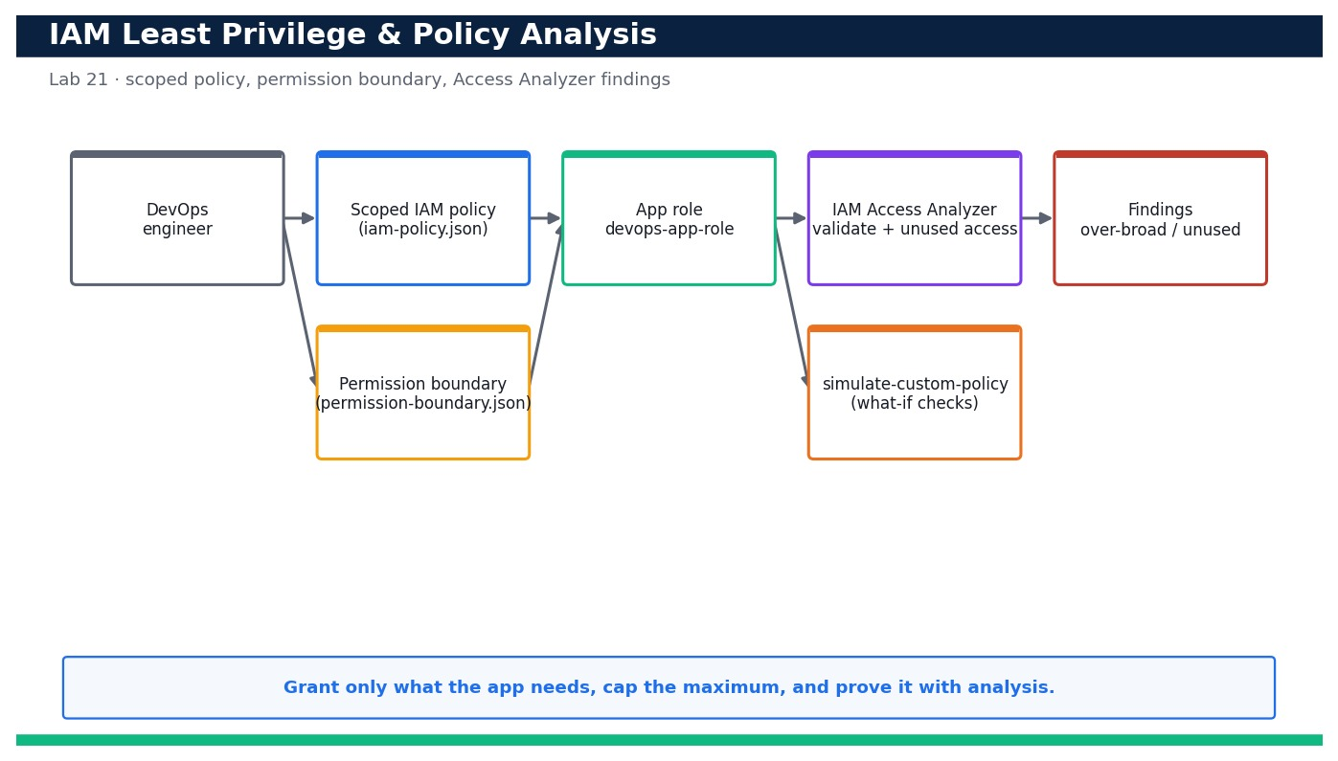
LAB 21 · DAY 5 · LO6 · HANDS-ON
Enforce IAM Least Privilege and Analyse Policies for Over-Permissive Access
LAB 21
Day 5 · LO6 · K6, A4
Broad permissions are the single most common cloud security failure. In this lab you replace a wildcard grant with a tightly scoped policy for the sample app's role, attach a permission boundary so the role can never exceed its remit, then use IAM Access Analyzer policy validation, and an Access Analyzer …
YOU'LL BUILD
A least-privilege IAM policy for the app role, capped by a permission boundary, that passes Access Analyzer validation with no security warnings and grants nothing beyond the app's real needs.
Tools: AWS IAM, IAM Access Analyzer, AWS STS, AWS CloudFormation
Reference architecture
OUTCOME & EVIDENCE
Outcome: You can prove, with Access Analyzer and policy simulation, that the app role grants exactly the actions the app needs and nothing more …
Evidence: The output showing zero SECURITY_WARNING findings for iam-policy.json.
DevOps Engineering on AWS · TGS-2023040474
© 2026 Tertiary Infotech Academy Pte Ltd
212
Notes:
Lab 21 overview — Write a scoped IAM policy, cap it with a permission boundary, and prove least privilege with IAM Access Analyzer.
Concept-led briefing only. The full detailed procedure, commands, expected outputs, validation and cleanup live in the Learner Guide and the lab README (not on the slides).
Reference architecture: course-generated diagram for Lab 21.
[Sources]
- AWS Certified DevOps Engineer – Professional (DOP-C02) Exam Guide (docs.aws.amazon.com/pdfs/aws-certification/latest/devops-engineer-professional-02).
- Legacy course deck: WSQ Master Trainer Slides — DevOps Engineering on AWS (v7).

Slide 214
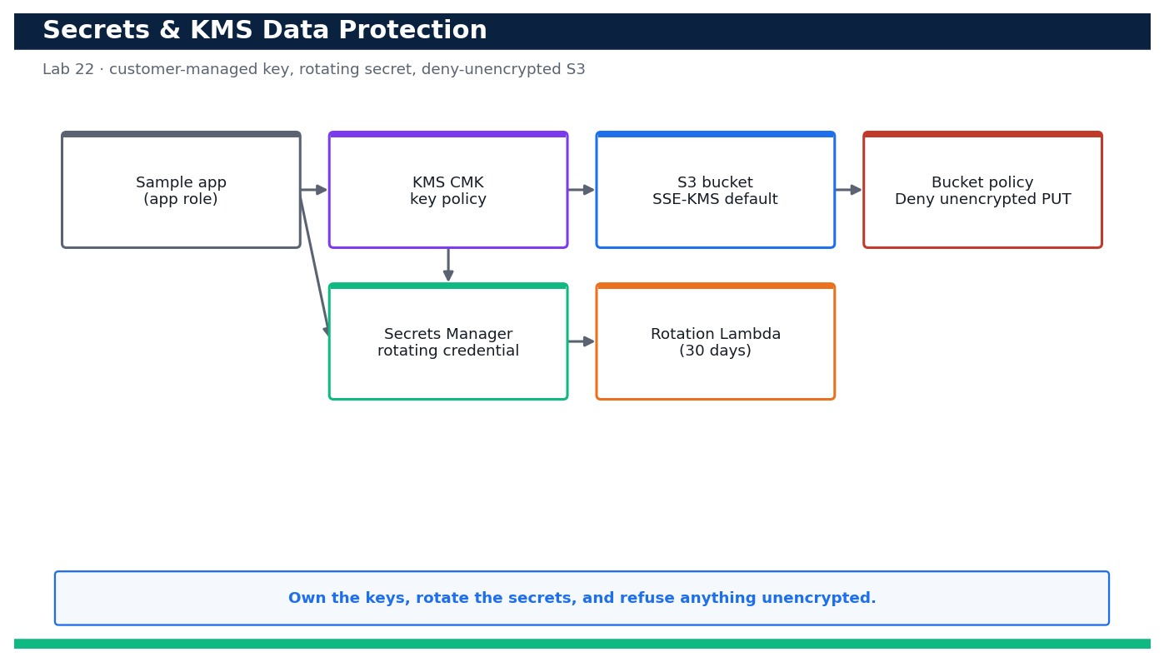
LAB 22 · DAY 5 · LO6 · HANDS-ON
Protect Data with Secrets Manager and Customer-Managed KMS Encryption
LAB 22
Day 5 · LO6 · K6, A4
Sensitive data must be encrypted with keys you control and secrets must never live in code. In this lab you create a customer-managed KMS key with a least-privilege key policy, store an application credential in AWS Secrets Manager …
YOU'LL BUILD
A customer-managed KMS key with a scoped key policy, a rotating Secrets Manager secret, and an S3 bucket that encrypts by default with your key and rejects any unencrypted upload.
Tools: AWS KMS, AWS Secrets Manager, Amazon S3, AWS Lambda (rotation), AWS CloudFormation
Reference architecture
OUTCOME & EVIDENCE
Outcome: You can store and rotate a secret in Secrets Manager under a customer-managed KMS key, retrieve it via KMS decrypt, and prove the …
Evidence: describe-key output showing KeyManager CUSTOMER, KeyState Enabled and rotation enabled for alias/devops-app.
DevOps Engineering on AWS · TGS-2023040474
© 2026 Tertiary Infotech Academy Pte Ltd
213
Notes:
Lab 22 overview — Create a customer-managed KMS key with a key policy, store a secret with rotation, and enforce encryption on S3.
Concept-led briefing only. The full detailed procedure, commands, expected outputs, validation and cleanup live in the Learner Guide and the lab README (not on the slides).
Reference architecture: course-generated diagram for Lab 22.
[Sources]
- AWS Certified DevOps Engineer – Professional (DOP-C02) Exam Guide (docs.aws.amazon.com/pdfs/aws-certification/latest/devops-engineer-professional-02).
- Legacy course deck: WSQ Master Trainer Slides — DevOps Engineering on AWS (v7).

Slide 215
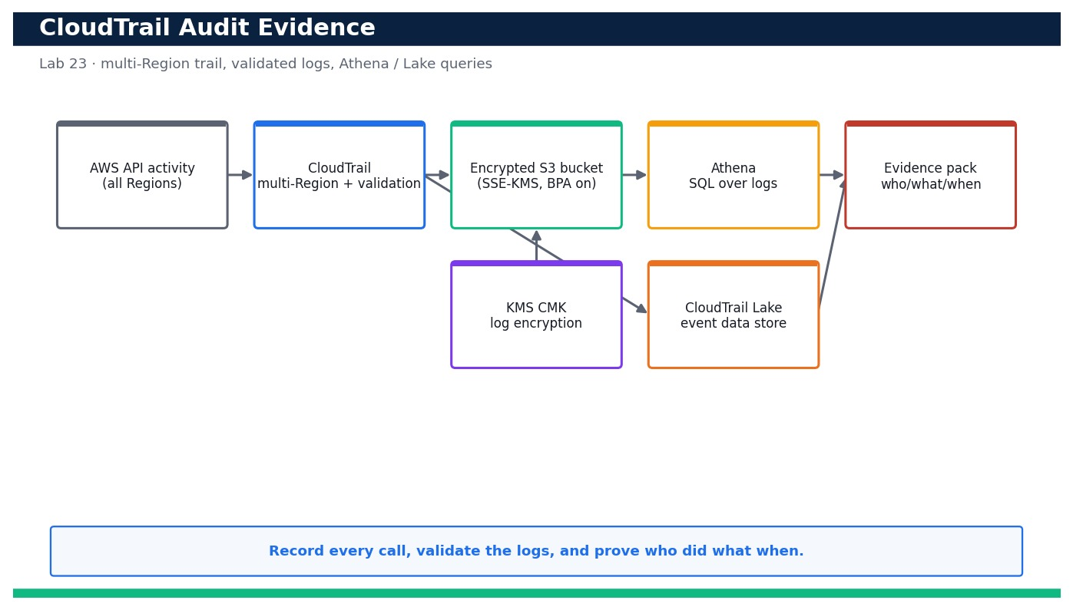
LAB 23 · DAY 5 · LO6 · HANDS-ON
Produce CloudTrail Audit Evidence and Answer Who-Did-What-When
LAB 23
Day 5 · LO6 · K6, A4
Auditors and incident responders need a tamper-evident record of every API call. In this lab you create a multi-Region CloudTrail with log-file validation that delivers to an encrypted, access-blocked S3 bucket, then query the events two ways …
YOU'LL BUILD
A validated, multi-Region CloudTrail delivering encrypted logs to S3, plus Athena/CloudTrail Lake queries that answer who-did-what-when and an exported evidence pack.
Tools: AWS CloudTrail, Amazon S3, Amazon Athena, CloudTrail Lake, AWS KMS
Reference architecture
OUTCOME & EVIDENCE
Outcome: You can answer 'who did what when' from CloudTrail two independent ways (Athena over S3 and CloudTrail Lake SQL), prove the …
Evidence: describe-trails output showing multi-Region true, log-file validation true and a KMS key on devops-trail.
DevOps Engineering on AWS · TGS-2023040474
© 2026 Tertiary Infotech Academy Pte Ltd
214
Notes:
Lab 23 overview — Stand up a multi-Region CloudTrail with log-file validation and query it to export audit evidence.
Concept-led briefing only. The full detailed procedure, commands, expected outputs, validation and cleanup live in the Learner Guide and the lab README (not on the slides).
Reference architecture: course-generated diagram for Lab 23.
[Sources]
- AWS Certified DevOps Engineer – Professional (DOP-C02) Exam Guide (docs.aws.amazon.com/pdfs/aws-certification/latest/devops-engineer-professional-02).
- Legacy course deck: WSQ Master Trainer Slides — DevOps Engineering on AWS (v7).

Slide 216
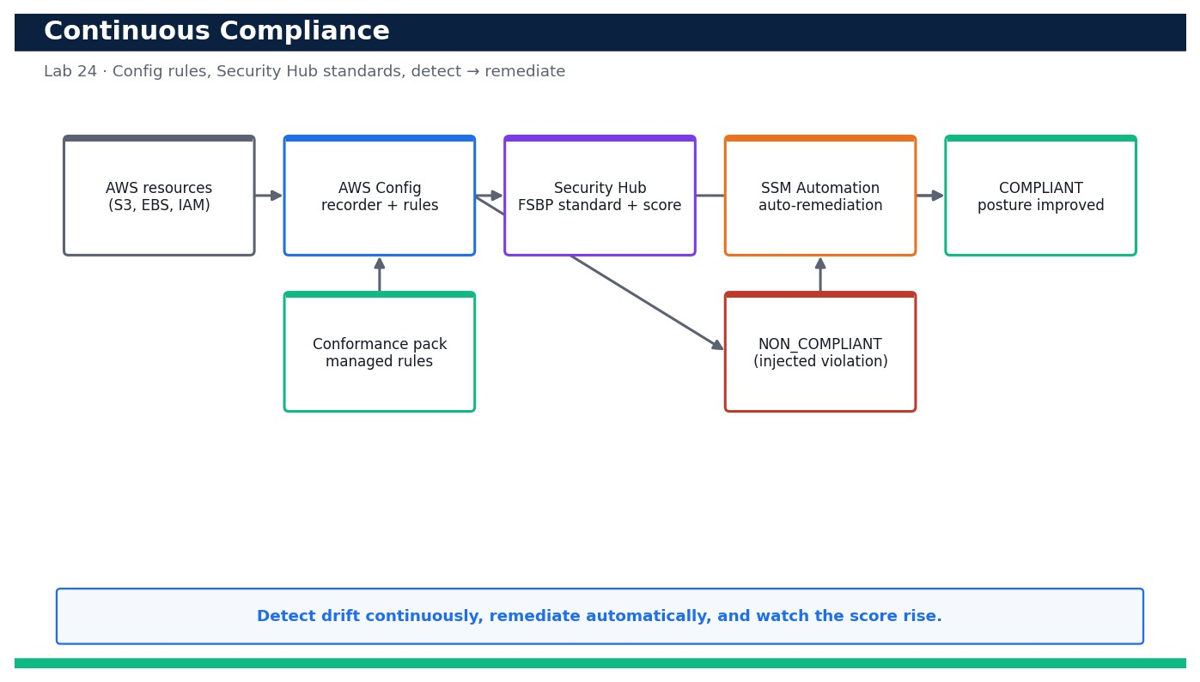
LAB 24 · DAY 5 · LO6 · HANDS-ON
Run Continuous Compliance with AWS Config and Security Hub
LAB 24
Day 5 · LO6 · K6, A4
Compliance is not a one-off audit — it must run continuously. In this lab you turn on the AWS Config recorder with managed rules (s3-bucket-public-read-prohibited, encrypted-volumes and more) delivered as a conformance pack, enable AWS …
YOU'LL BUILD
A continuously evaluating AWS Config + Security Hub setup that detects an injected violation as NON_COMPLIANT, auto-remediates it to COMPLIANT, and shows the posture score improve.
Tools: AWS Config, AWS Security Hub, AWS Systems Manager Automation, Amazon S3, AWS CloudFormation, conformance packs
Reference architecture
OUTCOME & EVIDENCE
Outcome: You can run a full continuous-compliance loop: inject a real violation, watch AWS Config and Security Hub flag it …
Evidence: describe-configuration-recorder-status showing recording true and get-enabled-standards showing FSBP enabled.
DevOps Engineering on AWS · TGS-2023040474
© 2026 Tertiary Infotech Academy Pte Ltd
215
Notes:
Lab 24 overview — Enable AWS Config managed rules and Security Hub standards, inject a violation and remediate to COMPLIANT.
Concept-led briefing only. The full detailed procedure, commands, expected outputs, validation and cleanup live in the Learner Guide and the lab README (not on the slides).
Reference architecture: course-generated diagram for Lab 24.
[Sources]
- AWS Certified DevOps Engineer – Professional (DOP-C02) Exam Guide (docs.aws.amazon.com/pdfs/aws-certification/latest/devops-engineer-professional-02).
- Legacy course deck: WSQ Master Trainer Slides — DevOps Engineering on AWS (v7).

Slide 217
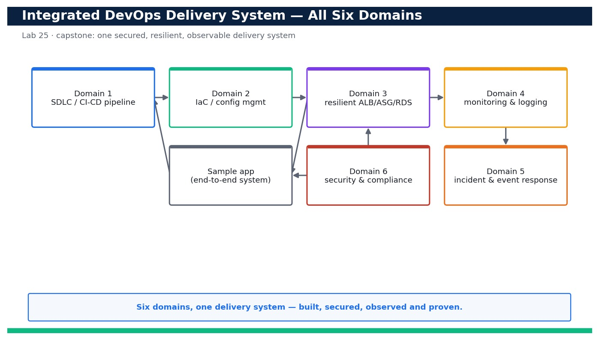
LAB 25 · DAY 5 · LO1–LO6 · HANDS-ON
Capstone — Blueprint, Well-Architected Review and Evidence Pack for the Whole Delivery System
LAB 25
Day 5 · LO1–LO6 · K1, K2, K3, K4, K5, K6, K7, A1, A2, A3, A4, A5, A6
This capstone ties the entire course together. You produce a single technical blueprint that connects all six domains — SDLC automation (Domain 1), configuration management & IaC (Domain 2), resilient architecture (Domain 3), monitoring & …
YOU'LL BUILD
A completed technical blueprint, a Well-Architected pillar review with scores and actions, and an evidence pack that proves the whole secured/resilient/observable delivery system against LO1–LO6.
Tools: AWS CodePipeline/CodeBuild/CodeDeploy, CloudFormation, EC2/ALB/Auto Scaling, RDS, CloudWatch, EventBridge, SNS, Lambda …
Reference architecture
OUTCOME & EVIDENCE
Outcome: You can present one coherent delivery system — a commit flowing through CI/CD to a resilient, observed, auto-remediating, secured and …
Evidence: The completed blueprint.md with all six domain sections filled and cross-referenced to the labs.
DevOps Engineering on AWS · TGS-2023040474
© 2026 Tertiary Infotech Academy Pte Ltd
216
Notes:
Lab 25 overview — Synthesise Labs 1–24 into one secured, resilient, observable delivery system with a blueprint, an operational review and an evidence pack.
Concept-led briefing only. The full detailed procedure, commands, expected outputs, validation and cleanup live in the Learner Guide and the lab README (not on the slides).
Reference architecture: course-generated diagram for Lab 25.
[Sources]
- AWS Certified DevOps Engineer – Professional (DOP-C02) Exam Guide (docs.aws.amazon.com/pdfs/aws-certification/latest/devops-engineer-professional-02).
- Legacy course deck: WSQ Master Trainer Slides — DevOps Engineering on AWS (v7).

Slide 218
DOMAIN RECAP
Recap — Security and Compliance
• You can now: Write a scoped IAM policy, cap it with a permission boundary, and prove least privilege with IAM Access Analyzer
• You can now: Create a customer-managed KMS key with a key policy, store a secret with rotation, and enforce encryption on S3
• You can now: Stand up a multi-Region CloudTrail with log-file validation and query it to export audit evidence
• You can now: Enable AWS Config managed rules and Security Hub standards, inject a violation and remediate to COMPLIANT
• You can now: Synthesise Labs 1–24 into one secured, resilient, observable delivery system with a blueprint, an operational review and an evidence pack
• Identity & access management — IAM users, roles, policies and permission boundaries enforce least privilege; roles beat long-lived keys.
• IAM at scale — Organizations SCPs, IAM Identity Center and federation manage access across many accounts.
• Data protection — KMS encryption, Secrets Manager, S3 Block Public Access and TLS protect data at rest and in transit.
DevOps Engineering on AWS · TGS-2023040474
© 2026 Tertiary Infotech Academy Pte Ltd
217
Notes:
Recap of Domain 06 — Security and Compliance.
[Sources]
- AWS Certified DevOps Engineer – Professional (DOP-C02) Exam Guide (docs.aws.amazon.com/pdfs/aws-certification/latest/devops-engineer-professional-02).
- AWS IAM Documentation (docs.aws.amazon.com/IAM/latest/UserGuide).
- Legacy course deck: WSQ Master Trainer Slides — DevOps Engineering on AWS (v7).

Slide 219
PUTTING IT ALL TOGETHER
Cross-Domain Integration
The six domains are one system — a single sample application delivered, run and secured end to end
DevOps Engineering on AWS · TGS-2023040474
© 2026 Tertiary Infotech Academy Pte Ltd
218

Slide 220
ALL SIX DOMAINS AS ONE SYSTEM
The Sample Application, End to End
Source
GitHub via CodeConnections
CI/CD
CodePipeline/Build/Deploy
Run (HA)
ALB + Multi-AZ ASG
Observe
CloudWatch + X-Ray
IaC
CloudFormation
Secure & Audit
IAM/Config/CloudTrail
Respond
EventBridge + Lambda
▶ Domains 1–6 map onto one delivery-to-operations loop: build it (1), codify it (2), make it resilient (3), watch it (4), respond (5) and secure it (6).
DevOps Engineering on AWS · TGS-2023040474
© 2026 Tertiary Infotech Academy Pte Ltd
219
Notes:
The Sample Application, End to End. Domains 1–6 map onto one delivery-to-operations loop: build it (1), codify it (2), make it resilient (3), watch it (4), respond (5) and secure it (6).
Editable reference architecture drawn as native PowerPoint shapes.
[Sources]
- AWS Certified DevOps Engineer – Professional (DOP-C02) Exam Guide (docs.aws.amazon.com/pdfs/aws-certification/latest/devops-engineer-professional-02).
- AWS Well-Architected Framework (docs.aws.amazon.com/wellarchitected).
- Legacy course deck: WSQ Master Trainer Slides — DevOps Engineering on AWS (v7).

Slide 221
ONE CONNECTED SYSTEM · 5 LABS × 5 DAYS
How the 25 Labs Connect
Day 1 → Day 2
The CI/CD pipeline built across Labs 1–5 deploys the Infrastructure as Code defined in Labs 6–10.
Day 2 → Day 3
The network and app stacks become the highly available, auto-scaling, DR-ready foundation (Labs 11–15).
1
2
Day 3 → Day 4
The running fleet emits the metrics, logs and events monitored and routed in Labs 16–20.
Day 4 → Day 5
Alarms and events drive automated response, then least-privilege, encryption and audit (Labs 21–24).
3
4
Labs → Capstone
Lab 25 integrates all six domains into one secured, resilient, observable blueprint + evidence pack.
One system
Each lab produces an artifact the next builds on — 25 connected labs across 5 days, not isolated exercises.
5
6
DevOps Engineering on AWS · TGS-2023040474
© 2026 Tertiary Infotech Academy Pte Ltd
220
Notes:
The 25 labs form one delivery-to-operations system — five connected labs per day building the same sample application end to end.
[Sources]
- AWS Certified DevOps Engineer – Professional (DOP-C02) Exam Guide (docs.aws.amazon.com/pdfs/aws-certification/latest/devops-engineer-professional-02).
- Legacy course deck: WSQ Master Trainer Slides — DevOps Engineering on AWS (v7).

Slide 222
TRACING ONE EVENT ACROSS ALL SIX DOMAINS
Capstone Scenario — A change, a failure, a recovery
SITUATION
A developer merges a change that passes tests but degrades checkout latency once at production scale.
ANALYSIS
• Domain 1: the pipeline built and promoted an immutable artifact with a canary stage.
• Domain 3/4: canary p99 latency breaches the SLO; the CloudWatch alarm fires within minutes.
• Domain 5: the alarm triggers CodeDeploy auto-rollback and notifies the on-call via EventBridge/SNS.
• Domain 6: CloudTrail records exactly who changed what, feeding the blameless review.
• Domain 2: the durable fix is encoded in the template/config and re-applied, not hand-patched.
DECISION
No 2am heroics: the system detects, rolls back and records the event automatically. The follow-up hardens the canary threshold and adds a regression test.
DevOps Engineering on AWS · TGS-2023040474
© 2026 Tertiary Infotech Academy Pte Ltd
221
Notes:
Scenario: A developer merges a change that passes tests but degrades checkout latency once at production scale.
Domain 1: the pipeline built and promoted an immutable artifact with a canary stage.
Domain 3/4: canary p99 latency breaches the SLO; the CloudWatch alarm fires within minutes.
Domain 5: the alarm triggers CodeDeploy auto-rollback and notifies the on-call via EventBridge/SNS.
Domain 6: CloudTrail records exactly who changed what, feeding the blameless review.
Domain 2: the durable fix is encoded in the template/config and re-applied, not hand-patched.
Decision: No 2am heroics: the system detects, rolls back and records the event automatically. The follow-up hardens the canary threshold and adds a regression test.
[Sources]
- AWS Certified DevOps Engineer – Professional (DOP-C02) Exam Guide (docs.aws.amazon.com/pdfs/aws-certification/latest/devops-engineer-professional-02).
- AWS Well-Architected Framework (docs.aws.amazon.com/wellarchitected).

Slide 223
MAPPING A NEED ONTO THE DOMAINS
From Business Requirement to Six-Domain Design
'Ship weekly without downtime'
Domain 1 CI/CD + blue/green; Domain 3 multi-AZ so releases don't drop traffic.
'Recover an AZ loss in minutes'
Domain 3 Multi-AZ ASG + RDS failover; Domain 4 alarms to confirm health.
'Know within a minute when it breaks'
Domain 4 golden-signal alarms; Domain 5 event-driven notify + remediate.
'Prove we are compliant'
Domain 6 Config + CloudTrail; Domain 2 guardrails as code in every account.
TAKEAWAY
Real requirements cut across domains — a competent DevOps engineer composes controls from all six into one coherent design.
DevOps Engineering on AWS · TGS-2023040474
© 2026 Tertiary Infotech Academy Pte Ltd
222
Notes:
From Business Requirement to Six-Domain Design.
'Ship weekly without downtime' — Domain 1 CI/CD + blue/green; Domain 3 multi-AZ so releases don't drop traffic.
'Recover an AZ loss in minutes' — Domain 3 Multi-AZ ASG + RDS failover; Domain 4 alarms to confirm health.
'Know within a minute when it breaks' — Domain 4 golden-signal alarms; Domain 5 event-driven notify + remediate.
'Prove we are compliant' — Domain 6 Config + CloudTrail; Domain 2 guardrails as code in every account.
Takeaway: Real requirements cut across domains — a competent DevOps engineer composes controls from all six into one coherent design.
[Sources]
- AWS Certified DevOps Engineer – Professional (DOP-C02) Exam Guide (docs.aws.amazon.com/pdfs/aws-certification/latest/devops-engineer-professional-02).
- AWS Well-Architected Framework (docs.aws.amazon.com/wellarchitected).

Slide 224
A RECURRING DEVOPS TRADE-OFF
Decision — Build It Yourself or Use a Managed Service?
A
Managed service
B
Self-managed on EC2
C
Serverless-first
Default choice. Less undifferentiated heavy lifting (e.g. RDS vs self-run DB) — at higher unit cost and less control.
Only when you need control the managed option can't give (custom kernel, licensing). More ops burden and patching you own.
For spiky, event-driven work. Pay-per-use and minimal ops — within the service's limits and cold-start profile.
DevOps Engineering on AWS · TGS-2023040474
© 2026 Tertiary Infotech Academy Pte Ltd
223
Notes:
Decision — Build It Yourself or Use a Managed Service?.
Option A — Managed service: Default choice. Less undifferentiated heavy lifting (e.g. RDS vs self-run DB) — at higher unit cost and less control.
Option B — Self-managed on EC2: Only when you need control the managed option can't give (custom kernel, licensing). More ops burden and patching you own.
Option C — Serverless-first: For spiky, event-driven work. Pay-per-use and minimal ops — within the service's limits and cold-start profile.
[Sources]
- AWS Well-Architected Framework (docs.aws.amazon.com/wellarchitected).
- AWS Certified DevOps Engineer – Professional (DOP-C02) Exam Guide (docs.aws.amazon.com/pdfs/aws-certification/latest/devops-engineer-professional-02).

Slide 225
WRAP-UP
Course Summary & Next Steps
DevOps Engineering on AWS · TGS-2023040474
© 2026 Tertiary Infotech Academy Pte Ltd
224

Slide 226
LEARNING OUTCOMES
What You Achieved
LO1
Develop an AWS CI/CD pipeline proof of concept.
LO2
Identify the technical and practical requirements in an AWS cloud infrastructure setup.
1
2
LO3
Develop a resilient cloud solution based on AWS cloud components.
LO4
Implement regular AWS monitoring and perform necessary troubleshooting.
3
4
LO5
Demonstrate solutions to incidents and business problems on the AWS cloud.
LO6
Prepare a technical blueprint to address security and compliance.
5
6
DevOps Engineering on AWS · TGS-2023040474
© 2026 Tertiary Infotech Academy Pte Ltd
225

Slide 227
NEXT STEPS
Continue Your AWS DevOps Journey
Rebuild the labs
Redo all six labs from memory until the AWS workflows are automatic.
Automate more
Add tests, canary deploys and IaC to your own projects.
1
2
Well-Architected reviews
Run Well-Architected reviews on real workloads.
Keep learning
Explore ECS/EKS, Step Functions, and multi-account governance.
3
4
DevOps Engineering on AWS · TGS-2023040474
© 2026 Tertiary Infotech Academy Pte Ltd
226

Slide 228
WRAP-UP
Assessment
• Written Assessment (SAQ) — 1 hour. Practical Performance (PP) — 2 hours.
• Open book: slides, Learner Guide and approved materials only.
• Remember to take the Assessment digital attendance (TRAQOM).
• Submit your completed answers on the LMS at https://lms-tms.tertiaryinfotech.com/.
DevOps Engineering on AWS · TGS-2023040474
© 2026 Tertiary Infotech Academy Pte Ltd
227

Slide 229
ON ASSESSMENT DAY
Assessment Flow
1
2
3
4
5
▶
▶
▶
▶
TRAQOM survey — scan the QR code on the LMS
Assessment digital attendance — scan the SSG QR
Sit WA (SAQ) then PP — open book
Submit your answers on the LMS
Sign the Assessment Summary Record
DevOps Engineering on AWS · TGS-2023040474
© 2026 Tertiary Infotech Academy Pte Ltd
228

Slide 230
TRAQOM · SSG DIGITAL ATTENDANCE
Digital Attendance (Mandatory)
Take the SSG digital attendance at three points on every funded day:
SCAN TO SUBMIT ATTENDANCE
AM
PM
ASSESSMENT
Start of the morning session
Start of the afternoon session
Before the Day 5 assessment
1
The trainer/administrator displays the SSG digital-attendance QR code from the portal.
2
Scan the QR code with your mobile phone camera and submit your attendance.
3
It is mandatory for AM, PM and the Assessment sessions on WSQ-funded courses.
SSG digital-attendance QR — displayed live from the portal by the trainer
Minimum 75% attendance on the SSG Digital Attendance record is required to be eligible for assessment and funding.
DevOps Engineering on AWS · TGS-2023040474
© 2026 Tertiary Infotech Academy Pte Ltd
229
Notes:
Digital attendance (TRAQOM / SSG). Mandatory AM, PM and Assessment attendance for WSQ-funded courses.
The trainer displays the live QR from the SSG portal; the on-slide QR is an illustrative placeholder.
A minimum of 75% attendance is required for assessment and funding.
[Sources]
- Legacy course deck: WSQ Master Trainer Slides — DevOps Engineering on AWS (v7).

Slide 231
WELL DONE
Thank You!
You can now plan, automate, operate and secure DevOps solutions on AWS across the full delivery lifecycle.
DevOps Engineering on AWS · TGS-2023040474
© 2026 Tertiary Infotech Academy Pte Ltd
230

